Slide 1
Cookies and Session Objects
Evans Adams
March 2012

Slide 2
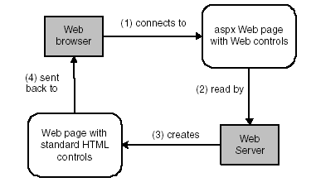
PostBack
After Step 4, user clicks a button on the web page, this kicks off the cycle one more time with the page Posted Back to the web server (a PostBack event)
Cookies are maintained
Session objects are maintained

Slide 3
Maintaining State
http is stateless technology
  Individual html pages are unrelated to each other
  No method for retaining the values of variables and controls from one page to the next
  We have used the $_POST method to ‘remember’ the values of controls (text boxes, drop-down lists, etc.) across multiple activations of the same page or across multiple pages

Slide 4
Types of State Management
$_POST method
  persistence on a single page or across multiple pages
  Values of controls are maintained in an encrypted, hidden field
Session state
  persistence in a single session, across multiple pages
Cookies
  persistence across multiple sessions (potentially)

Slide 5
Browser Cookies
Name-value pair stored in a file on the user's computer
  Deleted when browser session terminates by default
  Can be made persistent by overriding defaults
Users can disable cookies in their Web browser
Good for small amounts of string data
  Not encrypted!

Slide 6
Session State
A Collection associated with a single user’s browsing session
Stored on the web server
Saves data when navigating between pages
Session ID is created by web server
Any object can be saved, not just text (like cookies)
Remains active while the user's browser is running
  times out if there is no user activity

Slide 7
Cookies and Session Objects Examples
See index.php and register.php in Chapter 12 folder on O: drive

