Slide 1
Samples of Excellent Salmon Beneficial Feedback Diagrams

Slide 2
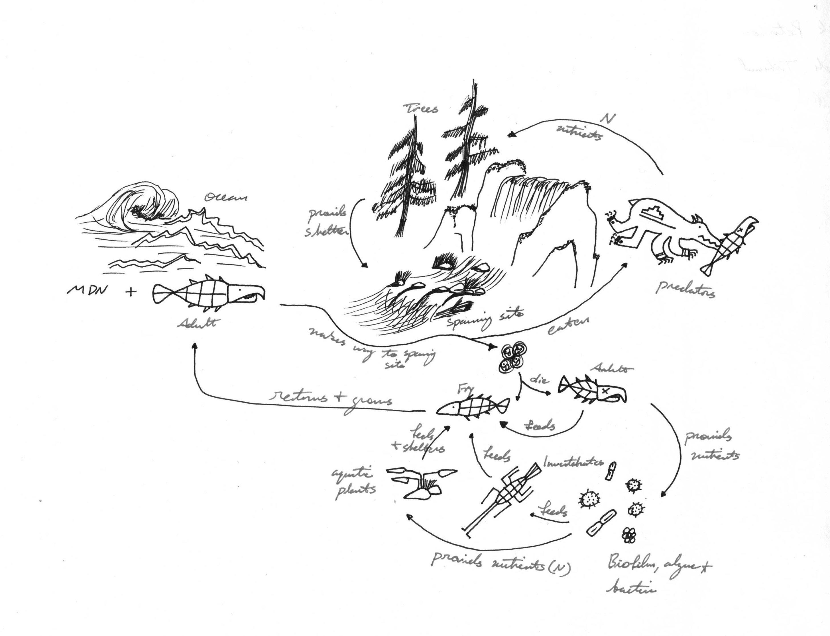

Slide 3
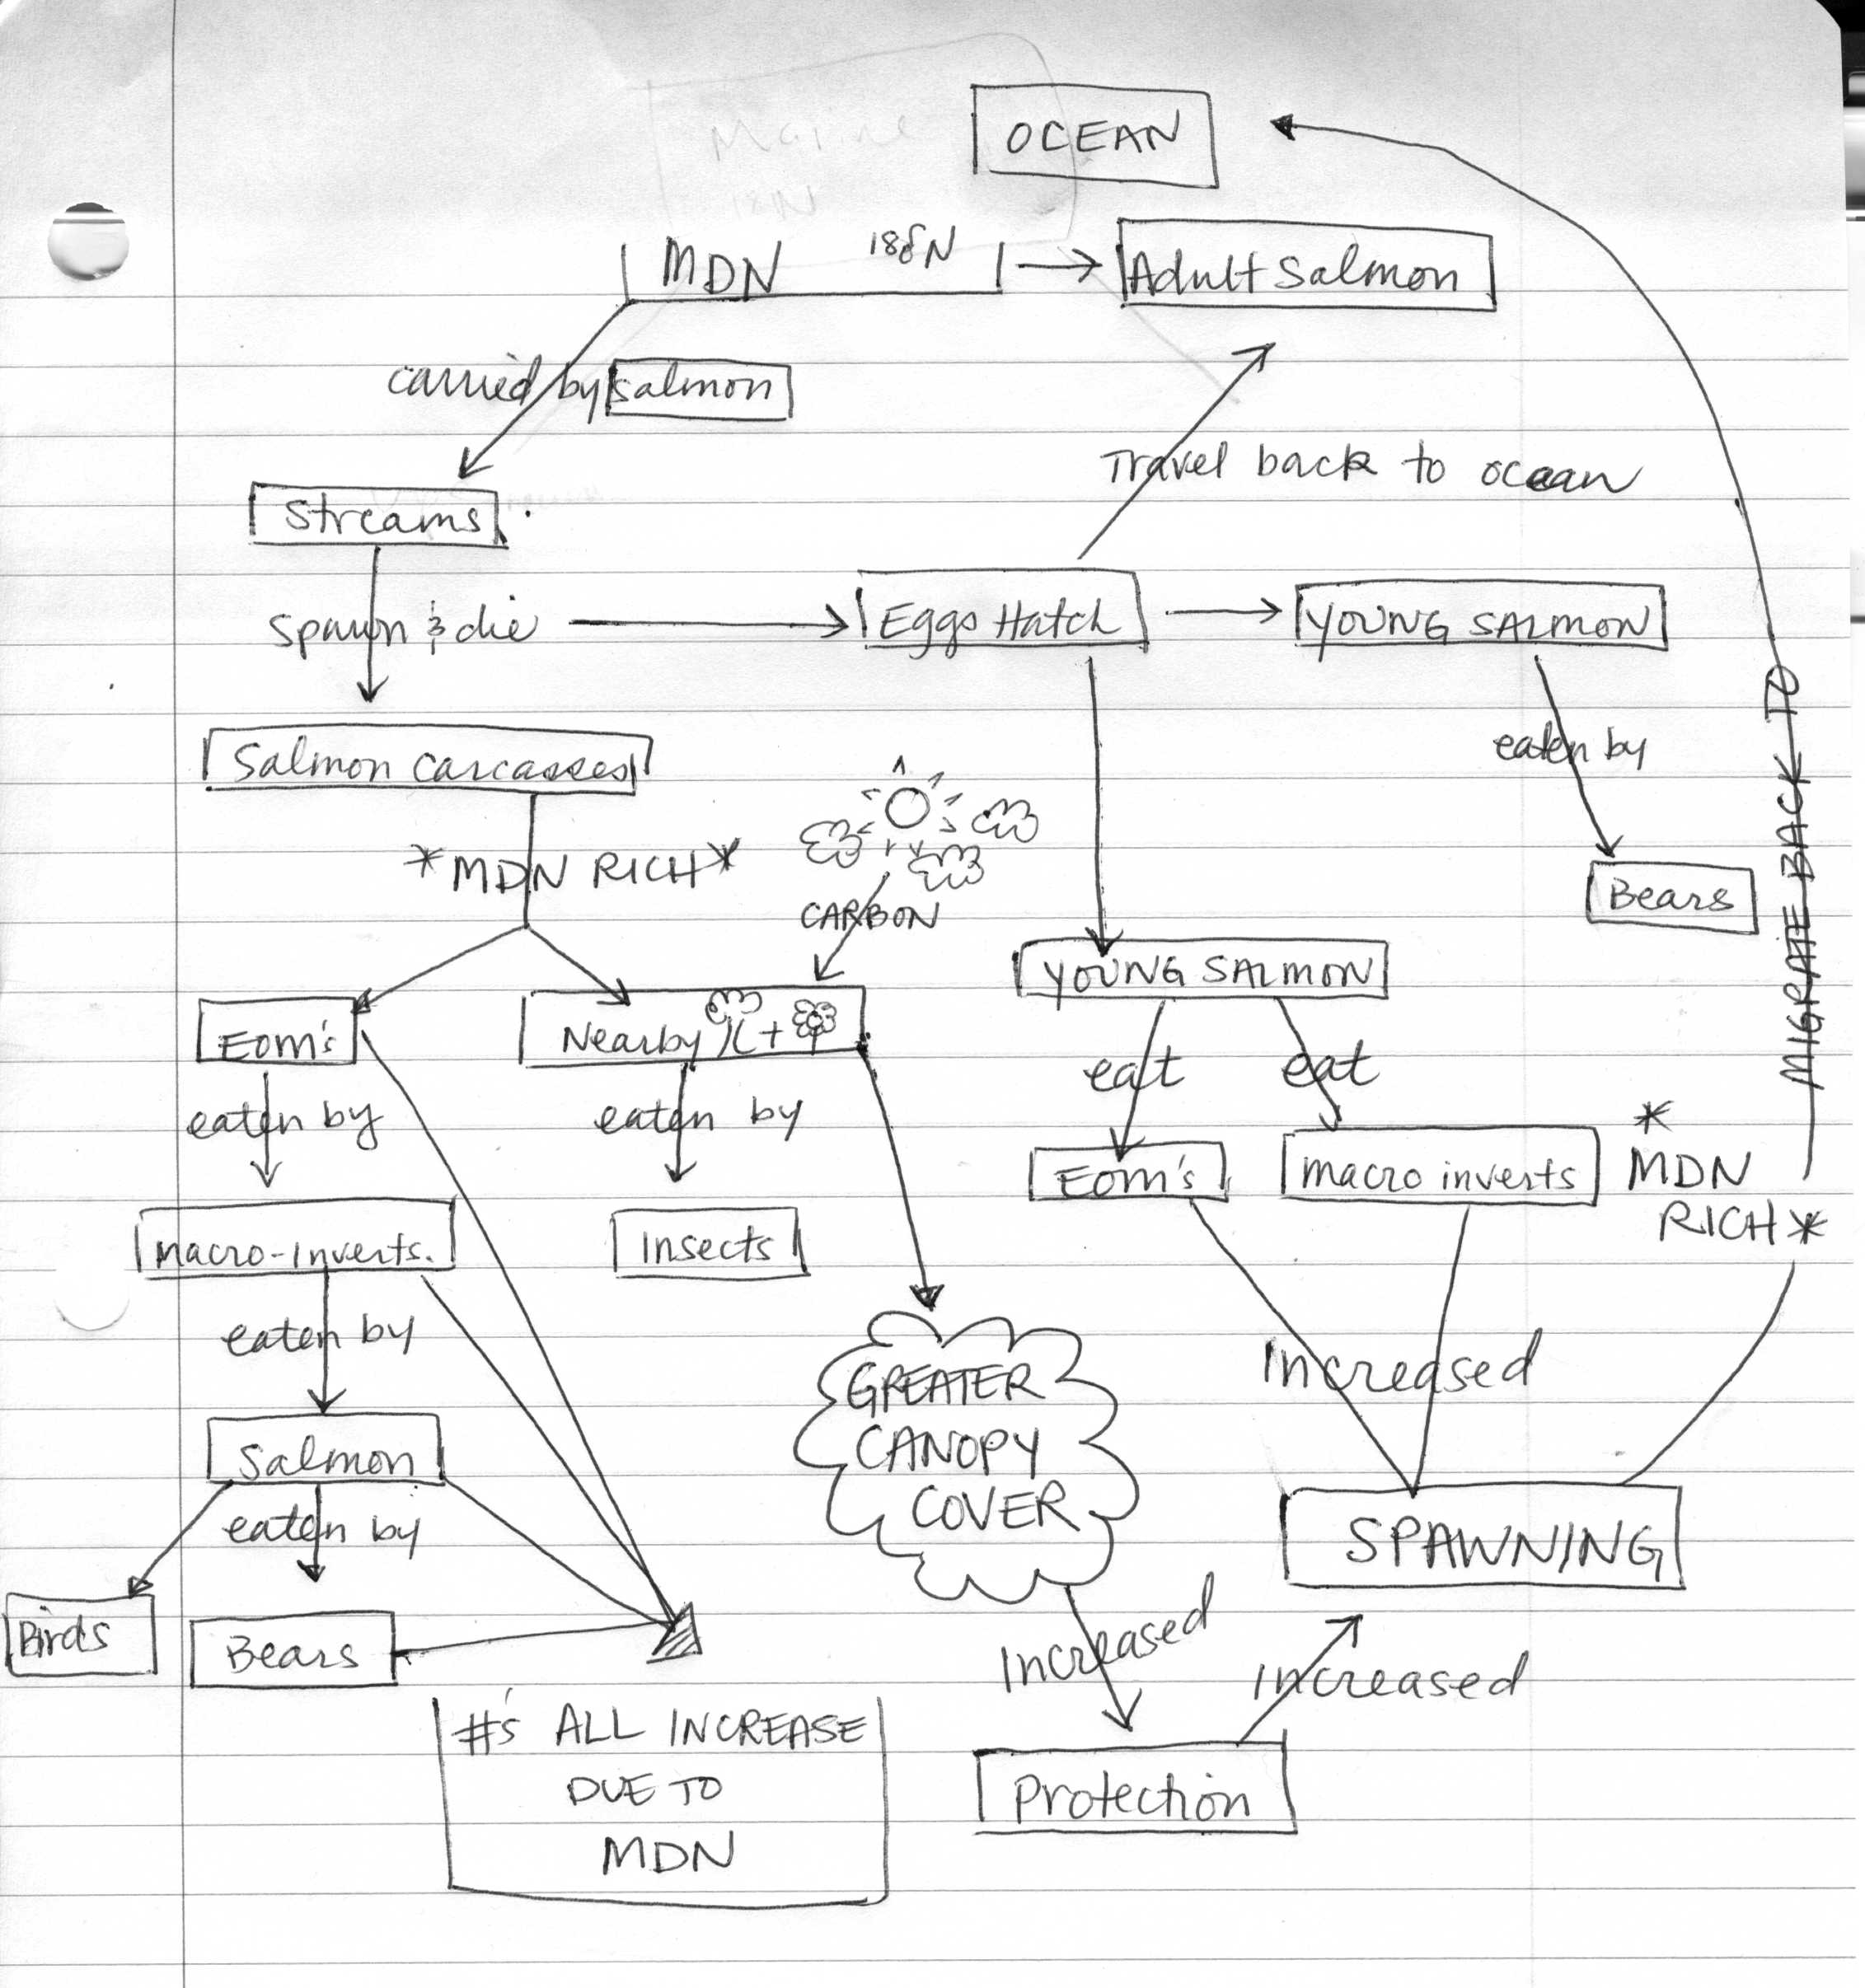

Slide 4
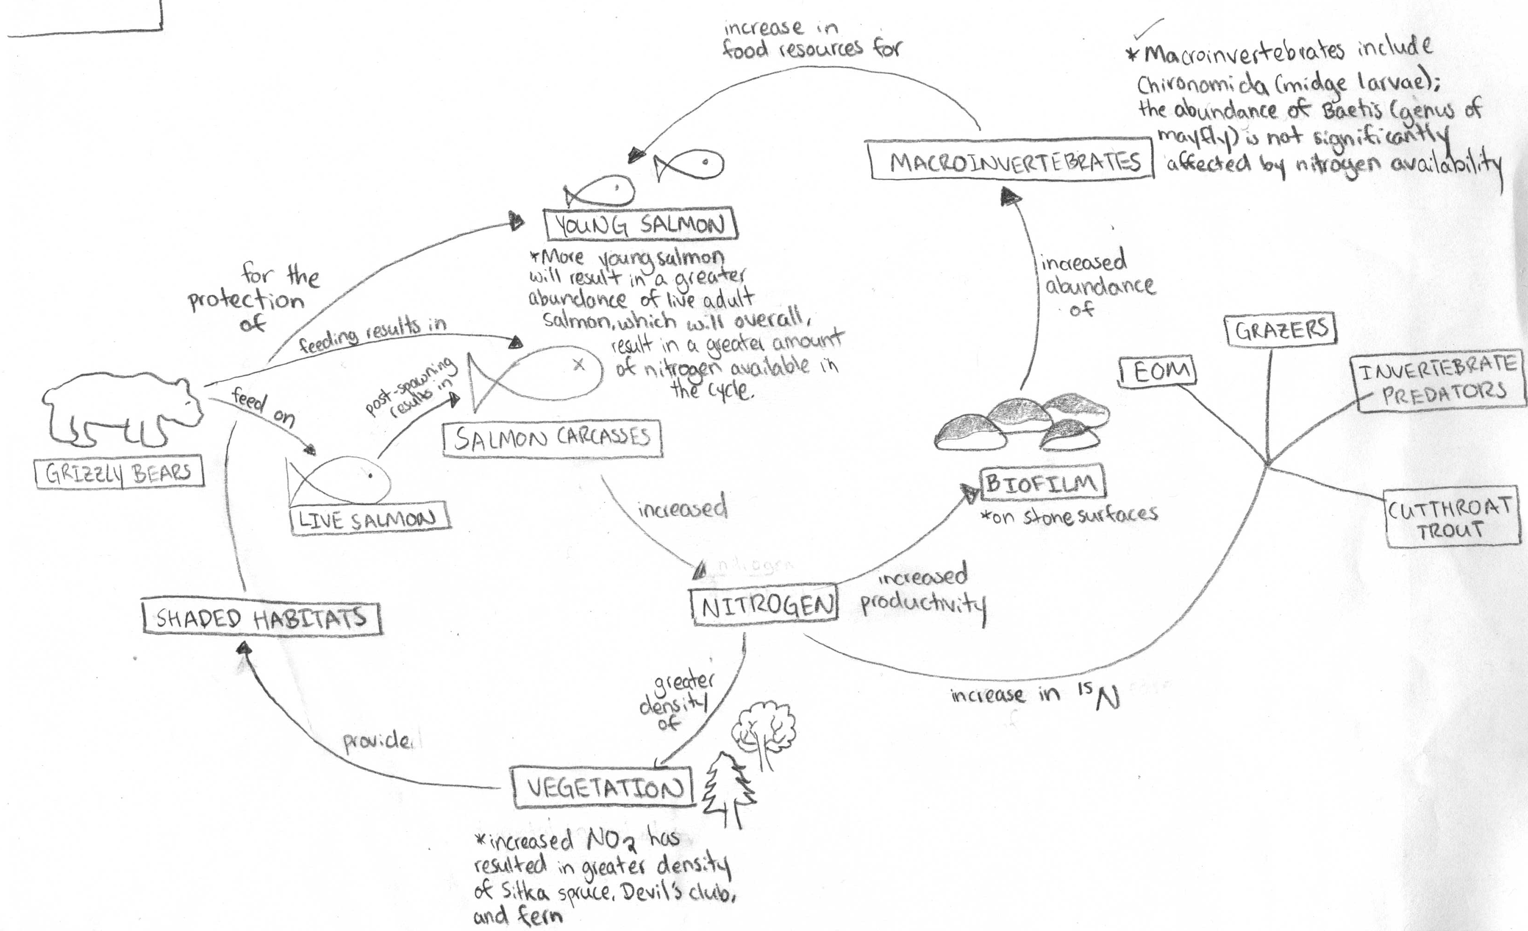

Slide 5
