Slide 1
The History of Life - & Death – on Earth
Bio 125
Part III: Threats to Diversity

Slide 2
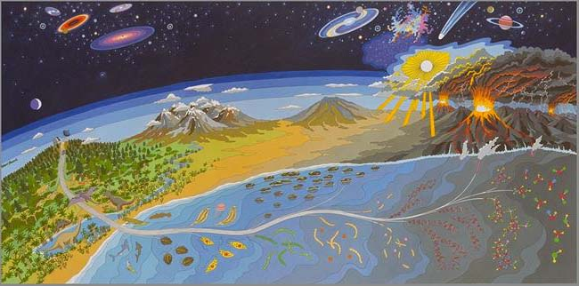
www.gwu.edu/~darwin/BiSc151/index4.html

Slide 3
Earth History
The Earth is very old – how old, do geologists currently think?
4.55 BILLION (4,550,000,000) years
How much is a Billion (10⁹)?
Start counting one number a second without stopping until you reach a billion. You will be able to stop in 31 years, 259 days, 1 hour, 46 minutes, and 40 seconds!

Slide 4
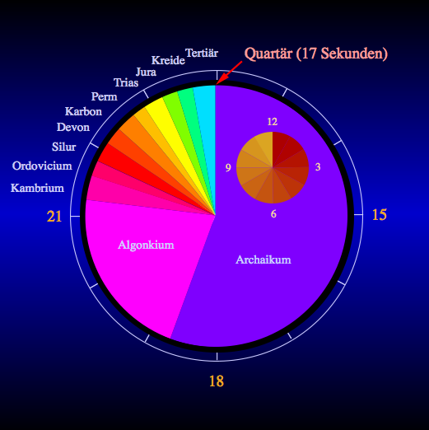
Introduction to Geologic Time:
Main Point: There is an immense amount of time in Earth’s history – enough for a lot of changes to occur…

Slide 5
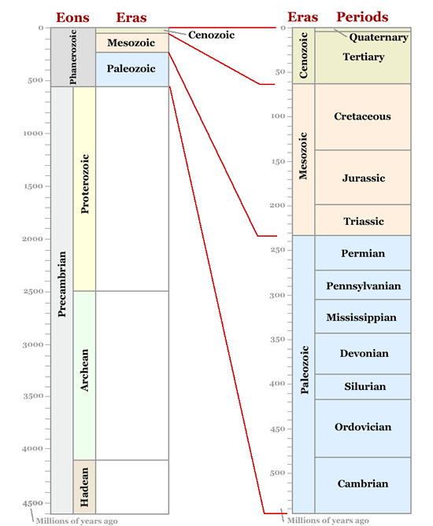
Geologic Time Periods
Source: geology.com/time.htm

Slide 6
What are the major events in the history of LIFE?
How life emerged from non-life: very challenging question
Most promising hypothesis:
UV energy from sun or lightning combined with elements found in early atmosphere to make complex organic compounds called amino acids – the building blocks of life
For more details visit: http://www.resa.net/nasa/origins_life.htm

Slide 7
Major events in the history of LIFE
Geological evidence indicates first cells arose 3.5 billion yrs ago
What kind of life would this have been?
Bacteria or, more likely, Archaea
Where would they have gotten their food??

Slide 8
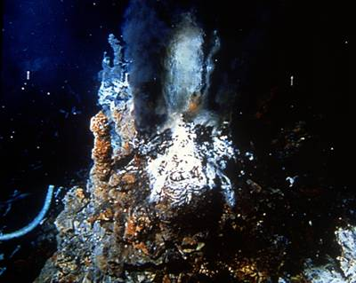
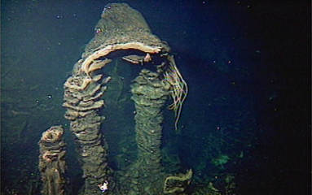
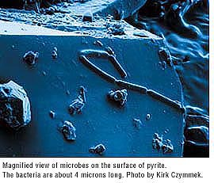
Chemosynthesis
Hot vent bacterial mat
Visit:
http://www.ocean.udel.edu/kiosk/bsmoker.html
Notes:
Another good site to visit: http://www.calacademy.org/science_now/archive/headline_science/black_smokers_10032000.php
Info about vents as possible location for origins of life…

Slide 9
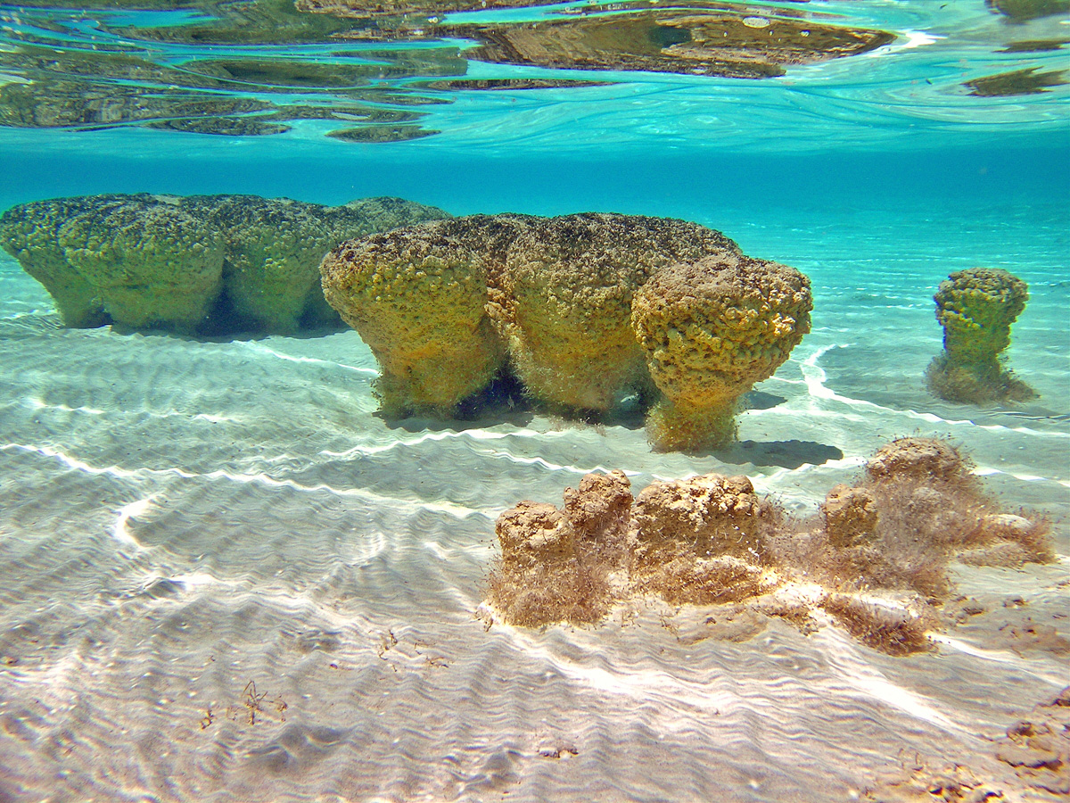
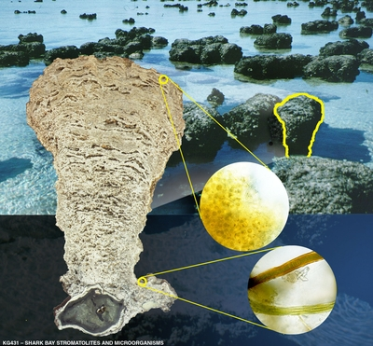
Photosynthesis
Modern Stromatolites – cyanobacterial columns in Shark Bay, Australia

Slide 10
Major events in the history of LIFE
Once the first single-celled organisms arose, what do you think were the major milestones in the evolution of life on Earth?
In your groups, begin to create your own sequence of major events in life’s history (use your books, and any prior knowledge you have)
Notes:
?? Give them a worksheet to fill in, with prompting questions? (e.g. “where must the first life have begun?” = oceans; etc.) OR even a list of major events

Slide 11
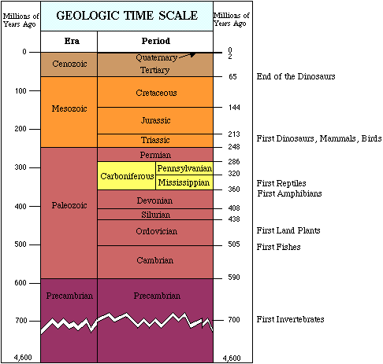
Major events in Life’s History:
from http://www.clearlight.com/~mhieb/WVFossils/GeolTimeScale.html

Slide 12
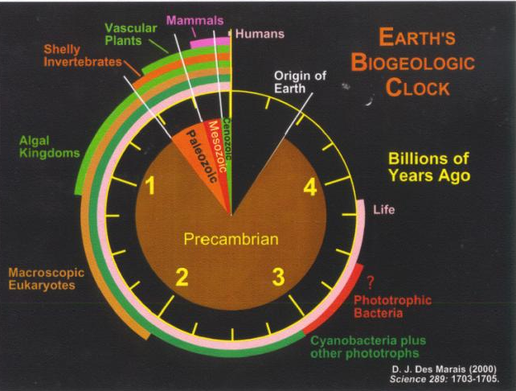

Slide 13
Summary Points: History of Life
History of Life involves enormous change
Follow this Link: http://www.pbs.org/wgbh/nova/link/history.html
Over time, life has become more diverse & more complex

Slide 14
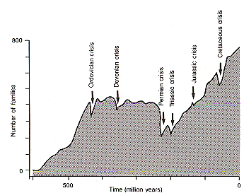

Slide 15
Summary Points: History of Life
BUT – Life & evolution have not progressed uninterrupted….

Slide 16
What is the average “life span” of a species?
Once a species arises via evolution and speciation (processes we’ve discussed!), does it last indefinitely?
What does Wilson say…?
Species last 2-10 million years (~4 million years on average)

Slide 17
Extinction is part of Evolution
What percentage of all species that have ever lived are now extinct?

Slide 18
Extinction is part of Evolution
How has extinction occurred over the course of the history of life – a steady process? Or in abrupt jumps?

Slide 19
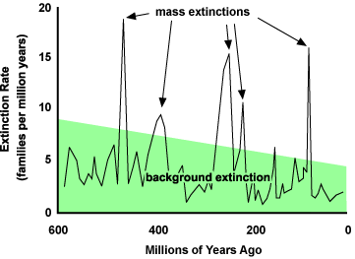

Slide 20
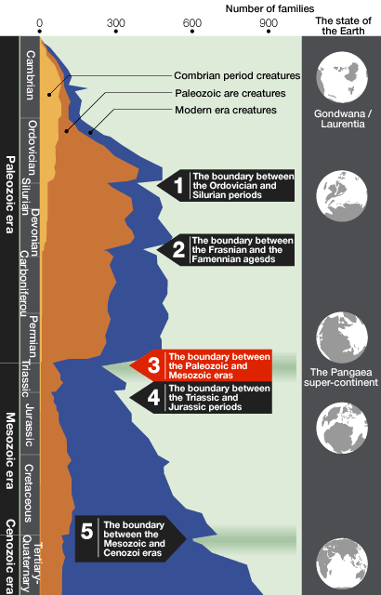
Mass Extinction Episodes in Earth’s history

Slide 21
Causes of Mass Extinctions
5 major extinction events:
5th: “K-T Boundary” = asteroid (dinosaurs)
  What did this extinction make room for?
Largest mass extinction event was at end of Permian: 95% of all species went extinct!! Cause unknown, but may be related to land masses coalescing into 1 super-continent (“Pangaea”) → climate cooling

Slide 22
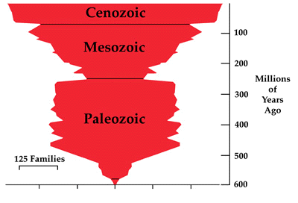
Mass Extinctions
Additional reading r.e. mass extinctions: www.jyi.org/features/ft.php?id=472

Slide 23
Mass Extinctions
What is the relationship between extinction & evolution?
Be able to address this question, and support your argument with some direct evidence from the history of life.

Slide 24
Mass Extinctions
There was another, smaller, mass extinction at the end of the Pleistocene which we will discuss in 2 class sessions
But today people talk about the 6th Mass Extinction, which is happening today under our very eyes
What is the cause of this 6th great extinction event?
This is the subject of the rest of the course…

