Slide 1
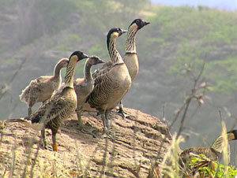
Threats to Biodiversity:
A Case Study of Hawaiian Birds

Slide 2
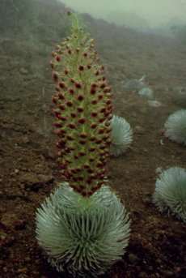
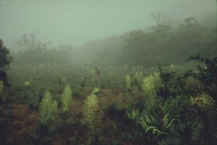
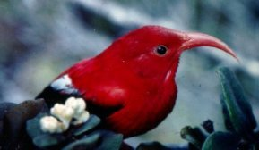
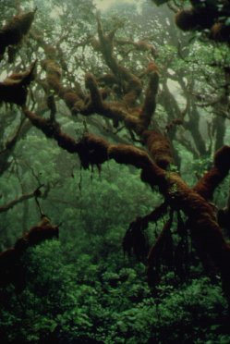
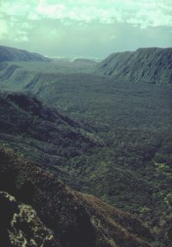
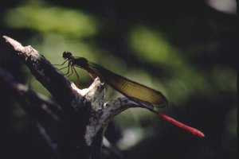
Biological Diversity of the Hawaiian Islands
www.nrel.colostate.edu/.../proj_49_hawaii.html

Slide 3
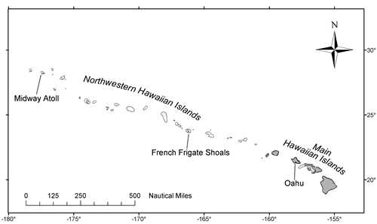
Why are the islands so unique, and so diverse?

Slide 4
Why are the islands so unique, and so diverse?
  Most isolated islands in the world
    2500 miles from N. America!
    3900 miles from Asia!
  40 million years old
  How often might a colonization event occur?
    Every 20-40,000 years!
    Evolutionary radiations
  Large elevation change
    Sea level to 14,000’!

Slide 5
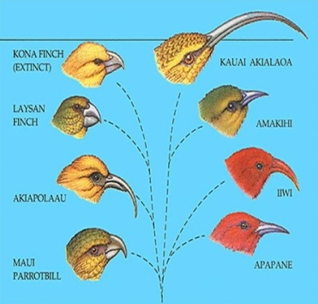
Why are the islands so unique, and so diverse?
As a result of all of these variables, Hawaii is home to many endemic species

Slide 6
Is Biodiversity threatened in Hawaii?
Species that are globally “critically imperiled” (less than 1,000 individuals remaining) or globally imperiled (1,000-3,000 individuals remaining):
  30 vertebrates, 102 invertebrates, 515 plants
New Jersey (about same size as Hawaii):
  3 vertebrates, 14 invertebrates, 21 plants

Slide 7
Why are the native species so threatened?
No native mammalian predators
No native large grazers
No native diseases

Slide 8
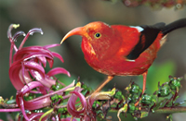
Hawaii’s Native Birds
Very diverse
In steep decline
http://www.jackjeffreyphoto.com/hawaii.html

Slide 9
Case Study:
Threats to diversity of native Hawaiian Birds
  modified from an exercise by Sarah K. Huber, Organismic and Evolutionary Biology, University of Massachusetts at Amherst
  Paula P. Lemons, Biology Department, Duke University
  www.sciencecases.org/hawaii/hawaii.asp

Slide 10
Case Study:
Examine the data presented in Table 1. How many of these species are currently extinct? What other trends do you notice? What factors might contribute to these trends?

Slide 11
Case Study:
A) One factor that leads to a decline in biodiversity is the introduction of non-native species. However, most species that are introduced to an area do not become established. What are some characteristics of species that might make them more likely to thrive in a new habitat?

Slide 12
Case Study:
B) What are some ways that non-native species could impact natives? List on board –possible types of interactions that could be involved.

Slide 13
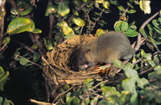
Case Study:
Several species of large rats arrived to Hawaii as stowaways on ships. These rats live in a variety of habitats and eat a variety of foods, both plants and animals. Speculate about how these introduced rats could directly and indirectly affect native bird species.

Slide 14
Case Study:
Researchers hypothesize that several factors may affect the extent of predation by rats on birds.
These factors include:
  bird size
  nesting site
  amount of time young spend in the nest (duration of egg incubation and nestling period)
  Formulate hypotheses about how these factors might affect predation.

Slide 15
Case Study:
Examine the data given to you (Table 2a, 2b, or 2c – each group analyze one set of data). Do the data support or refute your hypothesis?
Can you summarize the data with a graph, or in some other way?
Bring the results of your group discussions to class next time.

Slide 16
Case Study:
Rats are not the only invaders impacting bird diversity in Hawaii
For next class period, draw a model/diagram that shows how these other invasive species interact with each other to cause extinctions in native birds:
  Mosquitos
  Cattle
  Mongoose
  Wild pigs
  Exotic plants (like Banana Poka)
You may use this website for more background: http://www.jackjeffreyphoto.com/env_concerns.html

