Slide 1
Konza Prairie Long-Term Ecological Research Station
Tall Grass Prairie Ecosystem

Slide 2
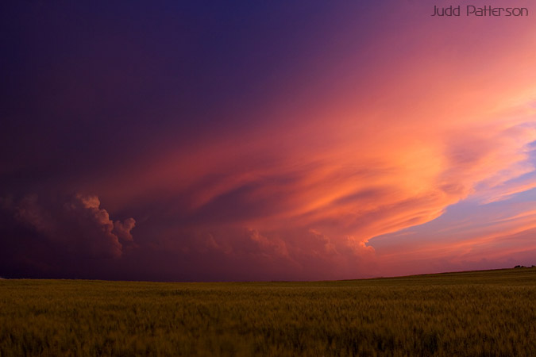
The Flint Hills of NE Kansas

Slide 3
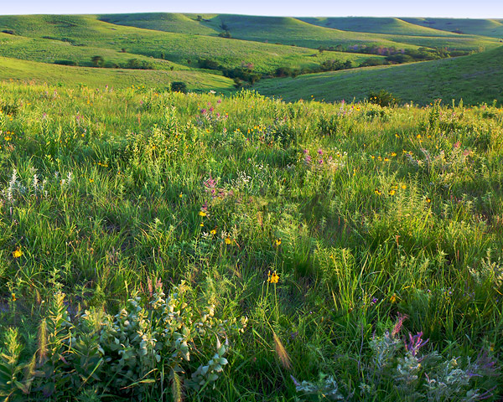
The Prairie Ecosystem:

Slide 4
Long-Term Ecological Research – Konza Prairie
Konza Prairie Biological Station
Interdisciplinary research program
Est. 1971
1 of 6 original field stations established to document temporal & spatial trends across biomes

Slide 5
Konza Prairie Ecosystem
3487 hectares (ha) unplowed tallgrass prairie (1 hectare = 2.5 acres)
Dominated by perennial warm season grasses (as opposed to cool season grasses…)
Supports diverse community of over 500 other species – herbaceous forbs (=wildflowers), woody shrubs, trees

Slide 6
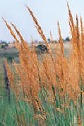
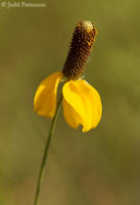
Konza Prairie Ecosystem
Diverse community
Perennial grasses – 2-3 meters tall in wet years!
Forbs – yellow coneflower

Slide 7
Konza Prairie Ecosystem
Temperate climate, periodic drought, large seasonal & interannual variation in rainfall
Cold dry winters; warm wet summers
Largest remaining area of unplowed tallgrass prairie in N. Amer.
  Only 5% of area once covered still remains

Slide 8
Konza Prairie Ecosystem
Experimental design at station:
  Divided into 60 watersheds
  To study 3 critical factors in maintaining tallgrass prairie

Slide 9
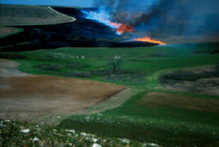
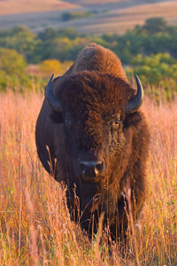
Konza Prairie Ecosystem
Periodic fire
Variable climate
Ungulate grazing

Slide 10
Konza Prairie Ecosystem
Focus of this exercise:
Explore concept of ecological constraints or limiting factors
What are the main limiting factors on plant growth in the tallgrass prairie?
Brainstorm…
How do these factors interact?

Slide 11
Konza Prairie Ecosystem
Compare:
Yearly changes in precipitation
With rate of growth for grasses & forbs
In a 16 year dataset

Slide 12
Konza Prairie Ecosystem
Biological measurements:
  Plant Growth
How do we measure this?
“Total Primary Productivity”

Slide 13
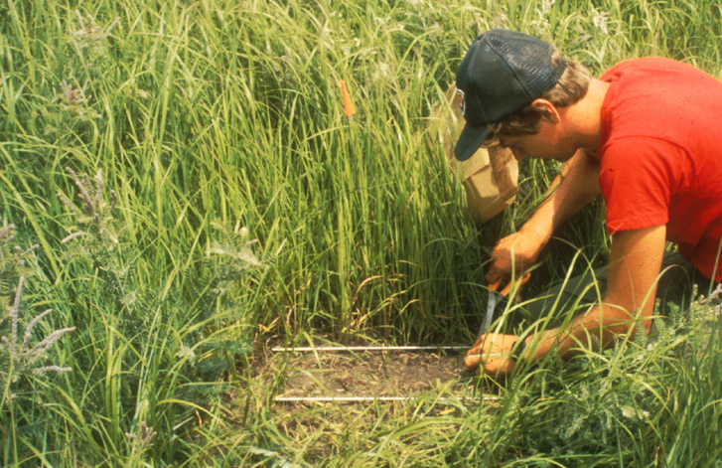
Konza Prairie Ecosystem
Collecting annual plant biomass… Exciting!!

Slide 14
Konza Prairie Ecosystem
Other influences on plant growth?
FIRE –
  Burn frequency effects
Soil depth & type
  Varies with topography
  Uplands = thin, rocky
  Lowlands = deeper, moisture-holding

Slide 15
Working with the Data
Get into a group of about 4 people (this is a temporary group; meet some new folks!)
Pick up paper copies of the graphs from front of room

Slide 16
Working with the Data
Work as a team to interpret the five graphs, using the “Step 1-Step 2” approach:
Step One: Describe the graph and what it shows. Make sure you understand how the figure is set up, what the axes show, and what information is depicted. Carefully describe the overall patterns in the data.
Step Two: Try to interpret the data. What are the key results shown?

Slide 17
What are the independent & dependent variables in this figure?
How would you describe the pattern of precipitation over time?

Slide 18
What data are being shown in this figure?
What are the independent & dependent variables in this figure?
How can the same data (precip) act as one type of variable in Fig 1 and the other type here?
Define “productivity.” What is its relationship to precipitation? Does this make sense to you?

Slide 19
Study carefully! What information is conveyed in this graph?
Identify independent & dependent variables– are they same or different than previous fig?
Describe what info is being conveyed here. Can you think of a biological explanation for this pattern? Be prepared to share with the class!

Slide 20
What information is conveyed in this graph? What do they mean by “upland” vs. “lowland”?
What relationship exists between topography, precipitation, & productivity?
Why do you think the topographic position of a site would affect its response to precipitation?

Slide 21
What information is conveyed in this graph? What are “grasses” vs. “forbs”?
What differences do you see in the response of these 2 veg types to precipitation?
Do the patterns shown in this figure help to explain results shown in any of the other graphs? (hint: look back now at Fig. 3!)

Slide 22
NOW put everything together from the whole data set:
What biological data are presented?
Which data represent potential constraining variables?
Can the variables be ranked hierarchically, in terms of the scale of their influence? → Do some variables operate at a larger, regional scale, while some are more local?
Which vegetation type under what combination of other factors is most strongly influenced by precipitation?

Slide 23
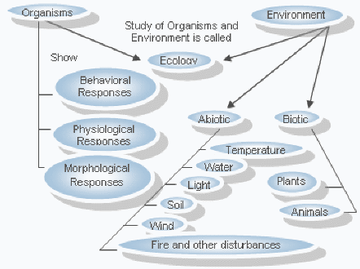
Concept Mapping:

Slide 24
Topic 2: The use of models in ecology.
Exercise (Homework):
Use the concept of hierarchies to construct a conceptual model (a "concept map") for the Konza Prairie Ecosystem.
Based on the data set you've been working with, show the relationships among the important constraining variables in this system, being sure to indicate the different scales of influence of each variable.
Start with the largest scale constraining environmental variable at the top of your "map", and show as the output of your model the vegetation type (i.e. forb or grass) that is favored.
Each of you should draw your own diagram, although feel free to discuss possible formats for doing this with classmates. BUT – if 2 maps look exactly alike, I can’t give either person credit! Do your own work!! Bring your finished diagram to class next time to turn in, and be prepared to draw your model on the board to share with the class.

