Slide 1
Saving Habitat – Pt. 2:
Legal Aids to Habitat Conservation

Slide 2
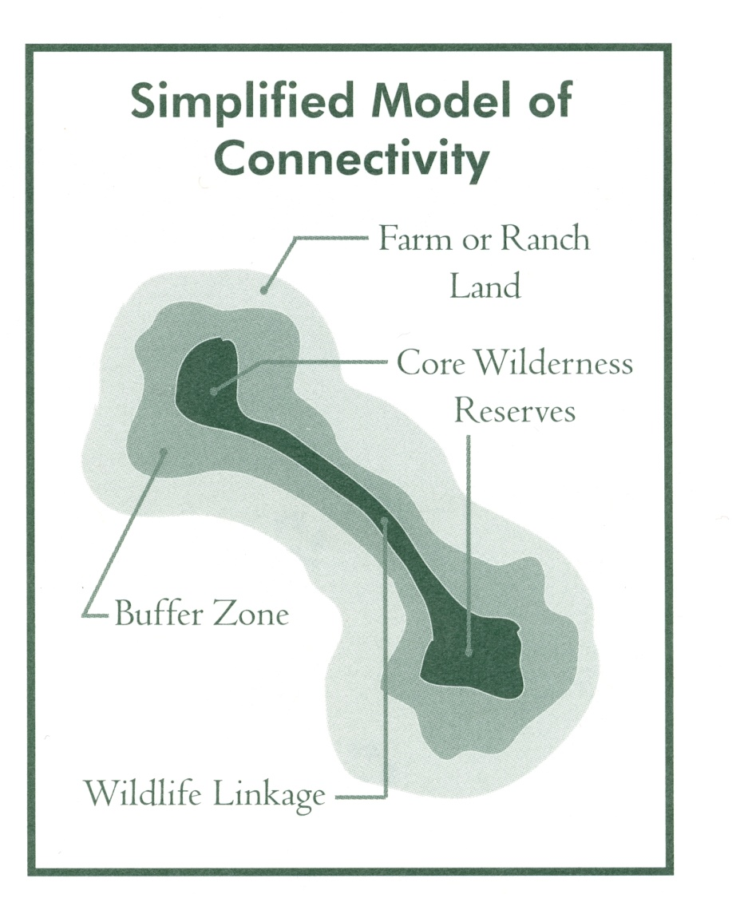
Ideal Design for Nature Reserves
Importance of Connectivity between preserves

Slide 3
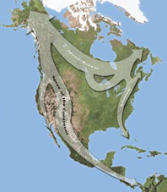
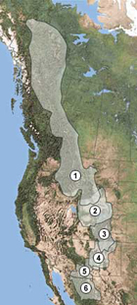
The Wildlands Project: “Reconnect the Continent with ‘MegaLinkages’”
http://www.twp.org/cms/page1090.cfm

Slide 4
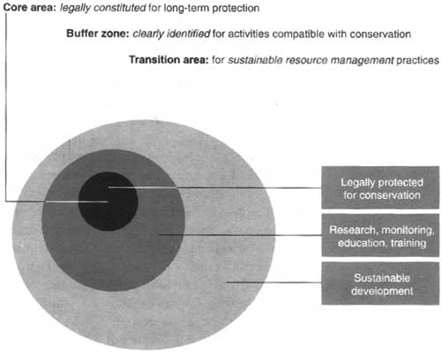
Worldwide: the Biosphere Reserve Concept
Interactive Map of Biosphere Reserves - Follow this Link: http://www.unesco.org/mab/wnbrs.shtml

Slide 5
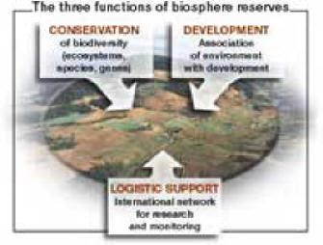
3 Functions of Biosphere Reserves:
Conservation: landscapes, ecosystems, species and genetic variation
Development: economic and human and culturally adapted
Logistic support: research, monitoring, environmental education and training

Slide 6
What have we done in the U. S. to preserve Biological Diversity?
28% of land area is Federally managed, mostly in the West & Alaska
4% of land area = in Wilderness (106 million acres), >50% in AK
plus millions of acres of less-protected land in National & State Parks, Wildlife Refuges, etc.

Slide 7
What have we done in the U. S. to preserve Biological Diversity?
National Parks are a unique idea in the world - first parks were in US
Most were set aside for scenic beauty, not as species reserves

Slide 8
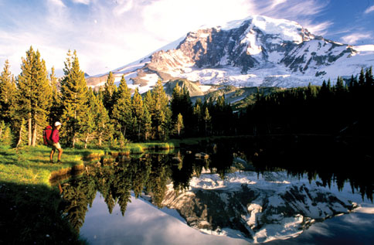
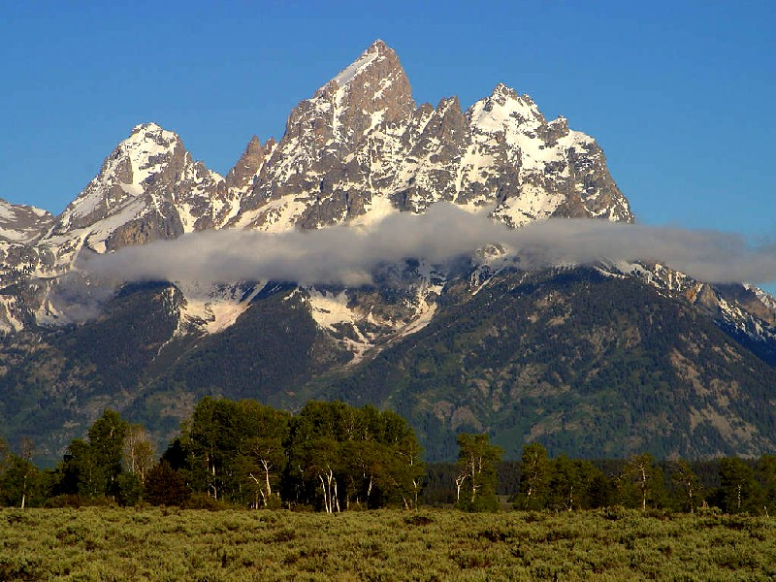
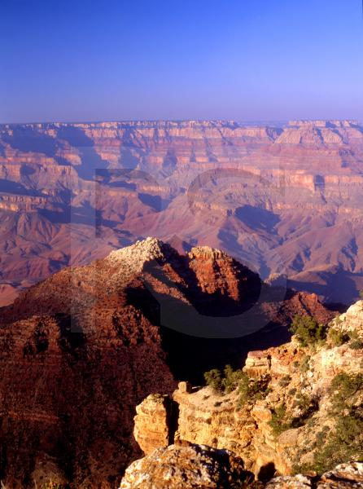
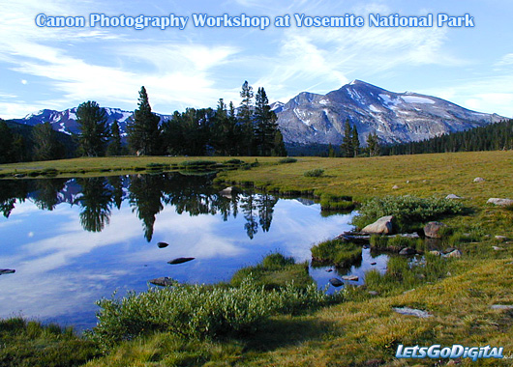
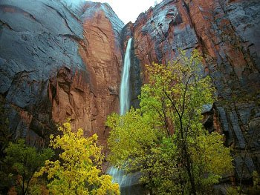

Slide 9
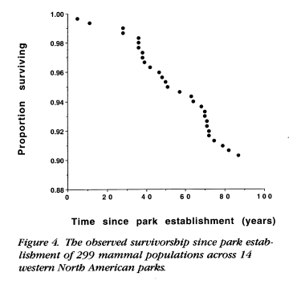
…but how well do parks do in preservation of biodiversity?
from: Newmark 1995; "Extinction of Mammals in National Parks"

Slide 10
Beyond National Parks, several other US Agencies charged with land & species preservation
Dept. of Agriculture
Dept. of Commerce (!)
Dept. of Interior (several agencies)
EPA

Slide 11
The Big Question -
Do we manage for preservation of…
Species?
OR
Habitats?
What would be better???

Slide 12
What is the main Legislation we have available for biodiversity preservation?
Endangered Species Act (ESA) (1973)
Conservation of threatened & endangered species
Prohibits “taking” of listed species or harming habitat
National Environmental Policy Act (NEPA) (1969)
Gov’t must give consideration to environment
Requires EA’s & EIS’s
Clean Water Act (1972)
Pollution control
Preserve wetlands, mitigate loss
Clean Air Act (1970)
Pollution control

Slide 13
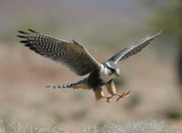
For Biodiversity, ESA is main legislation
Based on the HCN article you read – “Bred for Success” – how well are we doing?
In groups, discuss:
Benefits of ESA
Problems of ESA
Related to preserving species & their habitats

