Slide 1
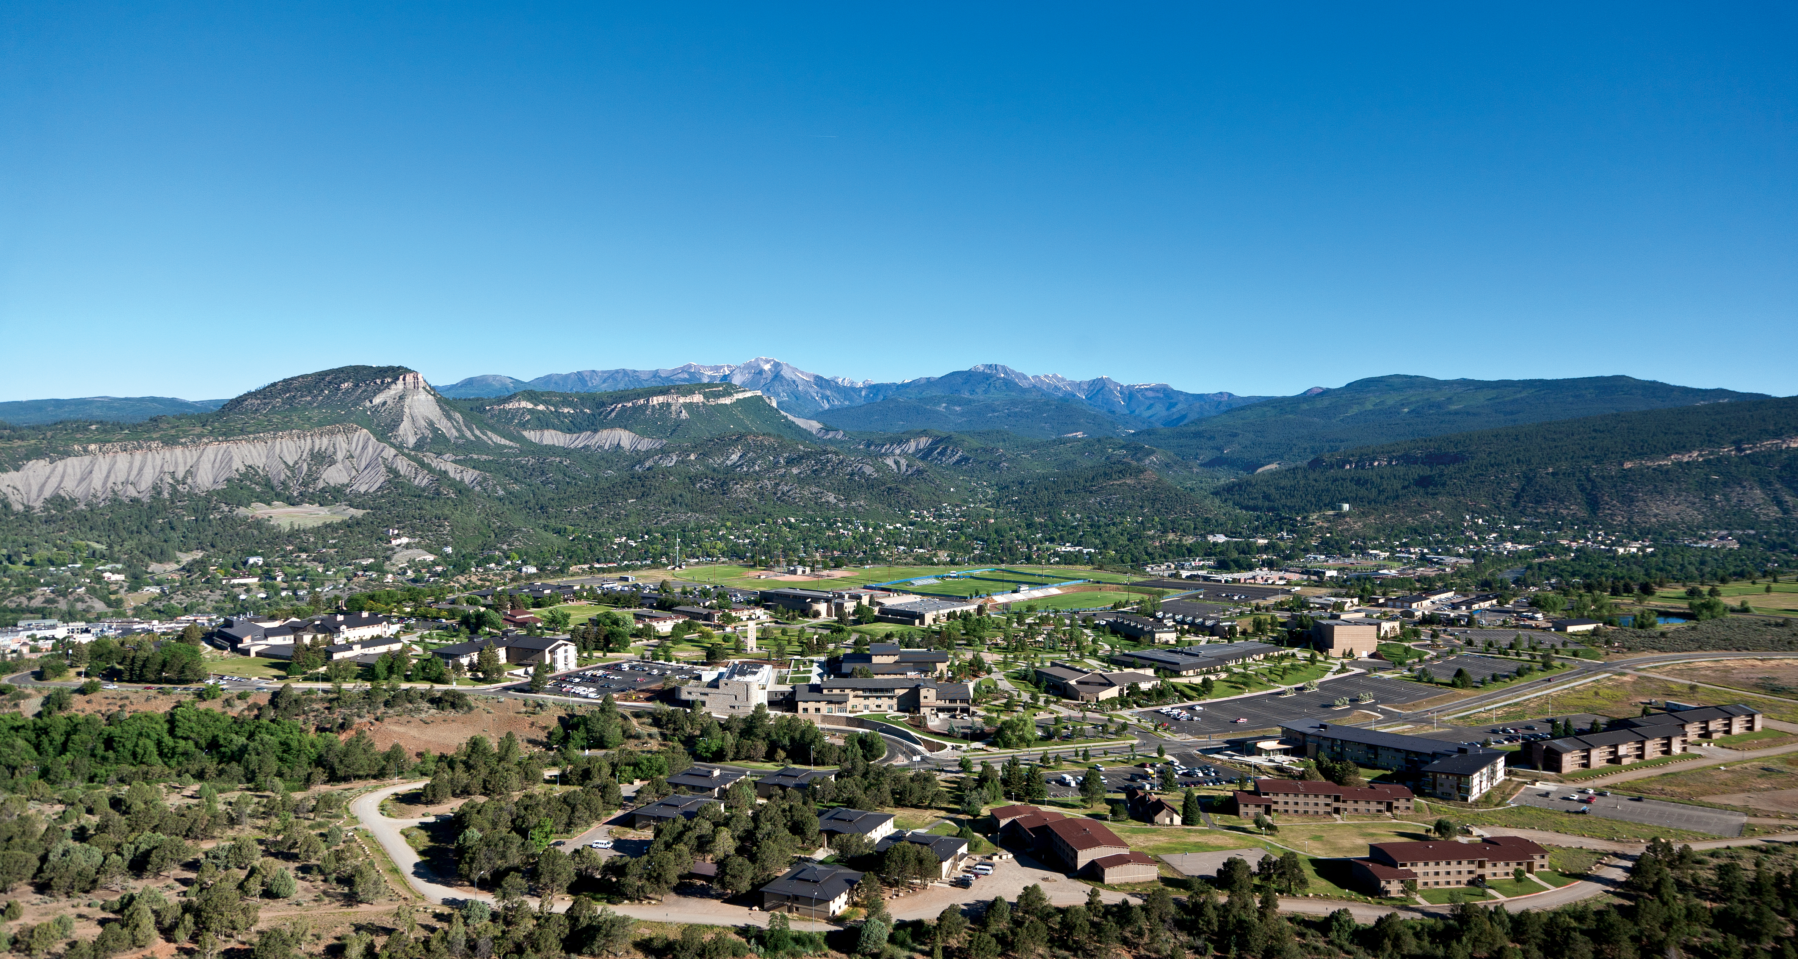
Introduction to Decision Analysis
How to make good decisions with an uncertain future.

Slide 2
Six Steps
Define Problem
Objective(s)
Model
Evaluate
Choose
Implement

Slide 3
Uncertainty
Cost of fuel
Real Estate
Stock Market
Consumer Demand
“Things change, people change, hairstyles change, interest rates fluctuate.” {Trivia: Name the character and the movie.}

Slide 4
Decision Analysis Example A
(from course webpage, file called Decision Analysis Intro and HW2)
A) A grocery store manager must decide how many crates of bananas to purchase for the upcoming week. Each crate holds 250 pounds of bananas and costs $75. The bananas sell for $0.49 per pound and by the end of the week any unsold bananas must be thrown away. Over the last eight weeks, demand has been 200 pounds once, 400 pounds twice, 600 pounds three times, and 800 pounds twice. According to expected value, should the manager purchase one, two or three crates of bananas? What is the best decision according to minimax regret?

Slide 5
Decision Alternatives and States of Nature
Decision Alternatives = Choices = Options = How many pounds of bananas to buy? 250? 500? Or 750? This is our choice, we control it.
States of Nature = Random Demand = How much customers want? 200 pounds? 400? 600? Or 800? This amount is uncertain and out of our control. (We can estimate these amounts thanks to historical data over the last several weeks.)

Slide 6
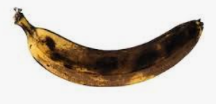
How uncertainty makes this difficult.
We don’t know demand in advance…
If we buy too much, we get rotten bananas.
If we don’t buy enough, we miss out on potential profit and customers will be dissatisfied.

Slide 7
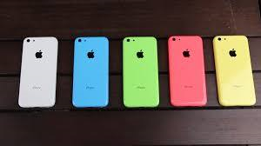
And it’s not just produce at the grocery store that is perishable…
Most tech products have a limited shelf life.
In 2012, a warehouse full of iPhone 5’s would have been worth a fortune.
Now, what they be worth?

Slide 8
Decision Analysis Example A (Again)
A) A grocery store manager must decide how many crates of bananas to purchase for the upcoming week. Each crate holds 250 pounds of bananas and costs $75. The bananas sell for $0.49 per pound and by the end of the week any unsold bananas must be thrown away. Over the last eight weeks, demand has been 200 pounds once, 400 pounds twice, 600 pounds three times, and 800 pounds twice. According to expected value, should the manager purchase one, two or three crates of bananas? What is the best decision according to minimax regret?

Slide 9
Set Up the Decision Analysis Table
Random demand on the top.
Choice\State of Nature | Demand = 200 | Demand = 400 | Demand = 600 | Demand = 800
Buy 250 pounds (1 crate)
Buy 500 pounds (2 crates)
Buy 750 pounds (3 crates)
Choices on the left side.

Slide 10
We need to fill in each cell with the correct net profit…
Choice\State of Nature | Demand = 200 | Demand = 400 | Demand = 600 | Demand = 800
Buy 250 pounds | 1. What number goes here? | 2. And here?
Buy 500 pounds | 3. And here?
Buy 750 pounds

Slide 11
What value goes in each cell of the table?
1. Consider the cell where we choose to supply 250 pounds and demand turns out to be 200.
Supply 250 pounds. Cost = -$75
Demand is 200 pounds.
We will sell only 200 pounds at $0.49 per pound. Income = $98
We have 50 pounds of leftover bananas, worth nothing. $0
Net Total is $98 - $75 = $23

Slide 12
We need to fill in each cell with the correct net profit…
Choice\State of Nature | Demand = 200 | Demand = 400 | Demand = 600 | Demand = 800
Buy 250 pounds | $23 | 2. And here?
Buy 500 pounds
Buy 750 pounds

Slide 13
2. Consider the cell where we choose to supply 250 pounds and demand turns out to be 400.
Supply 250 pounds. Cost = -$75
Demand is 400 pounds.
We will sell only 250 pounds at $0.49 per pound. Income = $122.50
We miss out on selling 150 pounds of unmet demand. $0
Net Total is $122.50 - $75 = $47.50

Slide 14
We need to fill in each cell with the correct net profit…
Choice\State of Nature | Demand = 200 | Demand = 400 | Demand = 600 | Demand = 800
Buy 250 pounds | $23 | $47.50
Buy 500 pounds | 3. What value goes here?
Buy 750 pounds

Slide 15
3. Consider the cell where we choose to supply 500 pounds and demand turns out to be 200.
Supply 500 pounds at -$75*2. Cost = -$150
Demand is 200 pounds.
We will sell only 200 pounds at $0.49 per pound. Income = $98
We have 300 pounds of leftover bananas, worth nothing. $0
Net Total is $98 - $150 = -$52

Slide 16
Now it’s your turn! Take some time and try to fill in the rest of the numbers on the table. Feel free to use a calculator or MS Excel …
Choice\State of Nature | Demand = 200 | Demand = 400 | Demand = 600 | Demand = 800
Buy 250 pounds | $23 | $47.50
Buy 500 pounds | -$52
Buy 750 pounds

Slide 17
No peaking! Don’t look ahead until you’ve done the calculations yourself…

Slide 18
Decision Analysis Example A
(Yet again)
A) A grocery store manager must decide how many crates of bananas to purchase for the upcoming week. Each crate holds 250 pounds of bananas and costs $75. The bananas sell for $0.49 per pound and by the end of the week any unsold bananas must be thrown away. Over the last eight weeks, demand has been 200 pounds once, 400 pounds twice, 600 pounds three times, and 800 pounds twice. According to expected value, should the manager purchase one, two or three crates of bananas? What is the best decision according to minimax regret?

Slide 19
Complete Decision Analysis Table: But how do we determine which choice (1, 2 or 3 crates) is the best?
Choice\State of Nature | Demand = 200 | Demand = 400 | Demand = 600 | Demand = 800
Buy 250 pounds | $23 | $47.50 | $47.50 | $47.50
Buy 500 pounds | -$52 | $46 | $95 | $95
Buy 750 pounds | -$127 | -$29 | $69 | $142.50

Slide 20
We need to factor in probabilities of different demand outcomes and then calculate the Expected Value (EV).
Probabilities →
Choice\State of Nature | Demand = 200 | Demand = 400 | Demand = 600 | Demand = 800 | Expected Value
Buy 250 pounds | $23 | $47.50 | $47.50 | $47.50
Buy 500 pounds | -$52 | $46 | $95 | $95
Buy 750 pounds | -$127 | -$29 | $69 | $142.50

Slide 21
Demand Probabilities
What are the likelihoods that demand will be 200, 400, 600 or 800?
Since there are four possibilities, we could assume that they are equally likely, each with a ¼ = 25% probability.
But we have better data than that. Historically:

Slide 22
Demand Probabilities
Demand | Frequency
200 | 1
400 | 2
600 | 3
800 | 2
Probability
1/8 = 12.5%
2/8 = 25%
3/8 =37.5%
2/8 = 25%

Slide 23
Decision Table with Probabilities. What is Expected Value?
Probabilities → | 12.5% | 25% | 37.5% | 25%
Choice\State of Nature | Demand = 200 | Demand = 400 | Demand = 600 | Demand = 800 | EV
Buy 250 pounds | $23 | $47.50 | $47.50 | $47.50
Buy 500 pounds | -$52 | $46 | $95 | $95
Buy 750 pounds | -$127 | -$29 | $69 | $142.50

Slide 24
Expected Value
The expected value is the weighted or long-run average of all possible outcomes weighted by their probabilities.
E[X] = Σx*p(x) where Σ is the sum, x represents each outcome and p(x) represents the probability of each outcome.

Slide 25
What is the expected value of supplying 1 crate of bananas?
Probabilities → | 12.5% | 25% | 37.5% | 25%
Choice\State of Nature | Demand = 200 | Demand = 400 | Demand = 600 | Demand = 800 | EV
Buy 250 pounds | $23 | $47.50 | $47.50 | $47.50
EV[1 crate] = $23*12.5% + $47.50*25% + $47.50*37.5% + $47.50*25% = $44.44
If you supply 1 crate, occasionally you earn $23 but mostly you earn $47.50. The weighted average or expectation is that you will earn about $44.

Slide 26
What is the expected value of supplying 2 or 3 crates?
EV[2 crates] = -$52*12.5% + $46*25% + $95*37.5% + $95*25% = $63.38
EV[3 crates] = -$127*12.5% - $29*25% + $69*37.5% + $142.50*25% = $38.38

Slide 27
Final Decision Table
Probabilities → | 12.5% | 25% | 37.5% | 25%
Choice\State of Nature | Demand = 200 | Demand = 400 | Demand = 600 | Demand = 800 | EV
Buy 250 pounds | $23 | $47.50 | $47.50 | $47.50 | $44
Buy 500 pounds | -$52 | $46 | $95 | $95 | $63
Buy 750 pounds | -$127 | -$29 | $69 | $142.50 | $38

Slide 28
The Answer (finally)
The original problem statement asked: According to expected value, should the manager purchase one, two or three crates of bananas?
Answer: The manager should supply two crates of bananas for a maximum expected profit of about $63.

Slide 29
The Answer (revisited)
According to EV, two crates is the best choice.
But…
Can you make an argument that one crate is still the “best” choice, even with a lower EV? How about three crates is “best,” even with the lowest EV?

