Slide 1
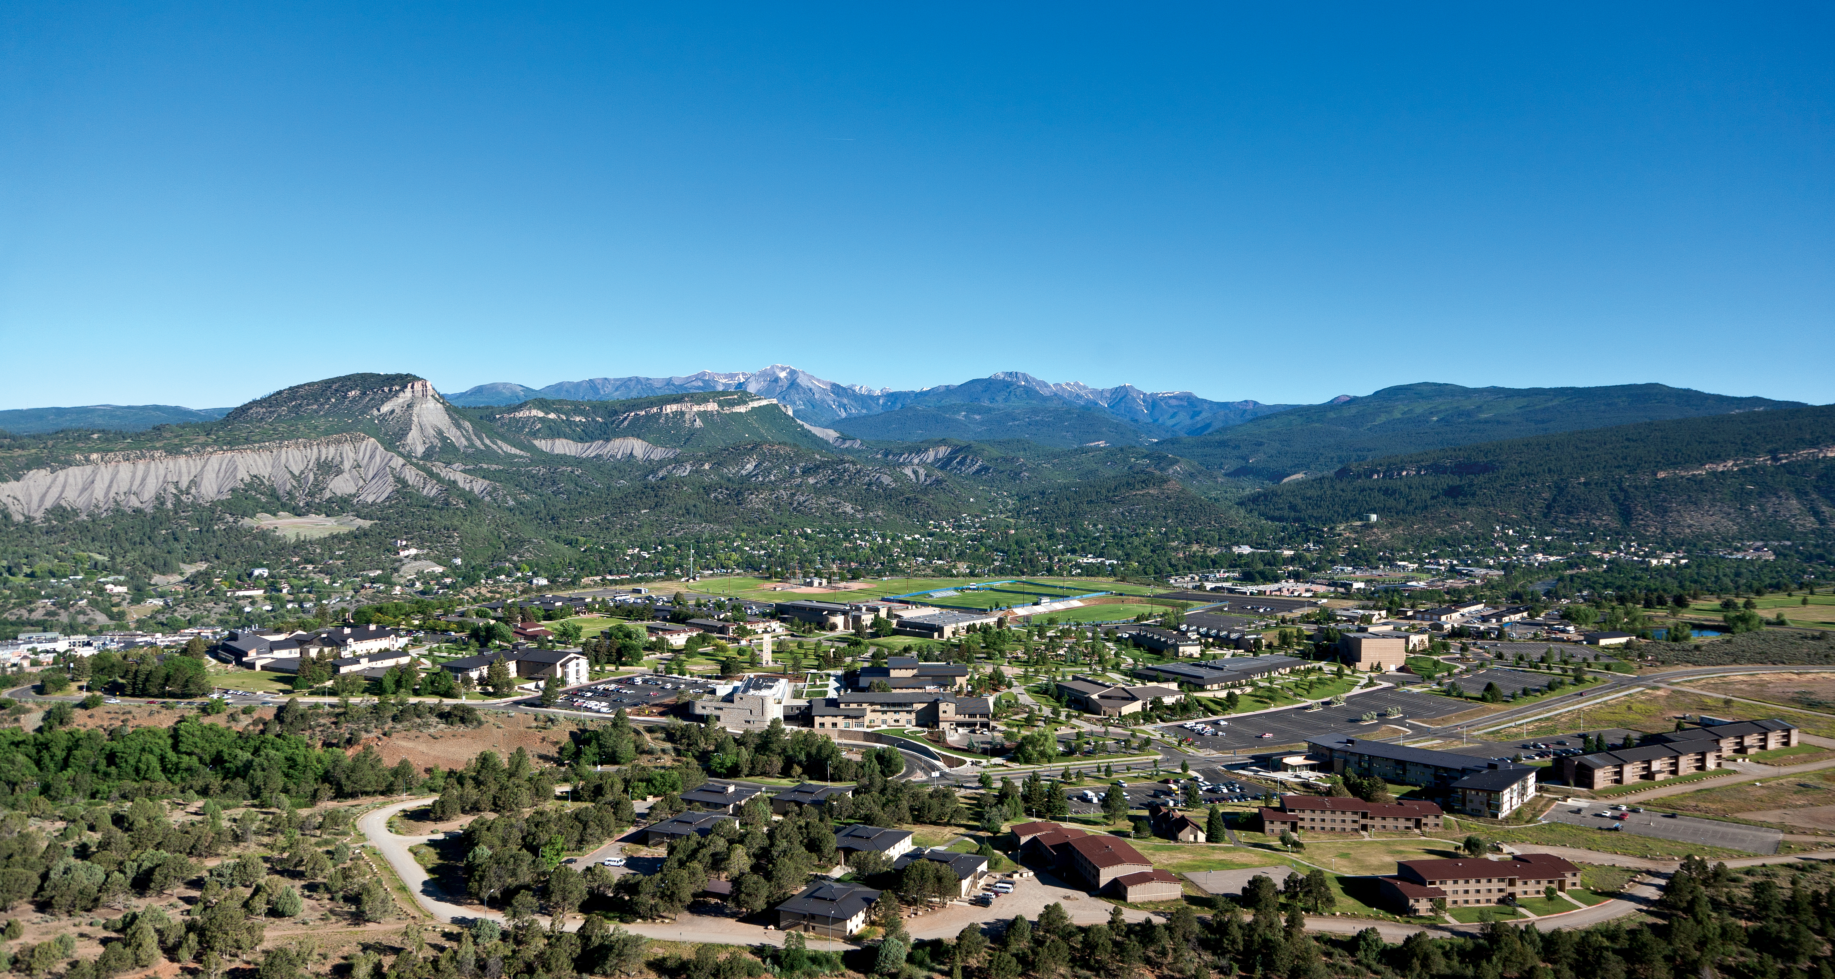
BA 353: Operations Management
Eric Huggins, Ph.D.
Professor of Management

Slide 3
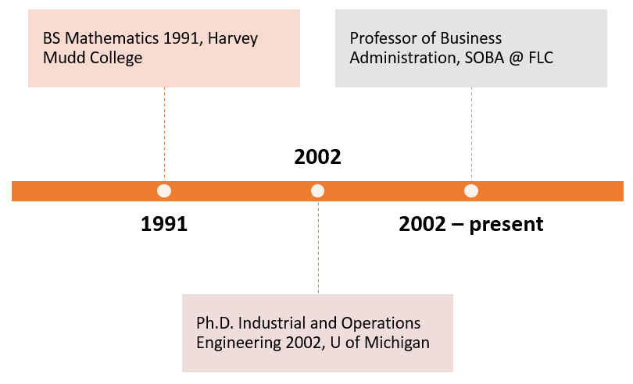
Eric Huggins
(970)946-9077
huggins_e@fortlewis.edu

Slide 4
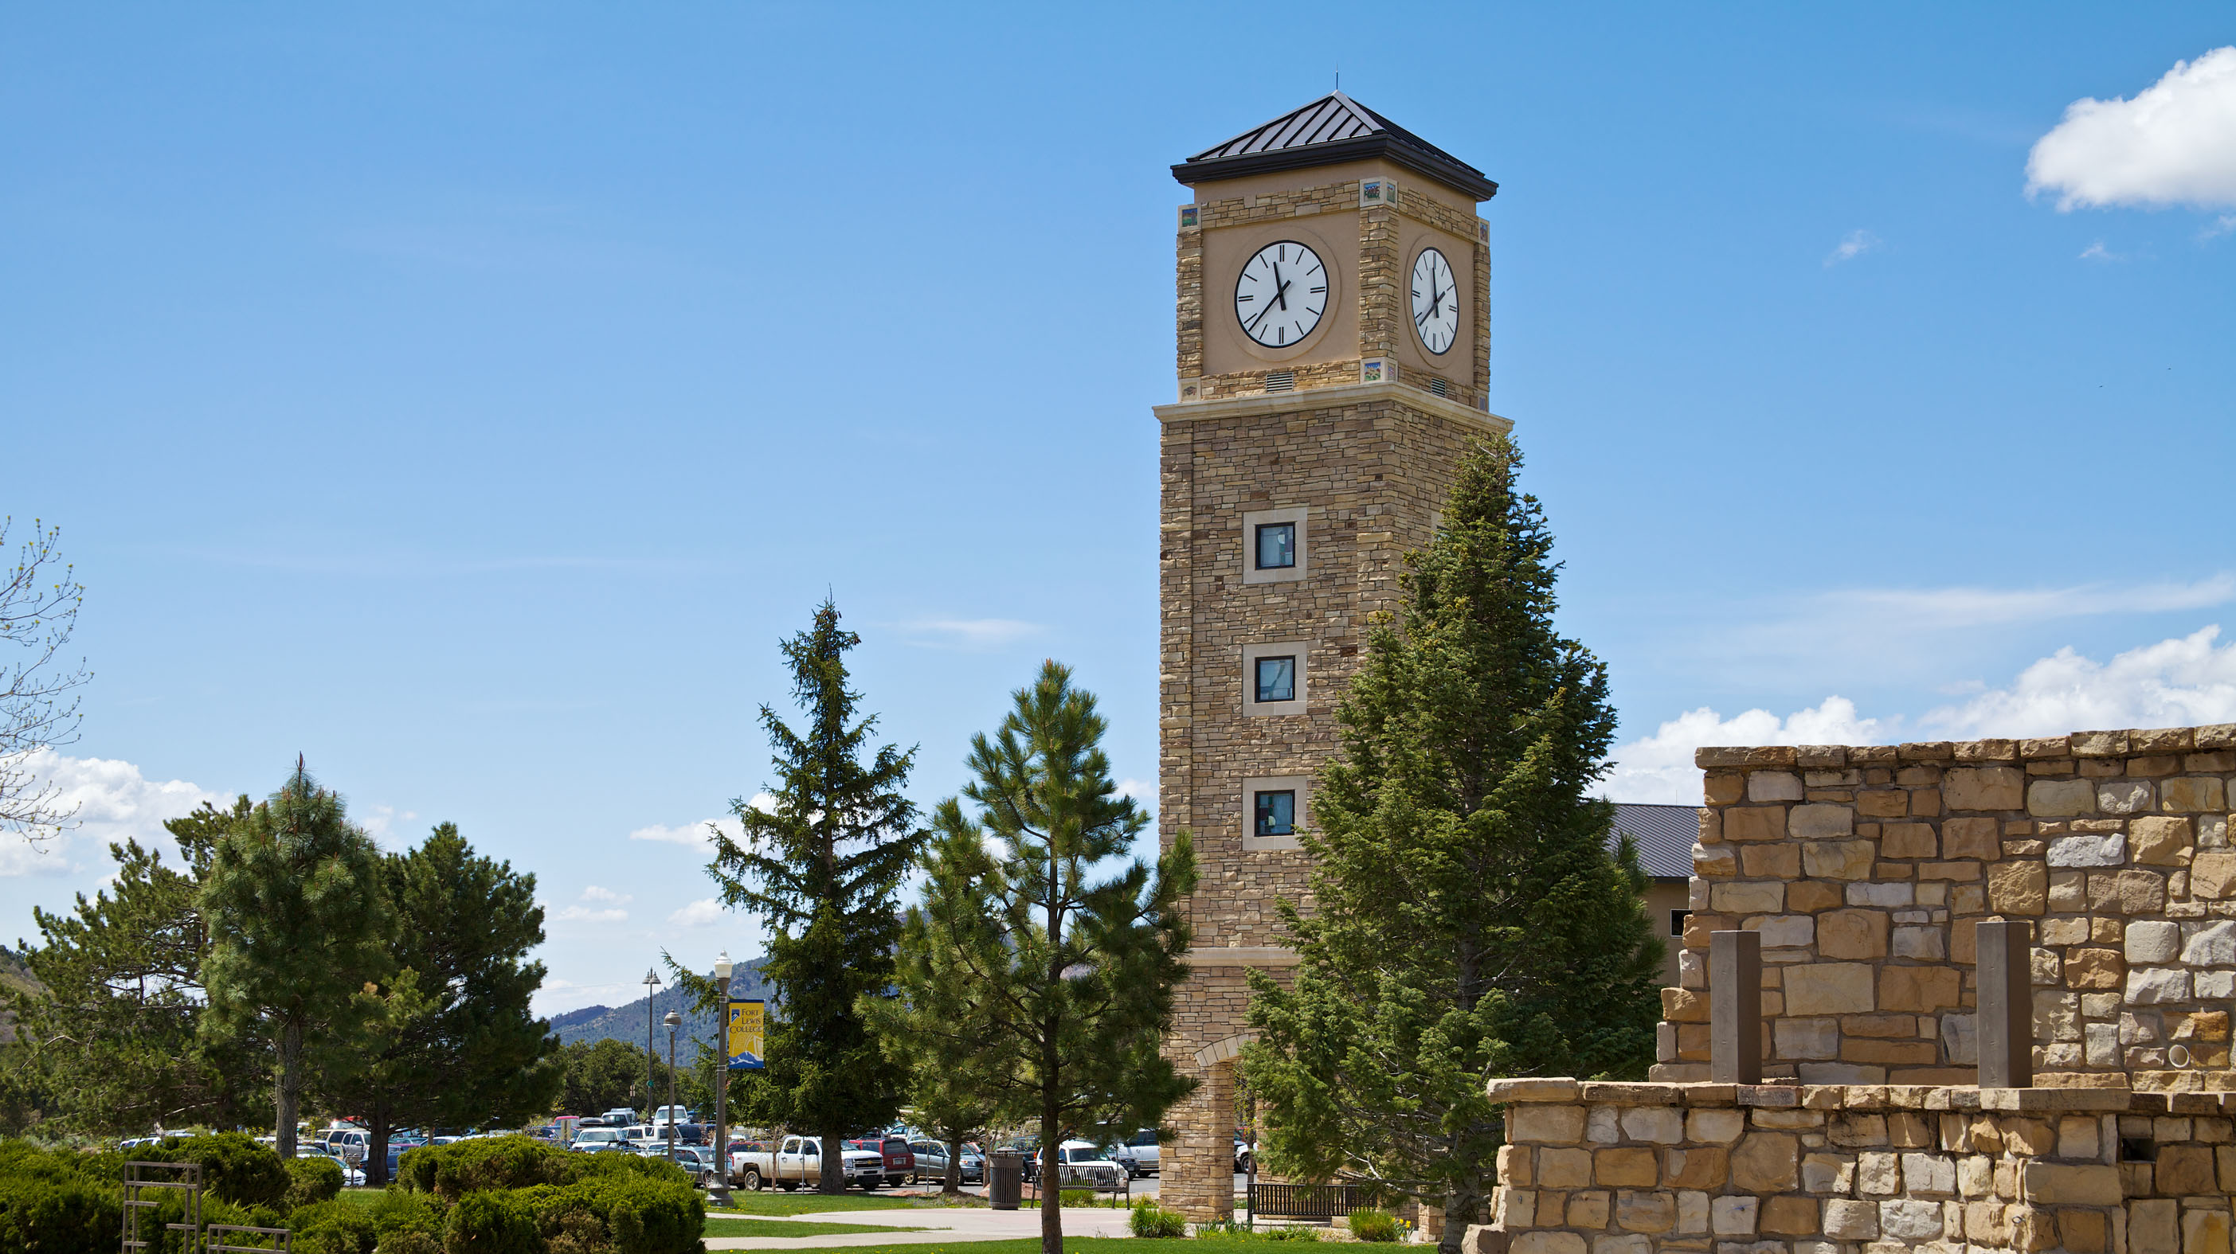
First Day of Class
Welcome students!
Show Canvas and Webpage
Syllabus – ICE 1 and HW 1
Roll Call
Questions

Slide 5
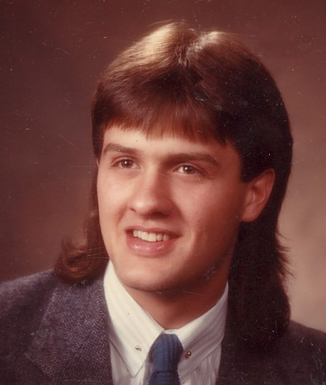
Welcome Students!

Slide 6
Locations
Show Canvas page
Show course webpage
Look at syllabus in particular

Slide 7
Expectations
We will all follow all COVID rules.
We are in this together, for entire term.
Students will attend in person.
Students will be available MWF at this time.

Slide 9
Examples
What is Operations Management?
Example 1: Assume you sell 10,000 products per year at $50 per unit. It costs $40 to produce and transport each unit. What is current net profit, and how can we increase it?

Slide 10
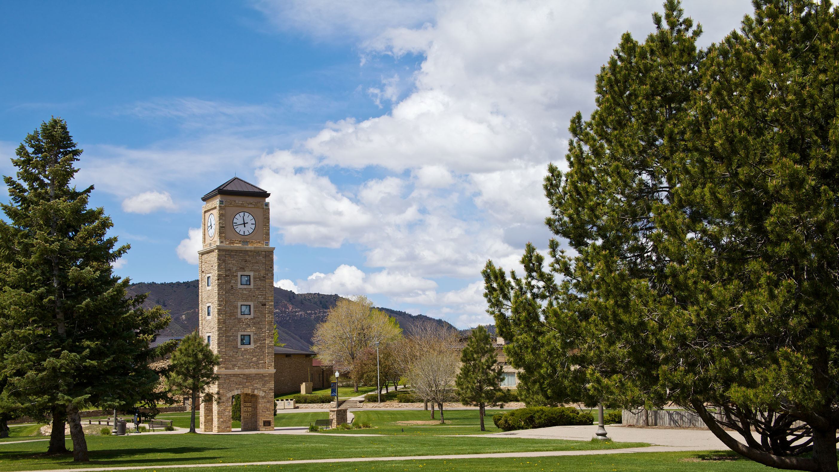
WHAT NOW?
Start Assignment 1!
Start ICE 1.
We will work on this together on Wednesday.

