Slide 1
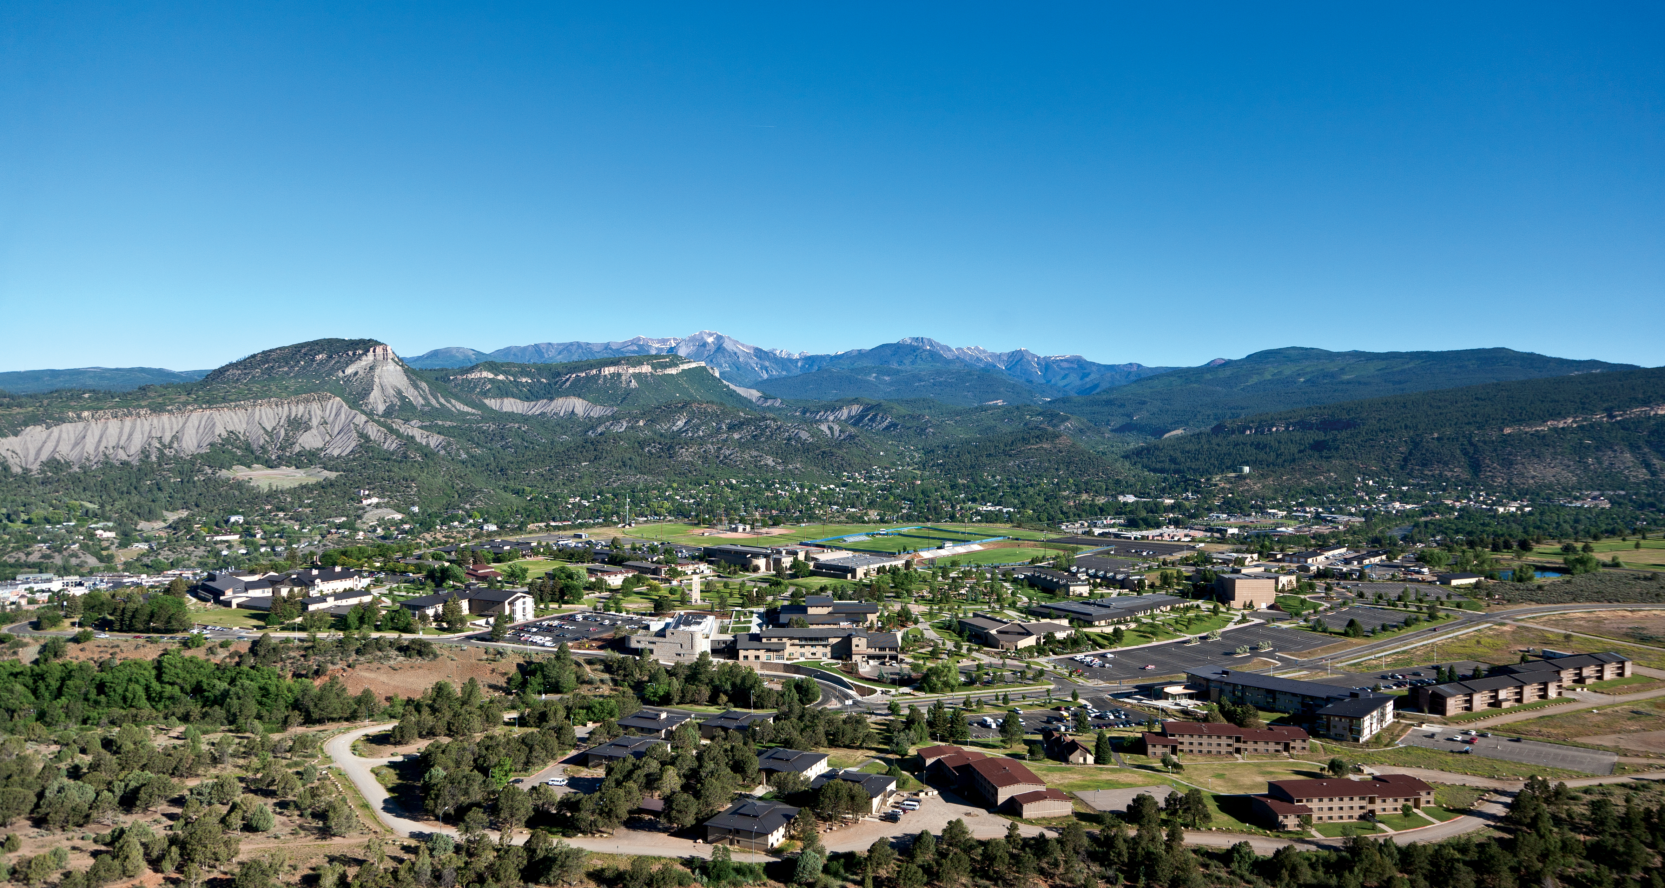
BA 353: Operations Management
Eric Huggins, Ph.D.
Professor of Management

Slide 3
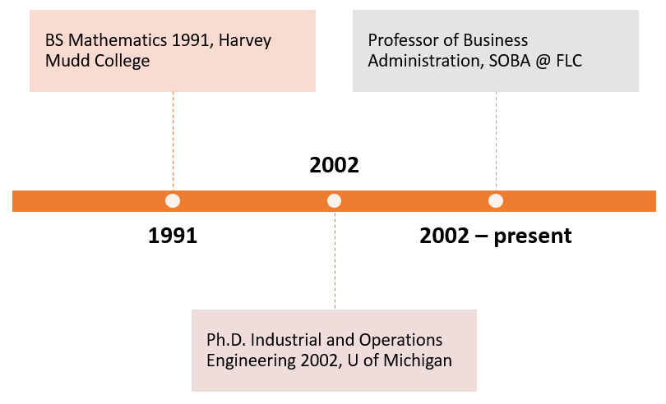
Eric Huggins
(970)946-9077
huggins_e@fortlewis.edu

Slide 4
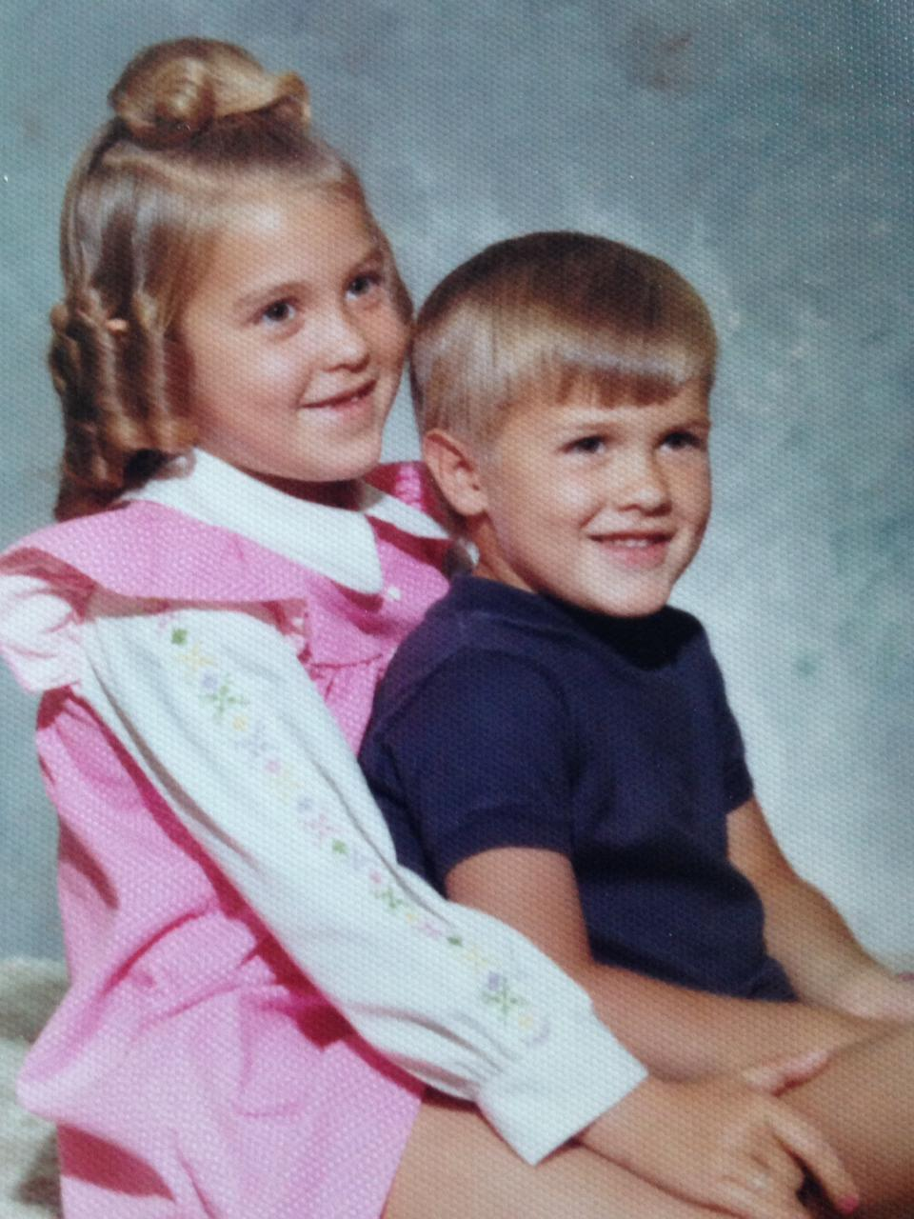
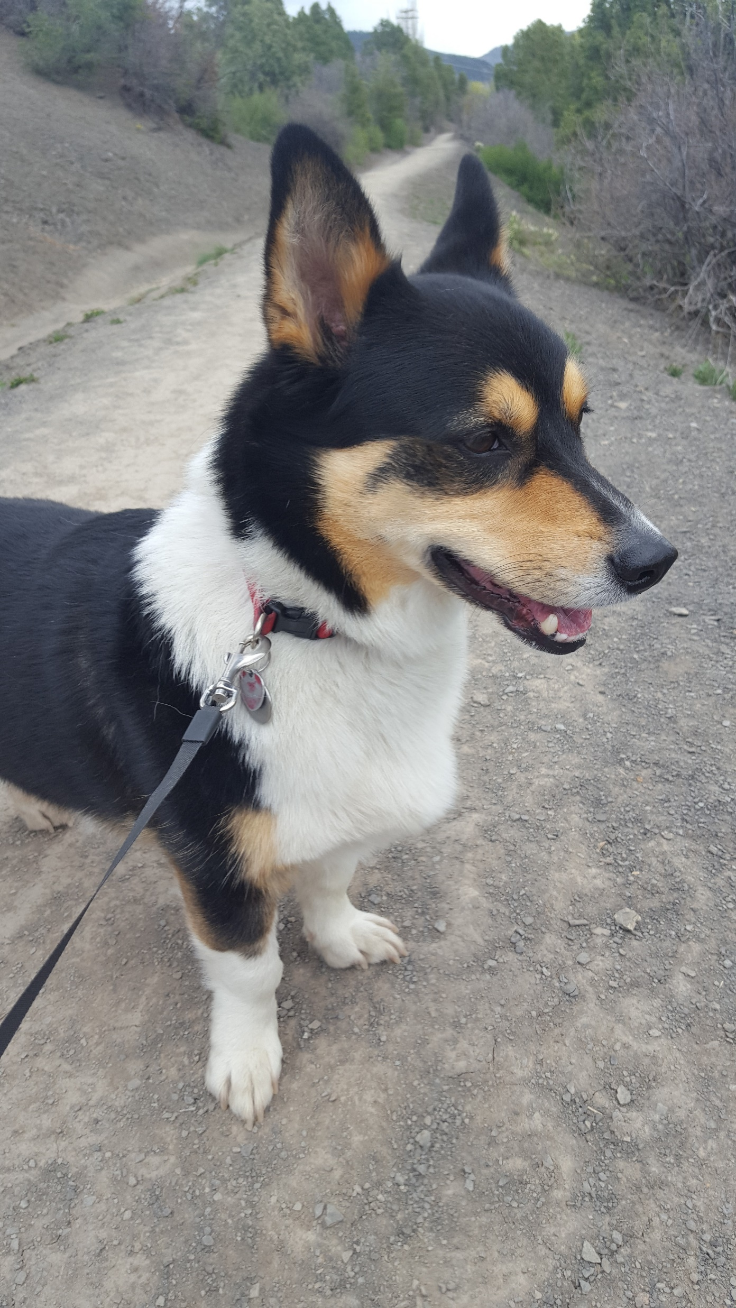
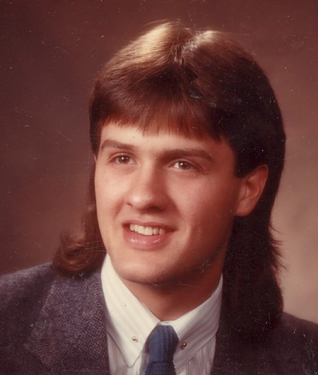
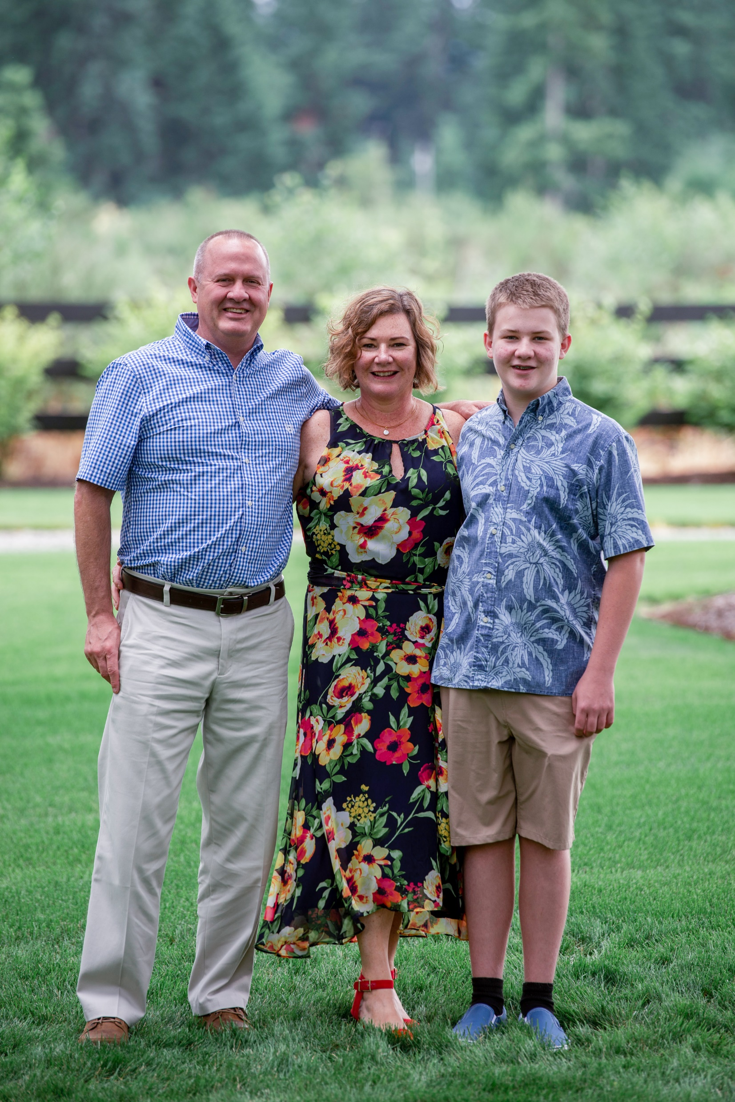
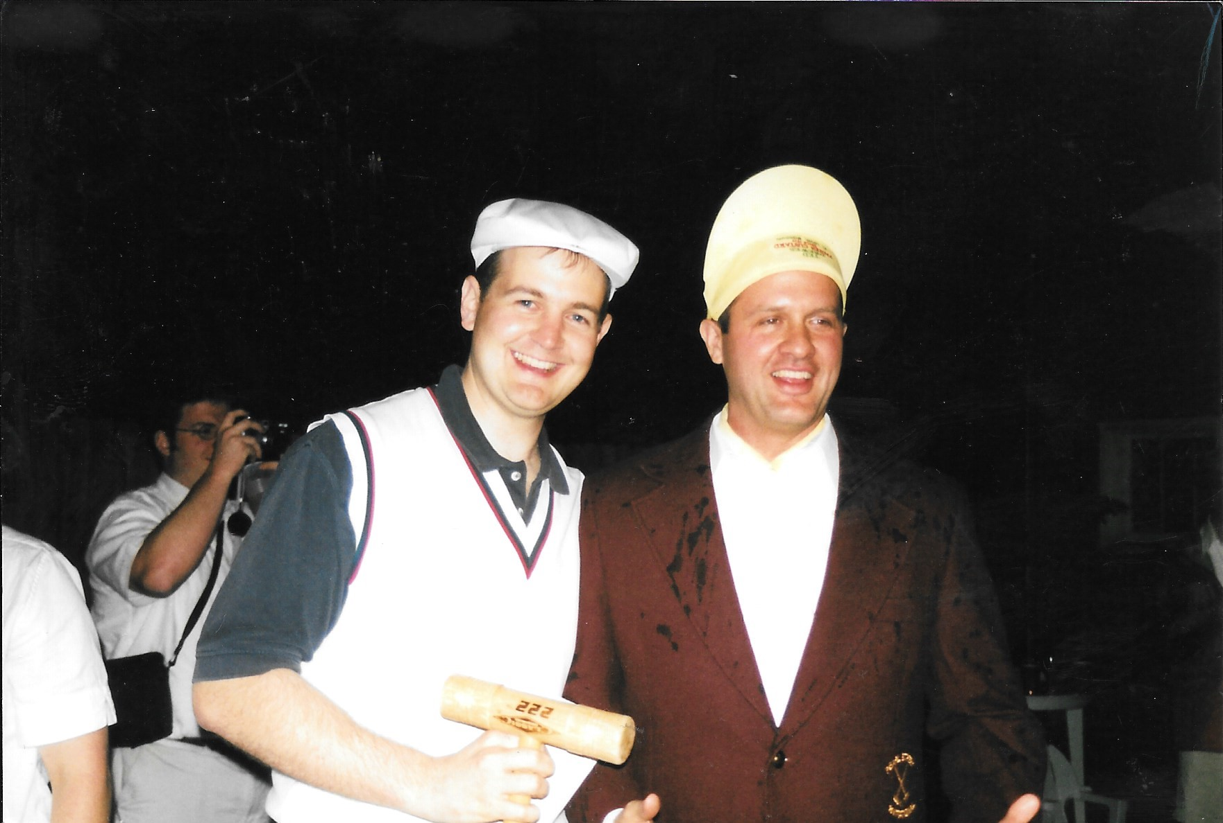

Slide 5
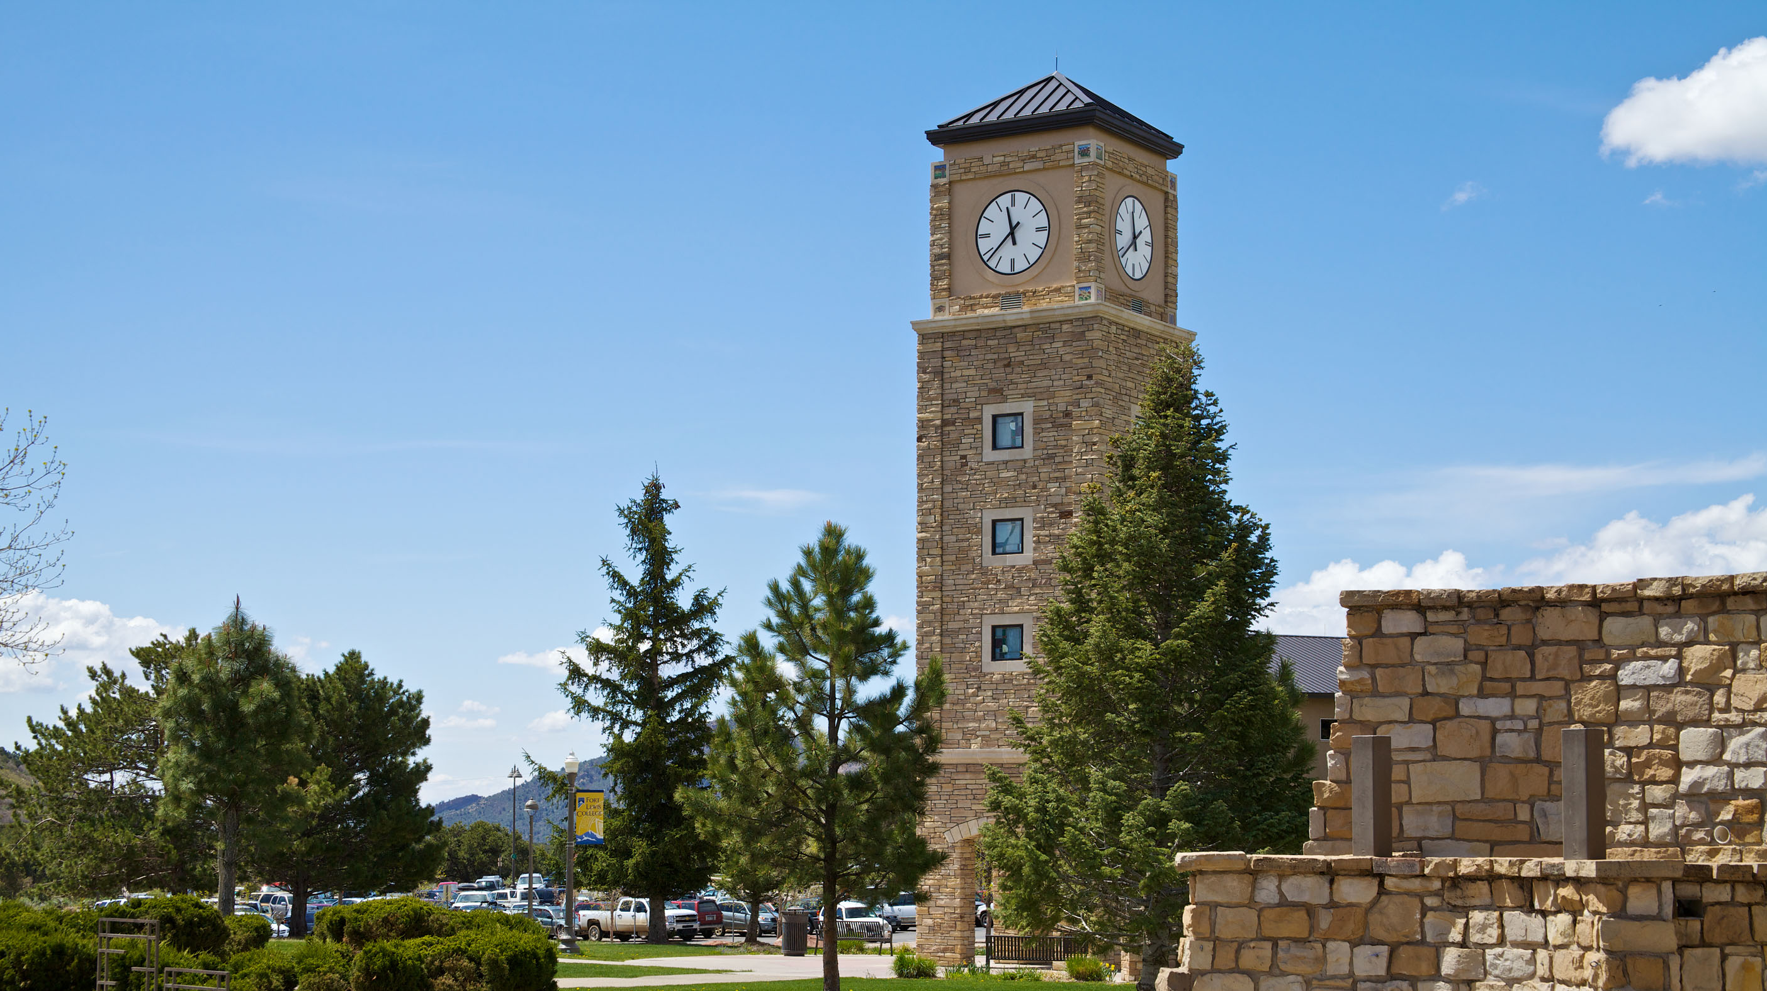
First Day of Class
Welcome students!
Show Canvas and Webpage
Syllabus – ICE 1
Roll Call
Next week
Hang around for individual questions

Slide 6
Welcome Students!
Zoom Chat Question: When the pandemic is OVER, where would you like to travel to?

Slide 7
Locations
Show Canvas page
Show course webpage
Look at syllabus in particular

Slide 8
Expectations
We will all follow all COVID rules.
We are in this together, for entire term.
Students will attend in person (when possible).
Students will be available MWF at this time.

Slide 10
Examples (Today or Monday?)
What is Operations Management?
Example 1: Assume you sell 10,000 products per year at $50 per unit. It costs $40 to produce and transport each unit. What is current net profit, and how can we increase it?

Slide 11
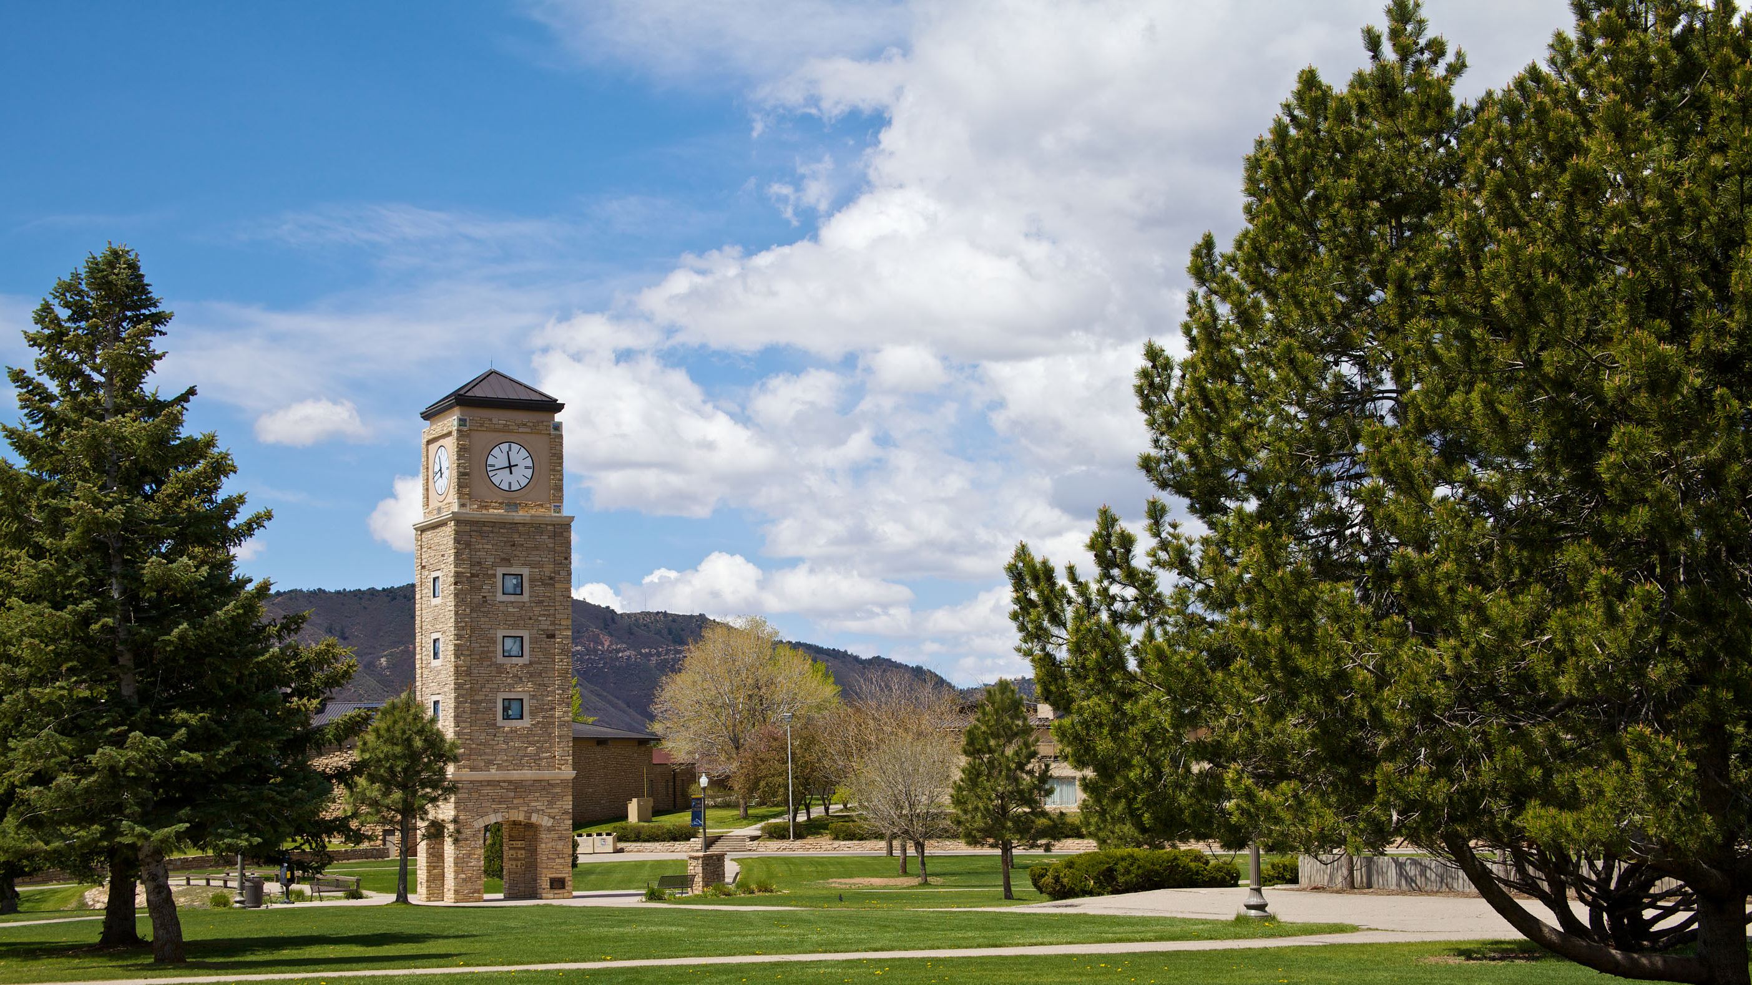
WHAT NOW?
Complete ICE 1. Due Sunday!!!
Start HW 1 and ICE 2.
How to work together?
Attend class on Monday 2/1.

