Slide 1
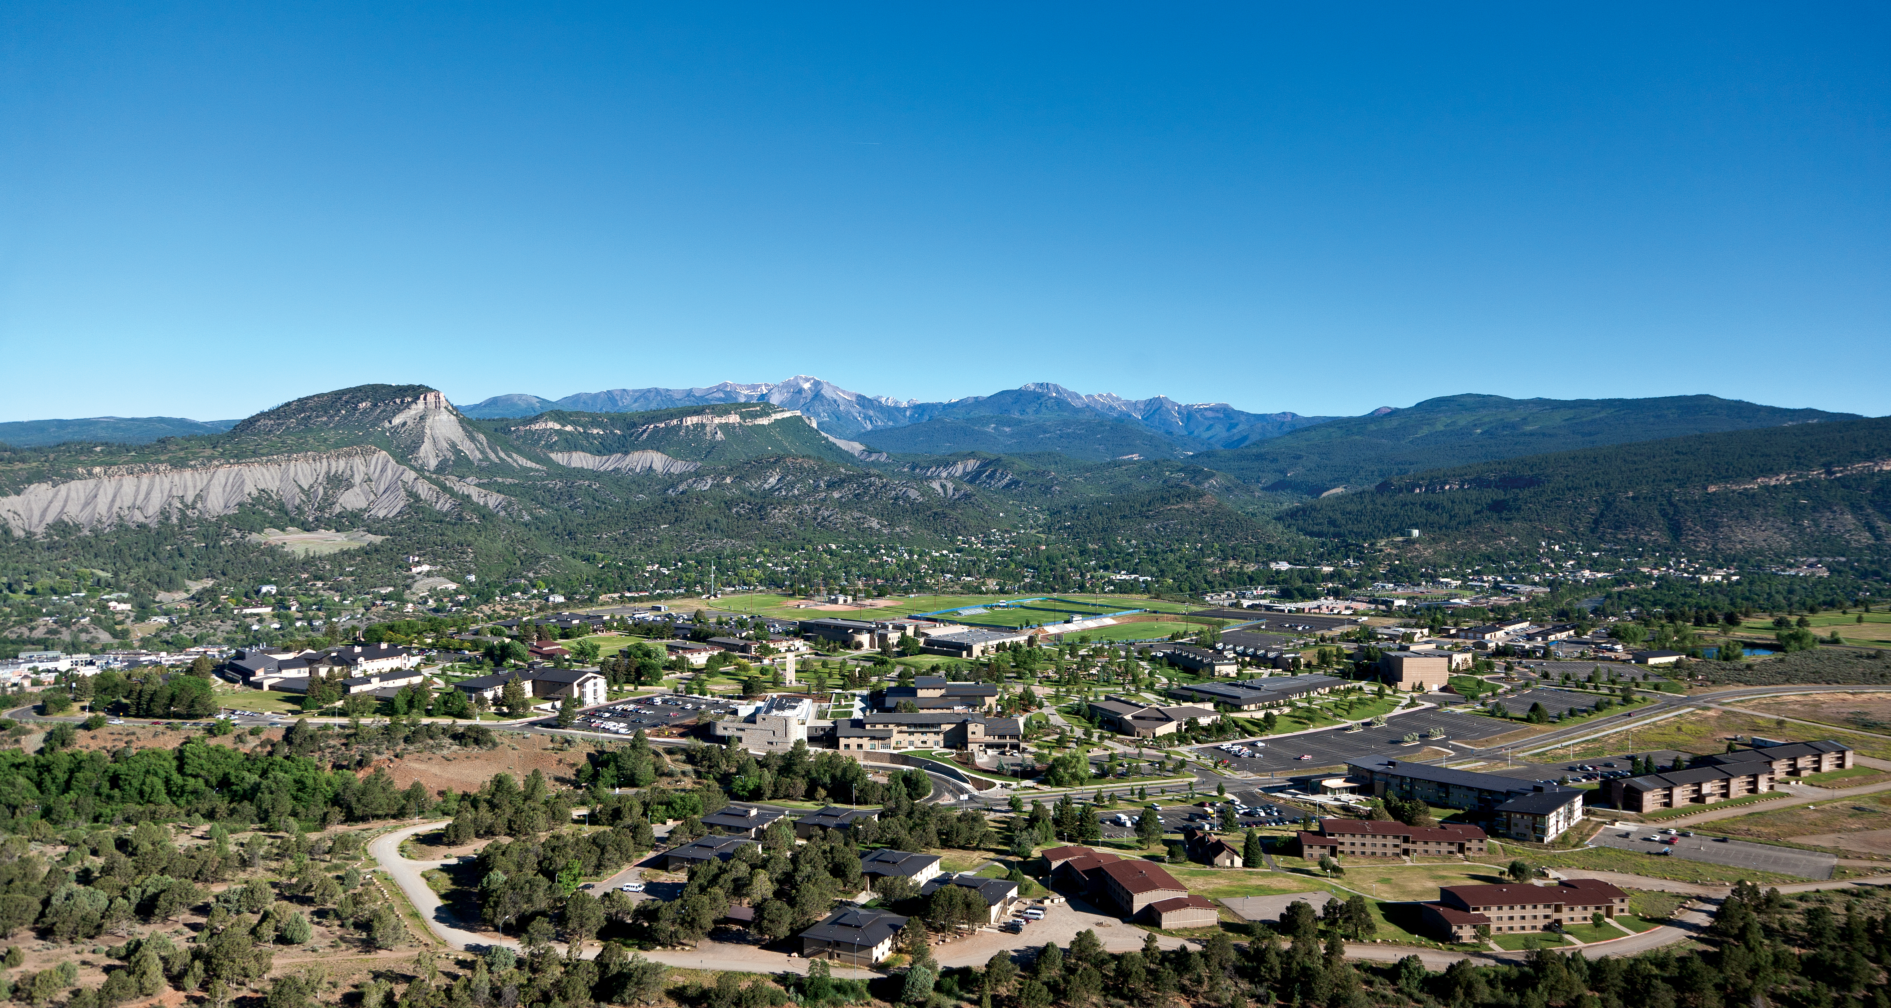
Introduction to Forecasting
The art and science of predicting future events.

Slide 2
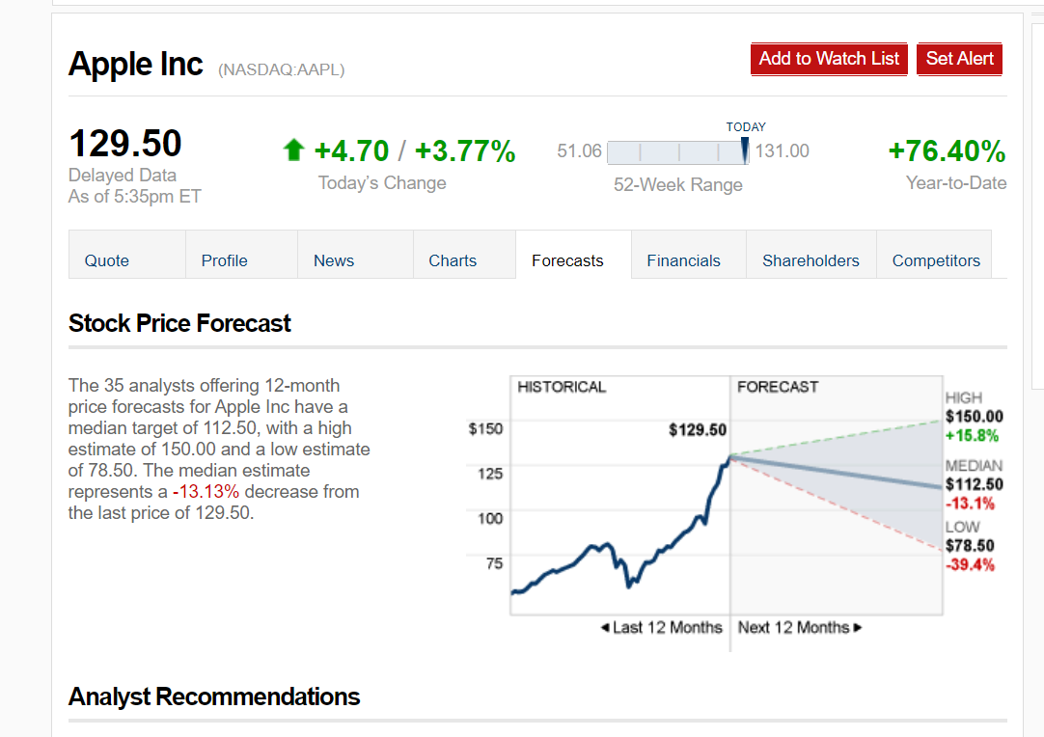
Important forecasts
Stock Earnings
Weather
Budgets
Demand

Slide 3
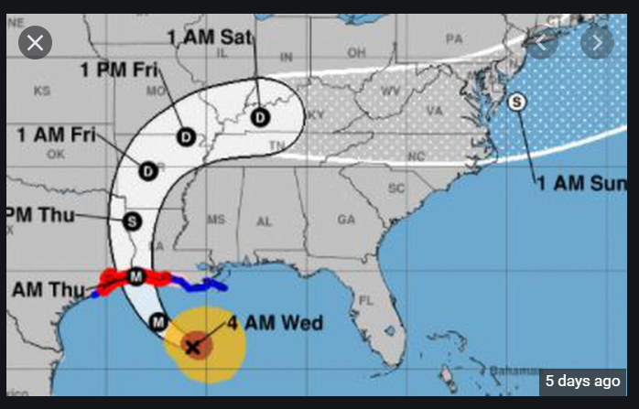

Slide 4
Budget Forecast at Ska Brewing Company
“If we knew how much sales were going to grow, it would help us tremendously. In addition to the budgeting that Erik mentioned I would say that we could greatly increase our efficiencies from a production standpoint. This would allow us to properly schedule production and dial in our inventory turnovers for each individual SKU.”
– Dave Thibodeau, Co-Founder of Ska

Slide 5
Demand at StoneAge Waterblast Tools

Slide 6
Forecasting Goals
Develop a solid prediction for what future demand will be. (Red line on previous slide.)
Accepting that our prediction is unlikely to be perfect, develop an error term that gives us some idea of how far off our prediction might be. (Blue lines on previous slide.)

Slide 7
Forecasting Goals
Good Forecast ± Probable Error

Slide 8
We will learn four different forecasting methods (out of dozens that exist – you can learn the rest of them in your MBA program).
Naïve Method
Moving Averages
Exponential Smoothing
Linear Regression

Slide 9
And we will compare the four forecasting methods with the MAD
MAD = Mean Absolute Deviation = the average absolute error between forecasts and historical data.
A smaller MAD means a method fits the historical data closely – what we want.
Does a small MAD on historical data imply an accurate forecast for the future?

Slide 10
How do we pick best forecast (from four methods)?
Calculate FC ± MAD for each method.
Choose method with lowest MAD.
Why?

Slide 11
Reality Check
Does the past help predict the future?

Slide 12
Data Set
Year | Enrollment
1 | 320
2 | 323
3 | 319
4 | 353
5 | 343
6 | ???
Assume that this is upper-division enrollment for the SOBA over the past five years.
What will enrollment be in year 6?
Do SWAG method…….
Who cares and why?

Slide 13
Now, learn the four forecasting methods.
From Excel:
Study at the “Forecasting Spreadsheet with Notes” file on the course webpage. You may be able to figure out everything from just this file.
From Videos:
Watch the Forecasting videos on the course webpage. They cover everything you need to know and should have all won Oscars.*
*Part of this sentence is false.

Slide 14
This Week:
Today 2/7: Watch videos, learn four forecasting methods.
Weds 2/9: Meet in person, work on ICE 3.
Fri 2/11: Seasonality: Demand follows a predictable seasonal pattern.

Slide 15
Next Week:
Monday 2/14: No Class! Complete ICE 4.
Weds 2/16: Class on Zoom, complete ICEs 2 and 3.
Fri 2/18: Discuss Take Home Exam 1 and Individual Exam 1.

Slide 16
