Slide 1
BA 353: Operations Management
Week 9
3/29 – 4/2

Slide 2
Recent/Current Assignments
Homework 3
Got credit for attempting each problem.
Check your answers versus answer key online.
ICE 7
Due tonight.
Check answers with classmate(s) to ensure accuracy.

Slide 3
Operations Management Topics
Decision Analysis ✓
Forecasting ✓
Linear Programming – Three things to do…
Project Management
CPM ✓
Variable Activity Times – Week 10
Simulation: Weeks 10 and 11
Inventory Control: Weeks 12 and 13

Slide 4
Topic: Project Management
This class:
CPM ✓
Variable Activity Times – Week 10
Interested in more?
Take BA 352: Project Management.
More accurate models.
How to speed up a project (crashing).
Learn MS Project software.
Learn about careers in PM and how to get certified.

Slide 5
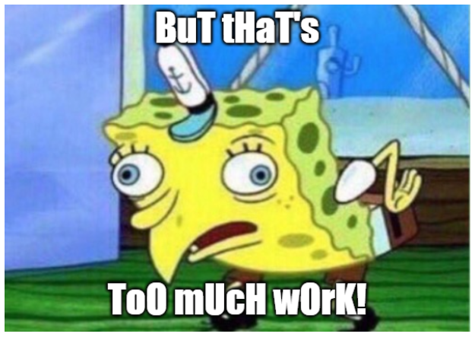
Linear Programming (LP)
Three Remaining Assignments
Individual Exam 2
Emailed ……
Take Home Exam 2
Homework 4
ALL DUE ON MONDAY 4/5
Work in teams!!!

Slide 6
This Week: Work on all three…
Today: Get started! Find partners for HW 4 and THE 2.
How to avoid procrastination?
Wednesday 3/31: ICE 8.1 (5 points)
Friday 4/2: ICE 8.2 (5 points)

Slide 7
ICE 8.1: Convince me you worked on LP stuff on Tues 3/30 or Weds 3/31.
Attend class synchronously (in person or remotely) on Weds 3/31 and ask at least one question.
Submit one of the three things early.
Send me a detailed email describing your progress on all three assignments and/or asking question(s).
Text me {(970) 946-9077} a photo of you being a massive LP nerd working on this stuff. Include your name in the text.
ICE 8.2: Convince me you worked on LP stuff on Thurs 4/1 or Fri 4/2.
Visit me on Zoom or in EBH 158 on Fri 4/2 and ask a question or update me on your progress.
Submit one of the three things early.
Send me a detailed email describing your progress on all three assignments and/or asking question(s).
Text me {(970) 946-9077} a photo of you being a massive LP nerd working on this stuff. Include your name in the text.

Slide 8
