Slide 1
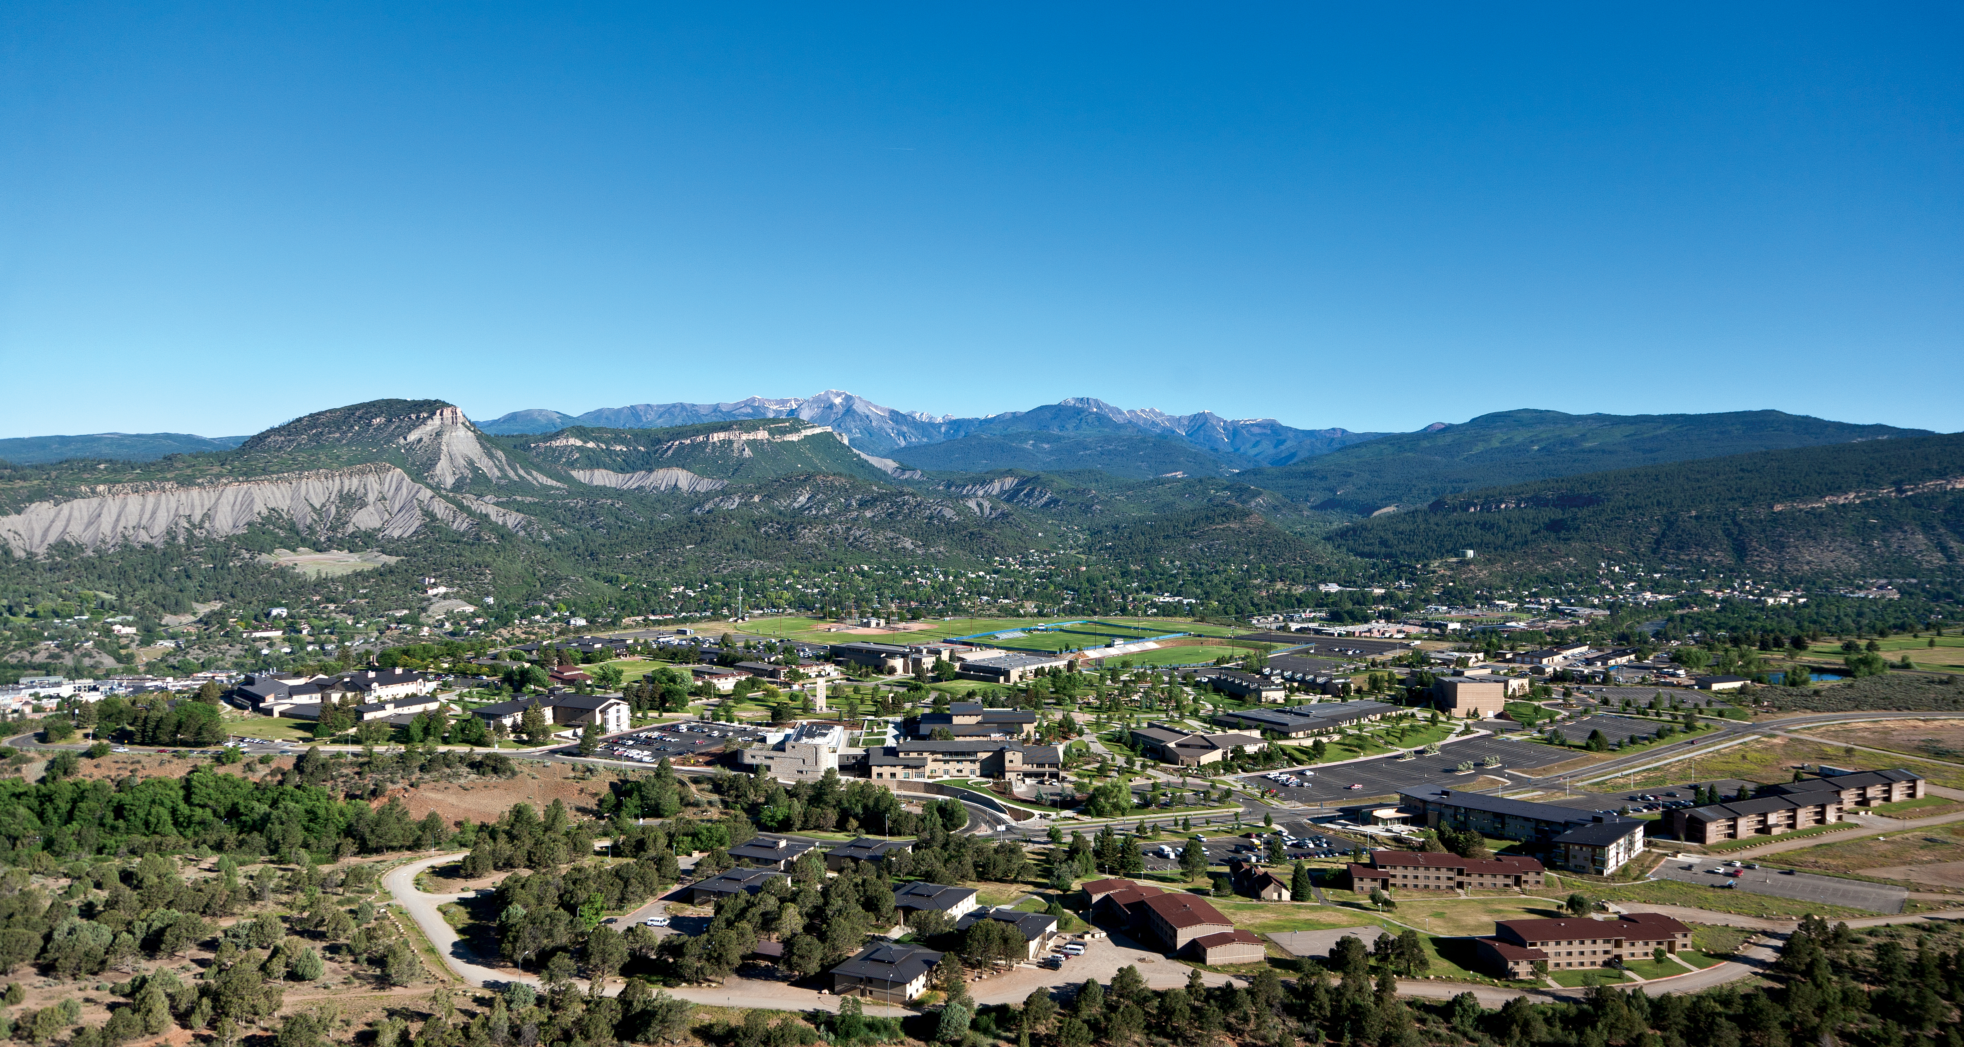
Introduction to Decision Analysis
How to make good decisions with an uncertain future.

Slide 2
Course Webpage and Canvas
Course Webpage (http://faculty.fortlewis.edu/huggins_e/OperationsS21.htm)
Find Syllabus, Assignments, ICEs, Videos.
This is where you learn the material.
Canvas (https://courses.fortlewis.edu/courses/20822/wiki)
Find Announcements, “textbook” chapters.
Submit Assignments online.

Slide 3
I want to start the semester strong!
Already turned in Assignment 1!
Complete ICE 1 and start Assignment 2 – find on webpage, submit via Canvas.
Get a head start on ICE 1 and Assignment 3…
Watch DA videos.

Slide 4
Decision Analysis Example A
(Found on course webpage, document called “Decision Analysis Intro and HW 2)
A) A grocery store manager must decide how many crates of bananas to purchase for the upcoming week. Each crate holds 250 pounds of bananas and costs $75. The bananas sell for $0.49 per pound and by the end of the week any unsold bananas must be thrown away. Over the last eight weeks, demand has been 200 pounds once, 400 pounds twice, 600 pounds three times, and 800 pounds twice. According to expected value, should the manager purchase one, two or three crates of bananas? What is the best decision according to minimax regret?
Set up and solve!

