Slide 1
BA 353: Operations Management 2/3/21
Show where recordings of classes are.
Canvas → Zoom LTI Pro → Cloud Recordings
Questions?
Memes
Now

Slide 3
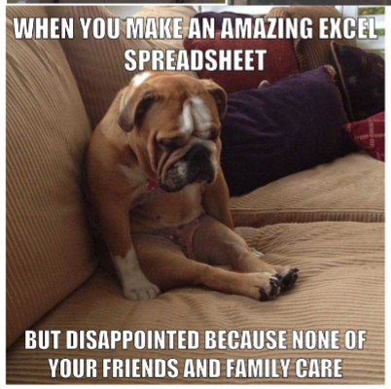

Slide 4
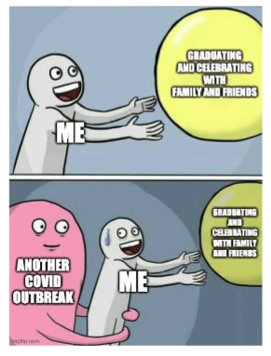

Slide 5
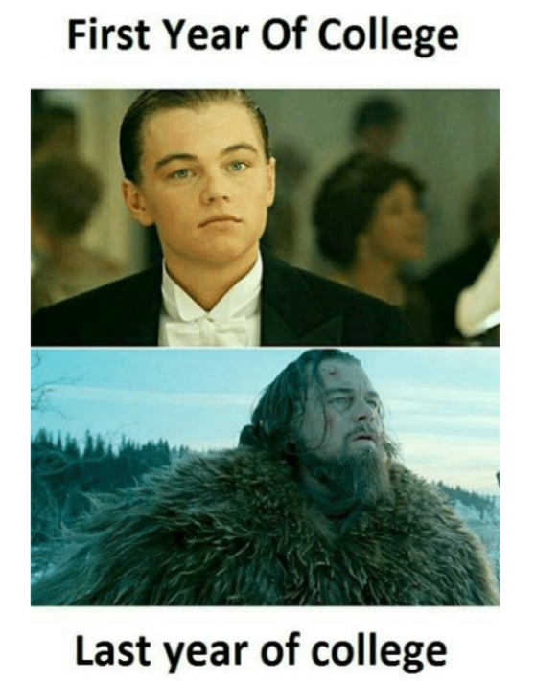

Slide 6
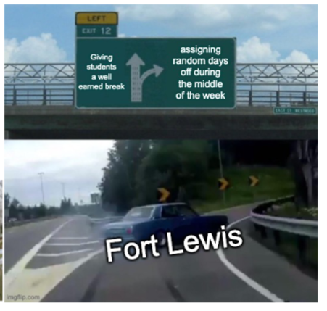

Slide 7
This Week
Today: Finish DA Table, do Expected Value. Which decision is “best?”
This Week:
ICE 2
Start ICE 3, problem 1, part a) at least!
Get Ahead?
Homework 1
Progress on ICE 3…

