Slide 1
BA 353: Week 13 and the rest of the semester…
Inventory Control/EOQ Model
Remaining Assignments

Slide 2
Inventory Control
Balance
Costs:
Holding
Setup/Delivery
Shortage

Slide 3
The Inventory Question
How much, and when?

Slide 4
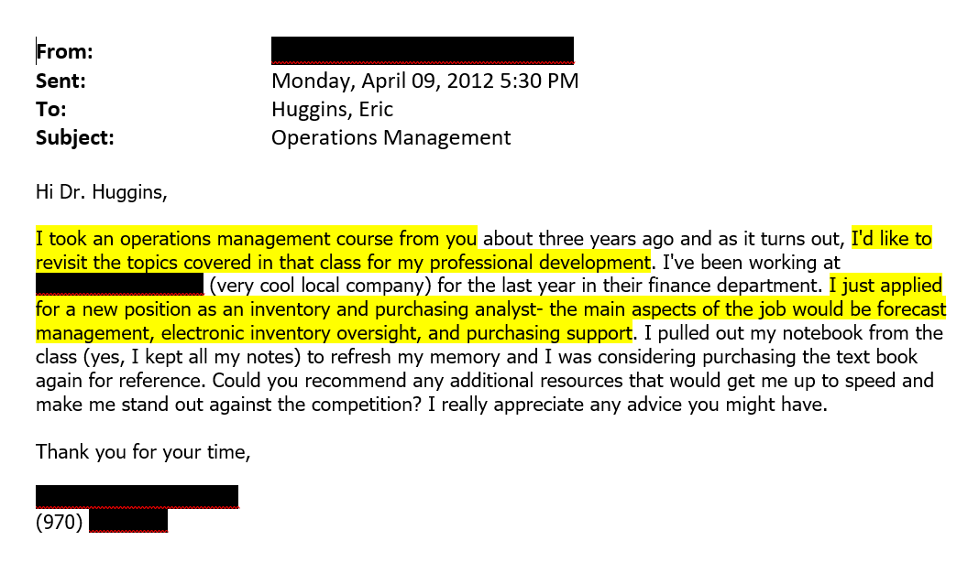

Slide 5
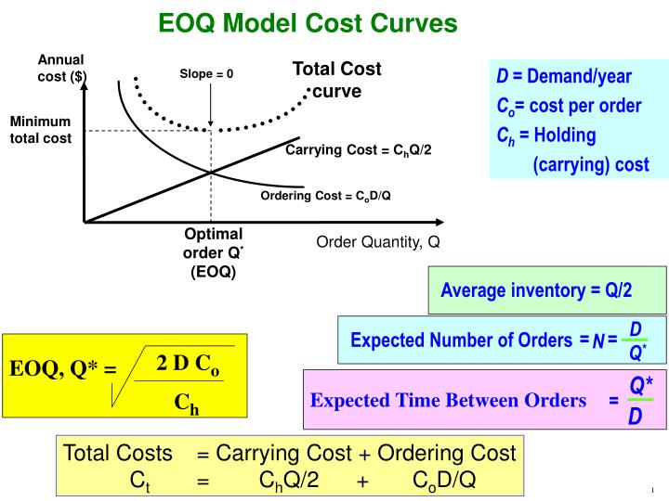
EOQ Model
EOQ = Economic Order Quantity
D = annual demand
S = setup/delivery cost
H = holding cost
Q = order quantity

Slide 7
Remaining Class Sessions
Monday 4/19: Intro to Inventory Control Class meeting? Yes | Wednesday 4/21: Watch Inventory Videos Class? No, Office Hours in EBH 158 and on Zoom. | Friday 4/23: Start Last ICE, complete at least problem 1. Class? No, OH on Zoom.
Monday 4/26: Last ICE due. Work on THE 3 too. Start Individual Exam 3. Class? No, OH in EBH 158 and on Zoom. | Wednesday 4/28: Class meeting? Yes Review Last ICE, Questions on THE 3 and Individual Exam 3. | Friday 4/30: Class? No, OH in EBH 158 and on Zoom. Work on THE 3 and Individual Exam 3.
Final Exam Week (Monday 5/3 – Thursday 5/6): Take Home Exam 3 and Individual Exam 3 are due on Tuesday 5/4 at midnight – but nothing is stopping you from getting them done early! Office Hours on Monday morning and afternoon and Tuesday morning, exact times TBD.

Slide 8
Remaining Assignments
Last ICE
Problem 1 due on Friday 4/23
The rest due on Monday 4/26.
Take Home Exam 3, due on Tuesday 5/4.
Individual Exam 3, due on Tuesday 5/4.

Slide 9
Operations Management: Activities that create goods and services efficiently.
Decision Analysis
Forecasting
Linear Programming
Project Management
Simulation
Inventory Control

Slide 10
