Slide 1
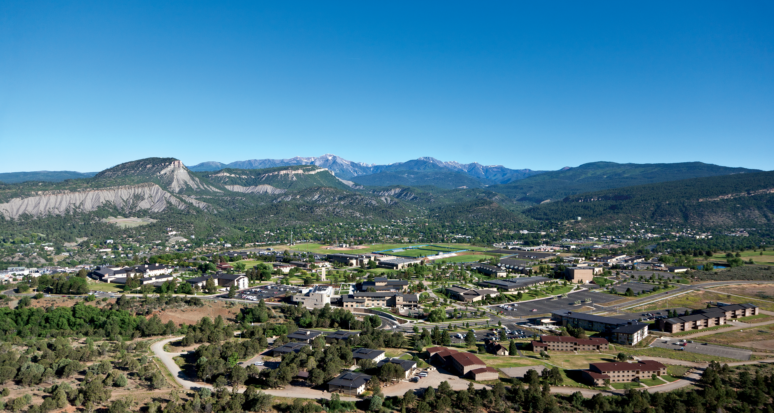
BA 353: Last Two Weeks
Inventory Control/EOQ Model
Remaining Assignments

Slide 2
Inventory Control
Balance
Costs:
Holding
Setup/Delivery
Shortage

Slide 3
The Inventory Question
How much, and when?

Slide 4
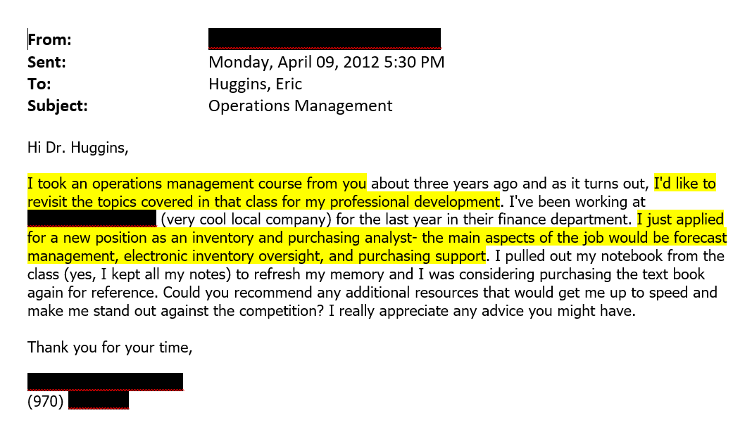

Slide 5
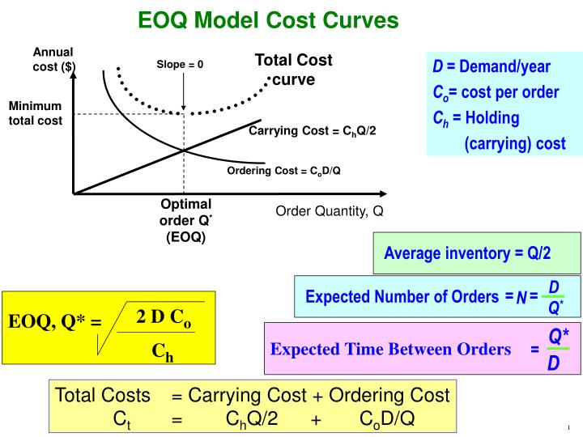
EOQ Model
EOQ = Economic Order Quantity
D = annual demand
S = setup/delivery cost
H = holding cost
Q = order quantity

Slide 7
Remaining Class Sessions
Monday 11/29: Simulation Class meeting? Yes | Wednesday 12/1: Intro to Inventory Control Class? Yes | Friday 12/3: Watch Inventory Videos Start Last ICE. Class? No, Office Hours in EBH 158 and on Zoom
Monday 12/6: THE 3.1 due. Work on THE 3.2 and Last ICE. Class? No, OH in EBH 158 and on Zoom. | Wednesday 12/8: Class meeting? Yes Questions on Last ICE, THE 3.2 and Individual Exam 3. Start Individual Exam 3. | Friday 12/10: Last ICE due. Class? No, OH in EBH 158 and on Zoom. Work on THE 3.2 and Individual Exam 3.
Final Exam Week (Monday 12/13 – Tuesday 12/14): Take Home Exam 3.2 and Individual Exam 3 are due on Tuesday 12/14 at midnight – but nothing is stopping you from getting them done early! Office Hours on Monday morning and afternoon and Tuesday morning, exact times TBD.

Slide 8
Remainder of the Semester
F 12/3, M 12/6, F 12/10 and Final Exam two-hour timeslot are “work” days. This is five hours of class time to complete assignments, during which I will be available to help.
Plus side: Lots of flexibility in your schedule, opportunity to finish early.
Down side: Easy to procrastinate. Too easy?
Question: Do I need to create incentives/deadlines to thwart procrastination?

Slide 9
Remaining Assignments
Take Home Exam 3.1 or Assignment 5, due on Monday 12/6.
Last ICE, due on Friday 12/10.
Take Home Exam 3.2, due on Tuesday 12/14.
Individual Exam 3, due on Tuesday 12/14.

Slide 10
Operations Management: Activities that create goods and services efficiently.
Decision Analysis
Forecasting
Linear Programming
Project Management
Simulation
Inventory Control

Slide 11
