Slide 1


BA 353: Week 13
Operations Management

Slide 2
Last ICE Number 1
1) For an inventory control system with annual demand of 50,000 units, holding cost of $5 and setup cost/delivery charge of $200, lead time of 3 days and open 365 days per year, calculate:
Q* = sqrt(2*50000*200/5) = 2000 – this is how much to order.
IC = $200*50000/2000 + $5*2000/2 = $10000 -- cost/year
How many deliveries per year? 50000/2000 = 25 -- deliveries/year
What is avg inv? 2000/2 = 1000 -- Inventory varies from 0 to 2000.
What is the ROP? d*l = 50000/365*3 = 411 -- Reorder when inventory level hits 411.

Slide 3
Last ICE Number 2
a) How much gasoline does the gas station sell annually? 292,000 – Always use D = annual demand in calculations.
b) Calculate the EOQ 13,106 and the number of annual deliveries ~22
c) Determine the TC, the total cost per year. $507,540
d) Is it more cost-effective to continue following the EOQ policy or to begin ordering full tankers for every delivery? What is the difference in total cost? $509,150. Continue with EOQ, ordering 30k is too much, $1610 more.

Slide 4
Last ICE Number 3
3) Monthly (careful, I may be tricking you here) demand for a product is approximately 1000 units. The setup/ordering cost is $1000 and the annual holding cost is 30% of the purchase price. The purchase price depends on the order quantity, as listed in the table below. Determine the optimal order quantity that minimizes TC, the total annual cost. D = 12,000 (not 1000!)
Order Quantity | Purchase Price | Q* | Effective Q | TC
Q < 2000 | $50.00 | 1265 | 1265 | $619k
2000 ≤ Q < 5000 | $49.50 | 1271 | 2000 | $615k
Q ≥ 5000 | $49.00 | 1278 | 5000 | $627k

Slide 5


To Do:
Take Home Exam 3
Individual Exam 3
Both due Tuesday 5/4

Slide 6
Operations Management: Activities that create goods and services efficiently.
Decision Analysis
Forecasting
Linear Programming
Project Management
Simulation
Inventory Control

Slide 7
Decision Analysis

Slide 8
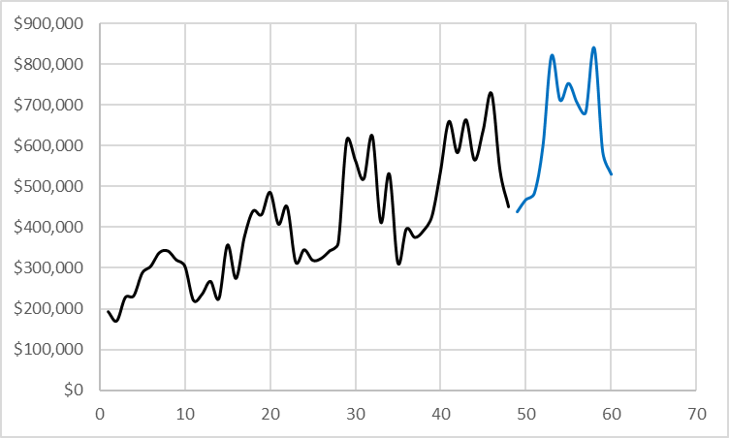
Forecasting

Slide 9
Linear Programming

Slide 10
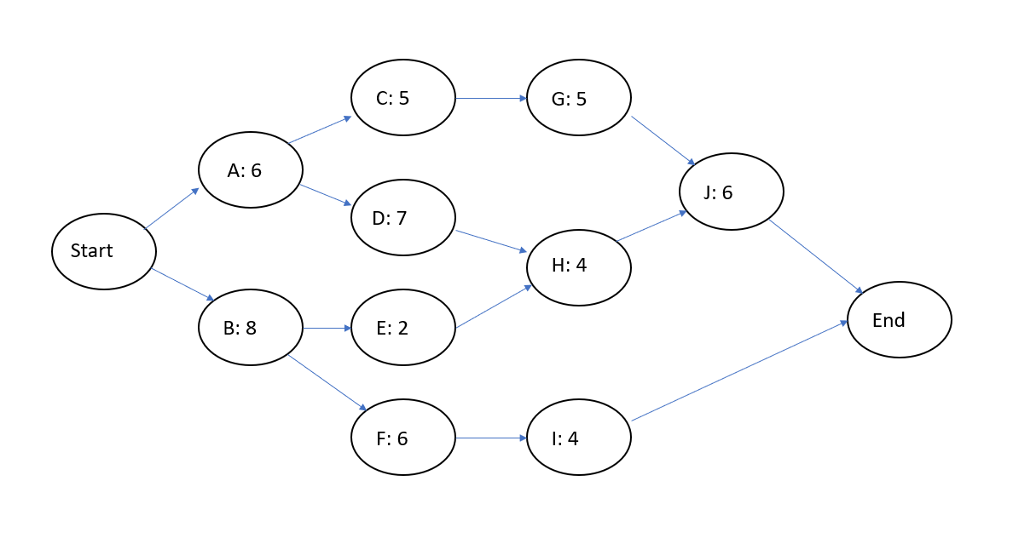
Project Management

Slide 11

Simulation (THE 3)
Inventory Control (Last ICE, Individual Exam 3)

Slide 12


Slide 13


