Slide 1
BA 355: Business Analytics
Eric Huggins, Ph.D.
Professor of Management

Slide 2
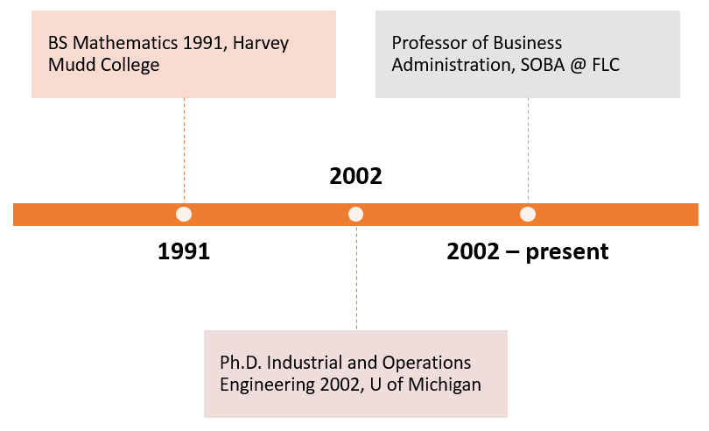
Eric Huggins
(970)946-9077
huggins_e@fortlewis.edu

Slide 3
First Day of Class
Welcome students in person.
Show Canvas
Syllabus
Roll Call
Thought experiments
The Fall 2024 Business Analytics College Football Challenge!
Start Assignment 1

Slide 4
First Week(s) of Class
Monday: Intro to Business Analytics
Wednesday: ICE 1 – Silly Bubble Games
Friday: CFB Challenge and ICE 2: Circles
Week 2: Case 1: Converting Football Point Spreads Into Probabilities

Slide 5
Welcome Students!
Show students Canvas
Syllabus in particular

Slide 7
Example 1
What do point spreads say about winning probabilities?
Explain point spreads, think about graph, draw it somehow…
Similarities with Credit Score versus likelihood of making payments on time? Draw this too…

Slide 8
Example 2
Business Analytics: The scientific process of transforming data into insight for making better decisions.
Transforming data into insight often involves finding patterns, connections or correlations.
In silly bubble-popping apps, what are scoring patterns?
Consider Bubble Breaker/Crush Eggs.
Play, find pattern, determine function – descriptive.
Predictive – try for large number.
Strategy – prescriptive.

Slide 9
Now?
Start Assignment 1

