Slide 1
BA 355: Business Analytics
Eric Huggins, Ph.D.
Professor of Management

Slide 2
Business Analytics
The scientific process of transforming data into insight for making better decisions.
Transforming data into insight often involves finding patterns, connections or correlations.
Descriptive
Predictive
Prescriptive

Slide 3
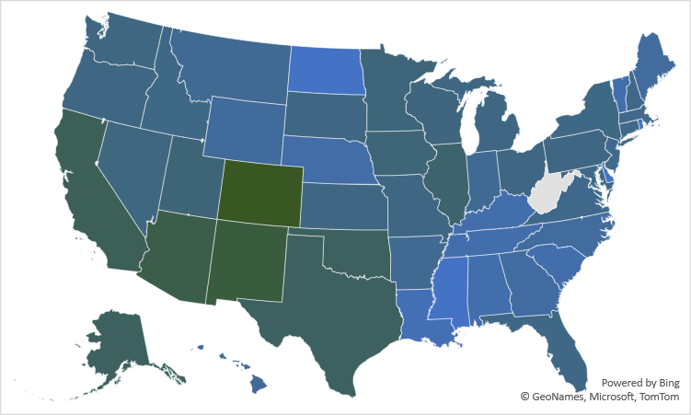
Descriptive (Cases 3 & 4)

Slide 4
Predictive (Cases 1 & 2)
Probability of winning a game?
P = 3%*point spread + 50%
or
P = 1/(1+e^(0.15*point spread))
Probability of defaulting on a loan?
P = 22.7*e^(-0.01*credit score)

Slide 5
Prescriptive (Case 2)
Only offer very low interest loans (2.5%) to applicants with really good credit scores (820 or above).

Slide 6
… and more…
How to fit a function/curve to data.
Data visualization.
Data cleaning.
Optimization.
Outliers.
Forecasting.
More Excel functions than you can shake a stick at!

Slide 7
Now?
Complete Case 5
Due Tuesday 12/14

