Slide 1


BA 355: Business Analytics
Eric Huggins, Ph.D.
Professor of Management

Slide 2

Business Analytics
The scientific process of transforming data into insight for making better decisions.
Transforming data into insight often involves finding patterns, connections or correlations.
  Descriptive
  Predictive
  Prescriptive

Slide 3
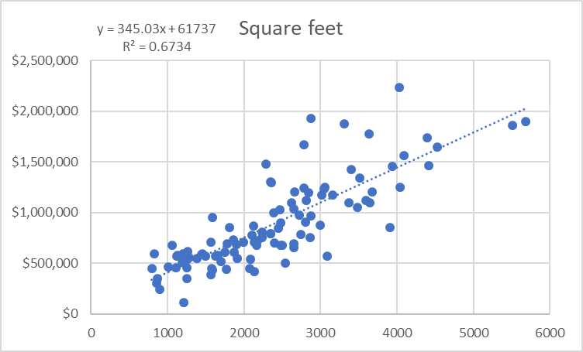
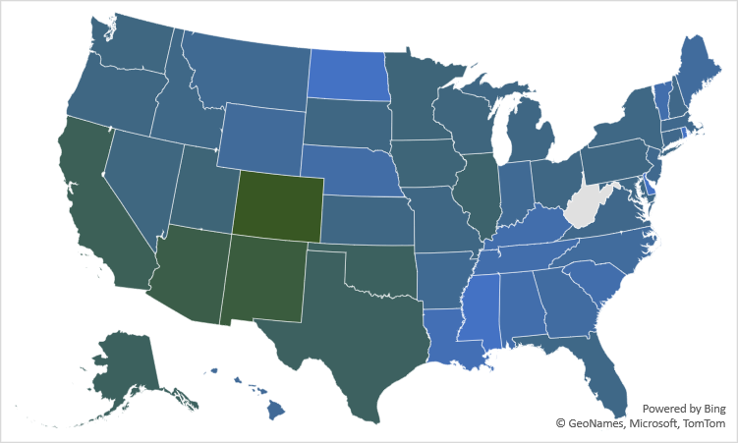
Descriptive (Cases 3 & 5)

Slide 4
Predictive (Cases 1 & 2)
Probability of winning a game?
P = 3%*(point spread) + 50%
or
P = 1/(1+e^(-0.14*(point spread)))
Probability of defaulting on a loan?
P = 22.7*e^(-0.01*(credit score))

Slide 5

Prescriptive (Case 2)
Only offer very low interest loans (2.5%) to applicants with greatcredit scores (820 or above).

Slide 6
… and more…
How to fit a function/curve to data. (How does regression work?)
Data visualization.
Data cleaning.
Optimization.
Outliers.
Forecasting.
More Excel functions than you can shake a stick at!

Slide 7


Now?
Complete Case 5
  Review
  Thorough
Due Tuesday 12/12

Slide 8


