Slide 1
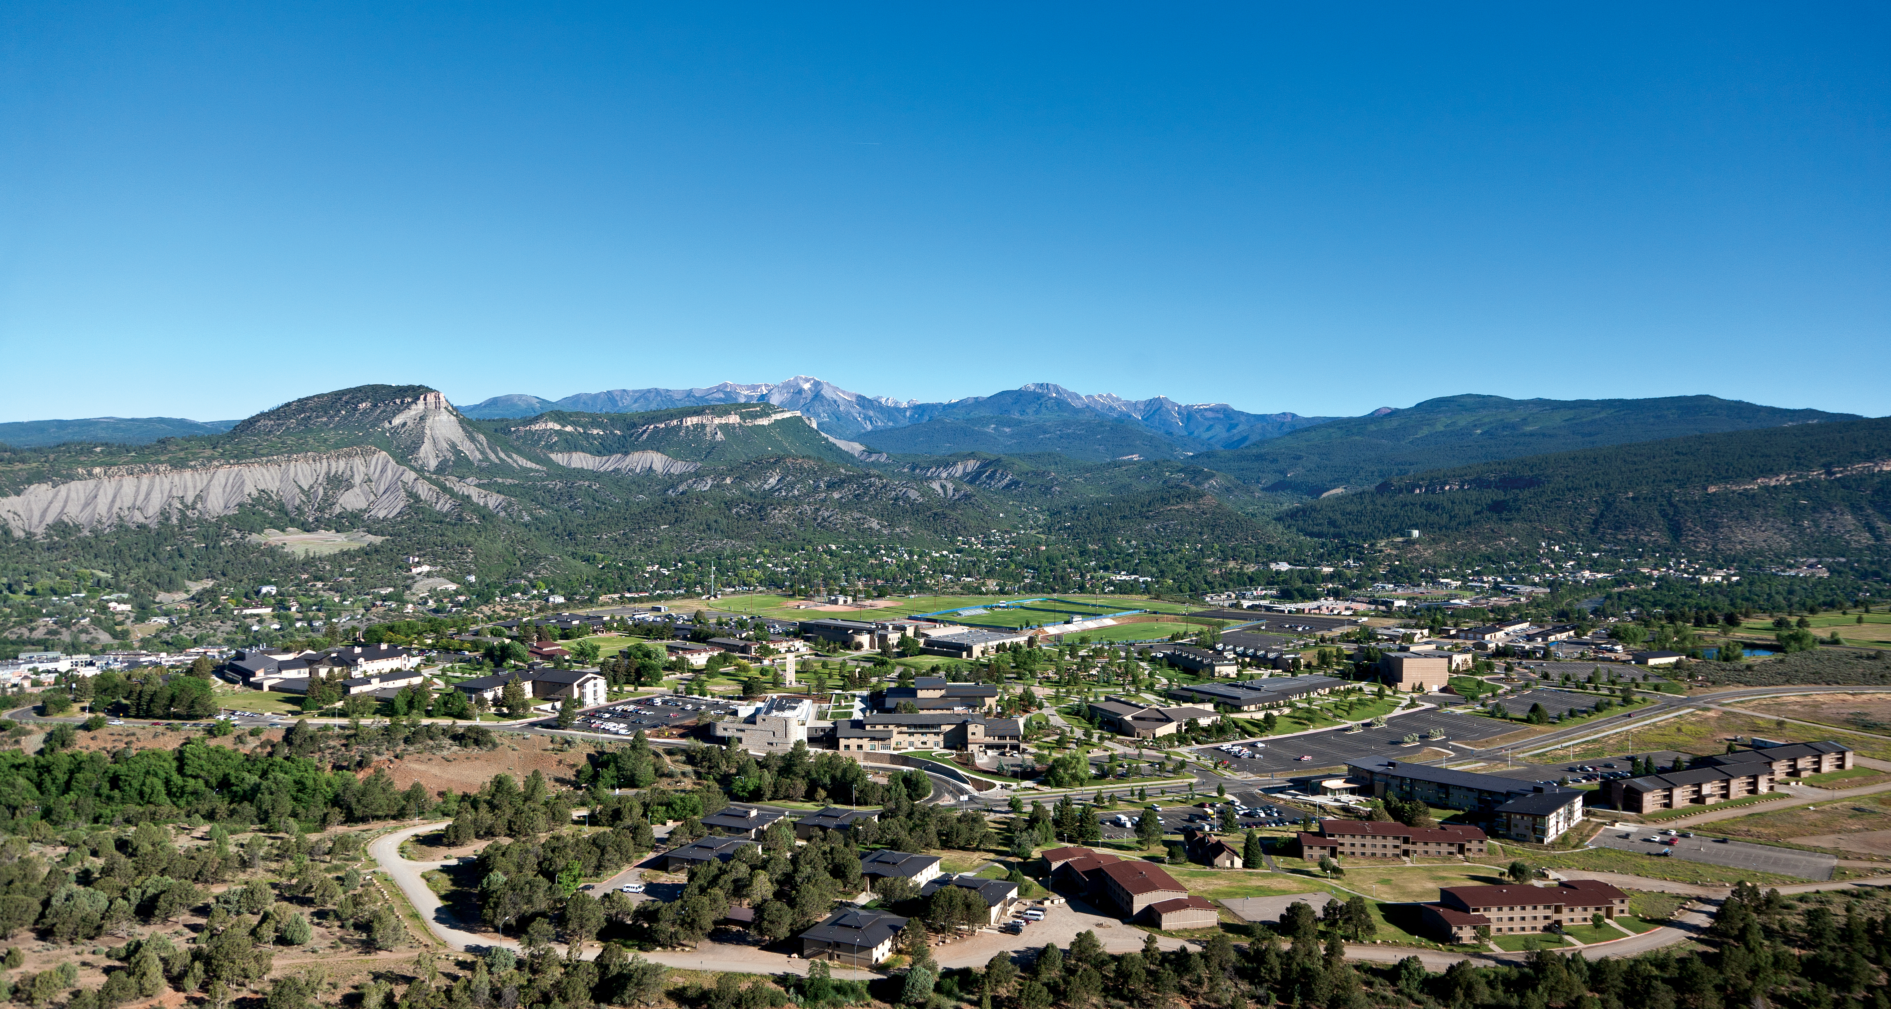
BA 355: Business Analytics
Introduction to Case Study 1: Converting Point Spreads into Probabilities

Slide 2
What is the probability that the Denver Broncos will beat the Tennessee Titans in their season opener on 9/14?
(Assuming the game happens, that is… Whether the game will happen or not is an entirely different question.)
The Broncos are currently a 1.5 point favorite. What does that tell us?

Slide 3
And in general, what is the probability that one NFL team beats another, given the point spread?

Slide 4
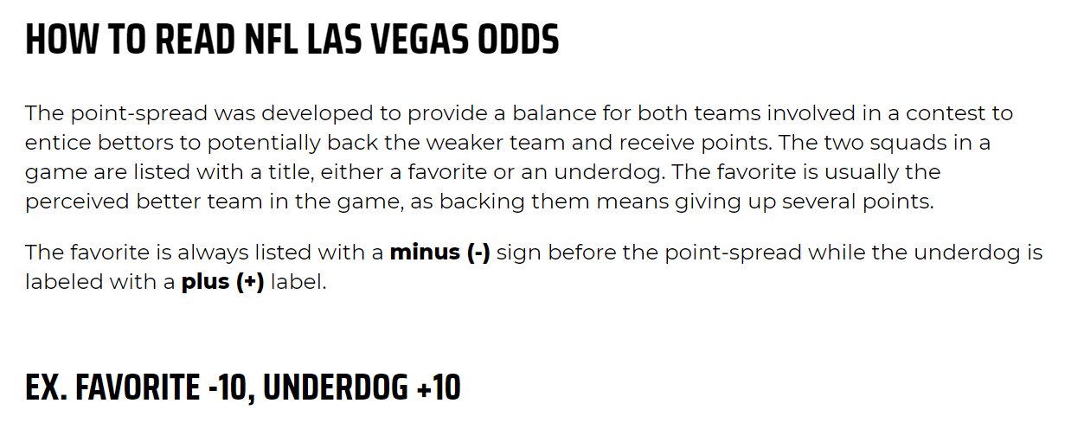
What is the “point spread?”

Slide 5
Source of previous slide…
https://www.vegasinsider.com/nfl/odds/las-vegas/
(let’s click this dodgy-looking link and see where it goes..)

Slide 6
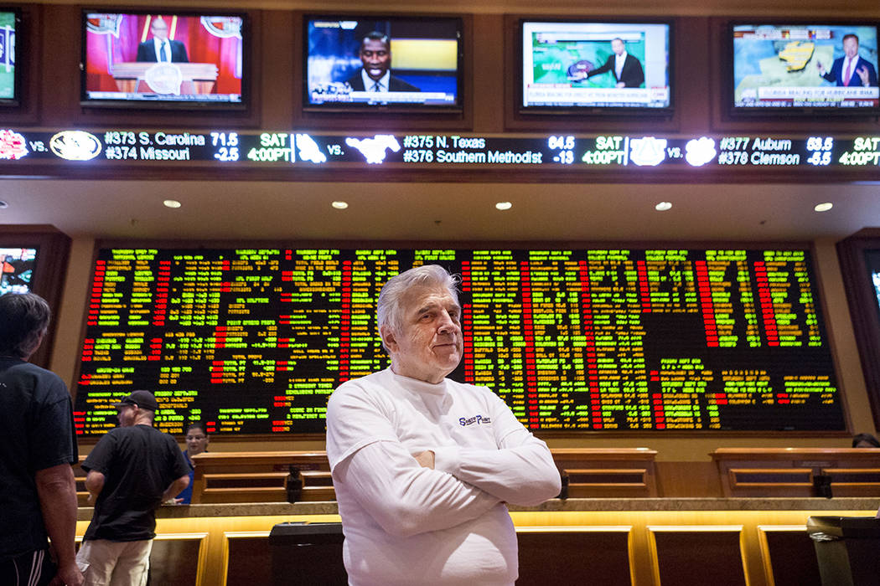
Where do these numbers come from?
Las Vegas bookies (or wise guys) come up with the point spreads, which can vary over time until the game starts.

Slide 7
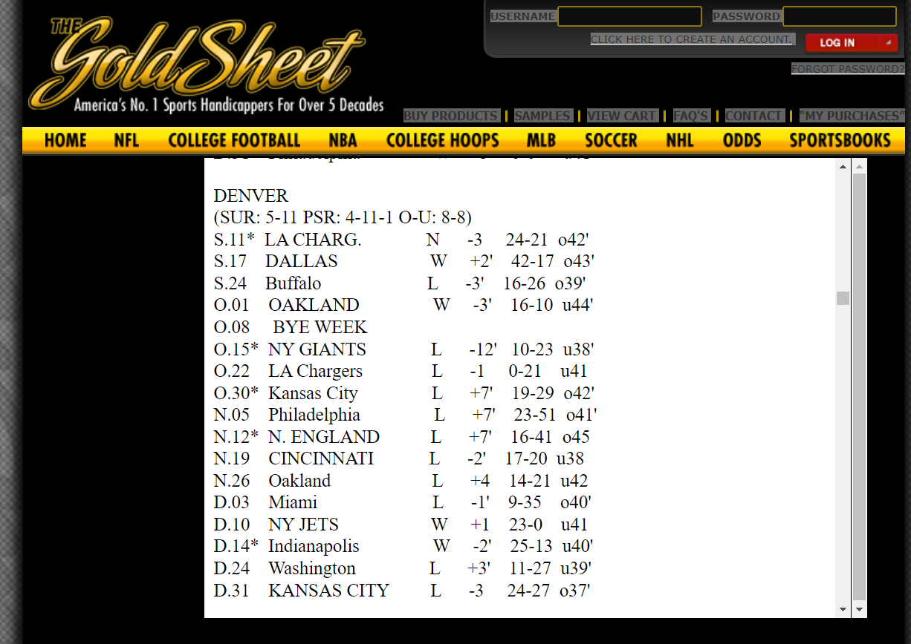

Slide 8
What if we kept track of point spreads and results?
Collect hundreds (or thousands) of data points with point spread before the game and result of the game – did the favorite or underdog win?
Can the point spread give us some idea of the probability that a team will win? (Does a bigger favorite have a better chance of winning?)

Slide 9
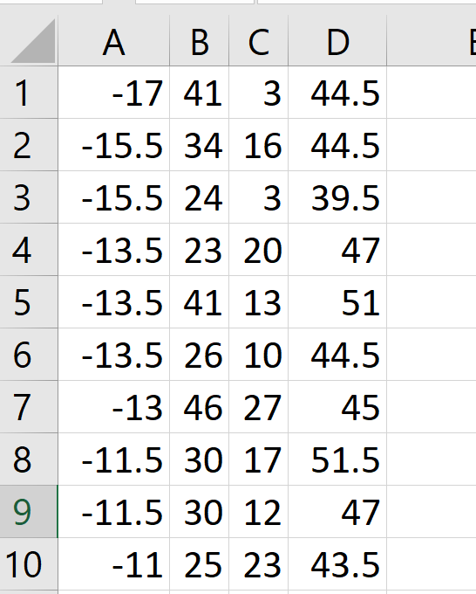
Using data from just 2016, available online.
Column A is the point spread.
Column B is how many points the favorite scored.
Column C is how many points the underdog scored.
Column D is the “over/under.”

Slide 10
Spread | Empirical Win Percentage
17 | 100%
15.5 | 100%
13.5 | 100%
13 | 100%
11.5 | 100%
11 | 100%
10.5 | 100%
10 | 100%
9.5 | 67%
8.5 | 78%
8 | 67%
7.5 | 82%
7 | 78%
6.5 | 84%
6 | 67%
5.5 | 73%
5 | 40%
4.5 | 36%
4 | 69%
3.5 | 66%
3 | 53%
2.5 | 57%
2 | 47%
1.5 | 77%
1 | 58%
0 | 50%
Case Study 1
You will combine data from four seasons (1068 games).
You will determine the empirical win percentage for each point spread.

Slide 11
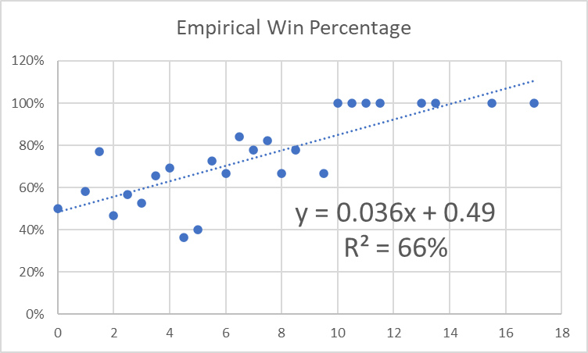
Case Study 1 continued
You will graph the data and fit a linear regression line to it, in the process determining how to estimate the probability a team wins based on the point spread.

Slide 12
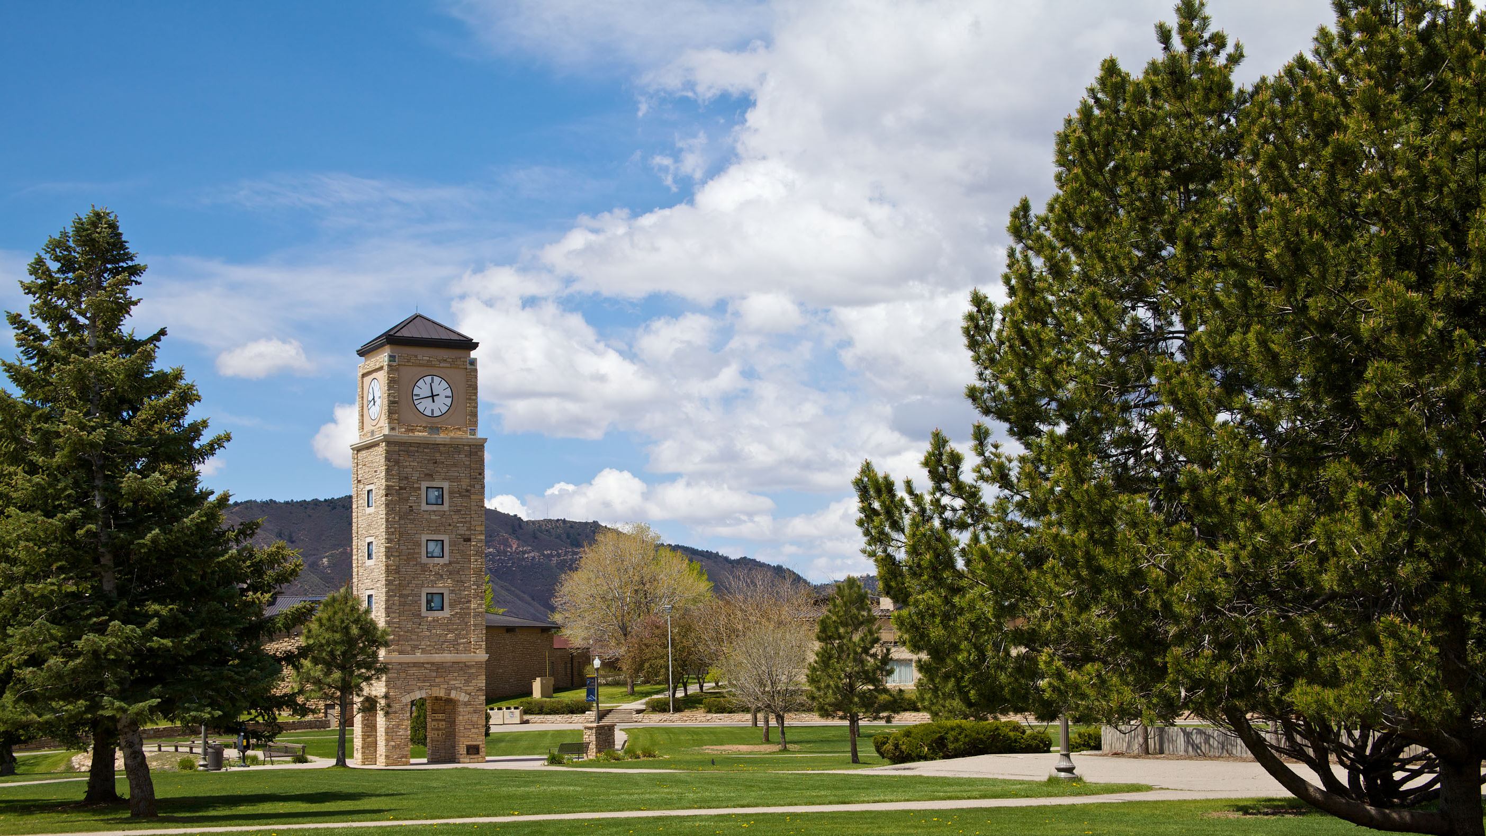
Good luck!
Get to work.
Figure out how to SAFELY work together.
Don’t fall behind, ask me for help when you need it.

