Slide 1
The Best Way to Recall 10 Knowledge Areas and Best PM Meme Tournament
Friday 4/24

Slide 2
Best Knowledge Area Mnemonics
Integration, Scope, Schedule, Cost, Quality, Resource, Communications, Risk, Procurement and Stakeholder.
9 I squash seasoned carrots quite regularly cause respect peas, Son.
9 I Quit Caring Cuz Red Rabbits Sometimes Sh*t Purple Sh*ts
8 I’m so sick COVID quarantine ruins class reopen please soon
6 It seems school causes quite rapid confusion regarding people’s smarts.
6 I see Sally Carter quarantining really close ‘round Peter Smith.
6 I Saw Sam’s Cat Quickly Run Circles Right Past Sarah
5 In southern South Carolina Queens race cars right past Simba.

Slide 3
Vote for Best Meme
Use thumbs up feature on Zoom.
Choose left or right (or top or bottom)
Round 1: 16 games
Round 2: 8 games
Round 3: 4 games
Round 4: 2 games
Round 5: Championship!

Slide 4
Game 1

Slide 5
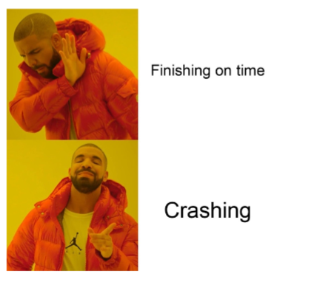
Game 2

Slide 6
Game 3

Slide 7
Game 4

Slide 8
Game 5

Slide 9
Game 6

Slide 10
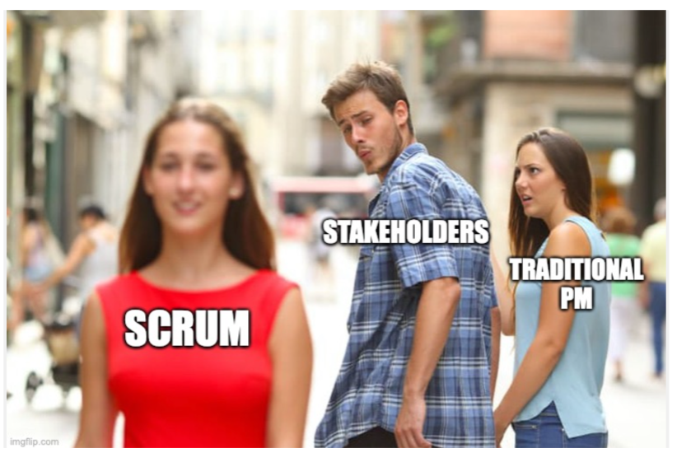
Game 7

Slide 11
Game 8

Slide 12
Game 9

Slide 13
Game 10

Slide 14
Game 11

Slide 15
Game 12

Slide 16
Game 13

Slide 17
Game 14

Slide 18
Game 15

Slide 19
Game 16

Slide 20
Sweet 16 Game 1

Slide 21
Sweet 16 Game 2

Slide 22
Sweet 16 Game 3

Slide 23
Sweet 16 Game 4

Slide 24
Sweet 16 Game 5

Slide 25
Sweet 16 Game 6

Slide 26
Sweet 16 Game 7

Slide 27
Sweet 16 Game 8

Slide 28
Elite 8 Game 1

Slide 29
Elite 8 Game 2

Slide 30
Elite 8 Game 3

Slide 31
Elite 8 Game 4

Slide 32
Final 4 Game 1

Slide 33
Final 4 Game 2

Slide 34
Championship Game

Slide 35
Championship Game

