Slide 1
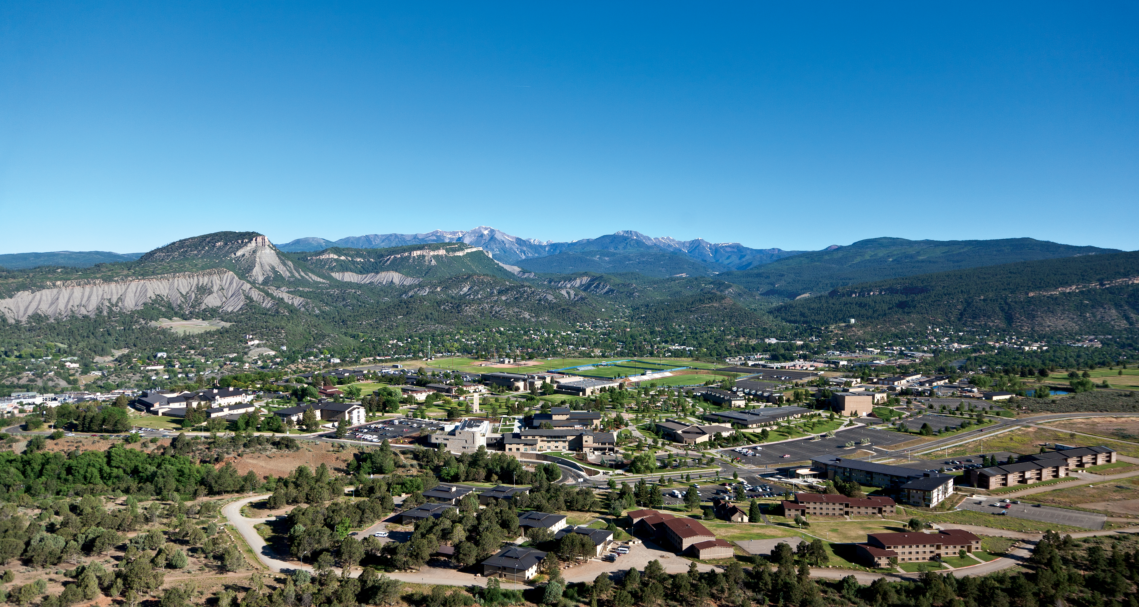

BA 353: Introduction to Project Management
Planning, scheduling, and controlling large, complex, expensive projects.

Slide 2


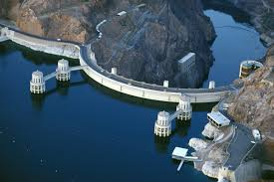

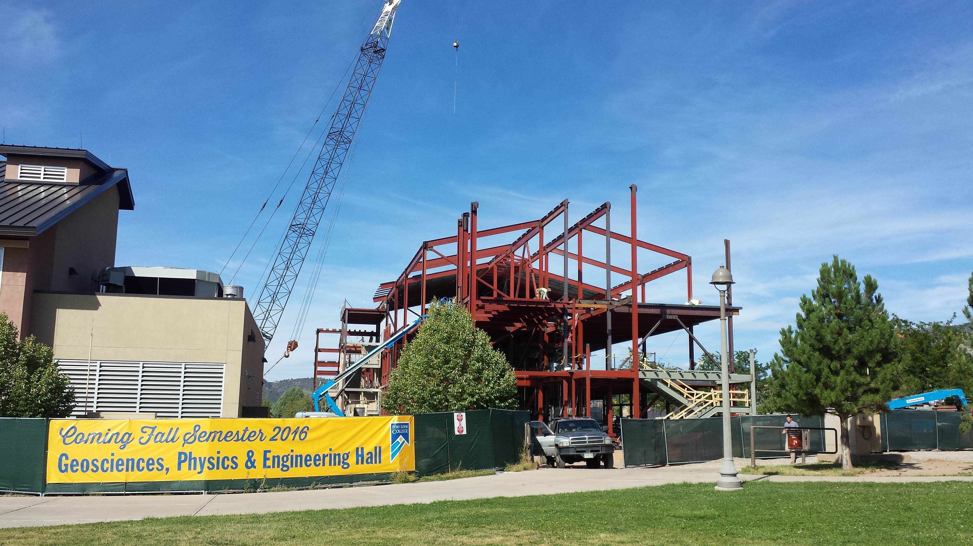
Examples of Big Projects

Slide 3
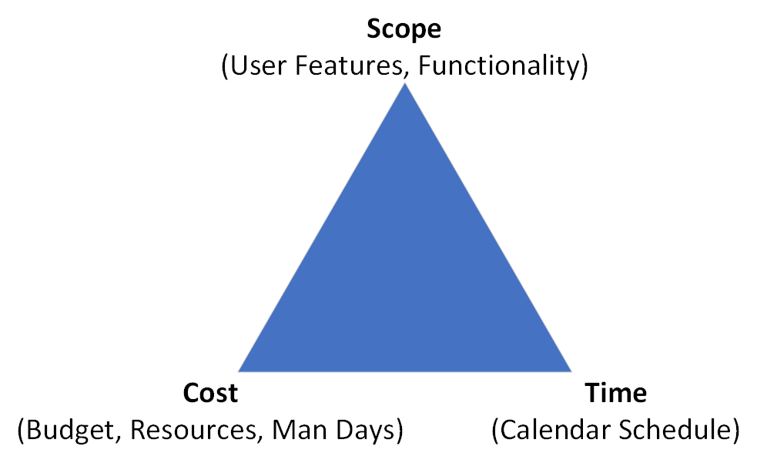
Project Management Triangle: All you need to know???

Slide 4
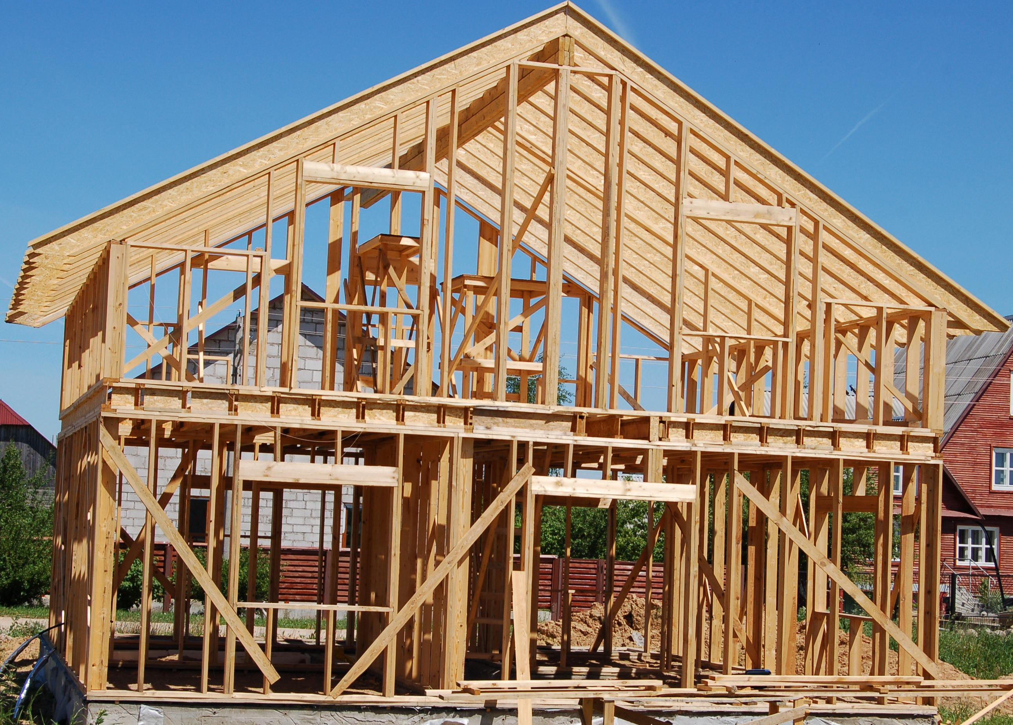
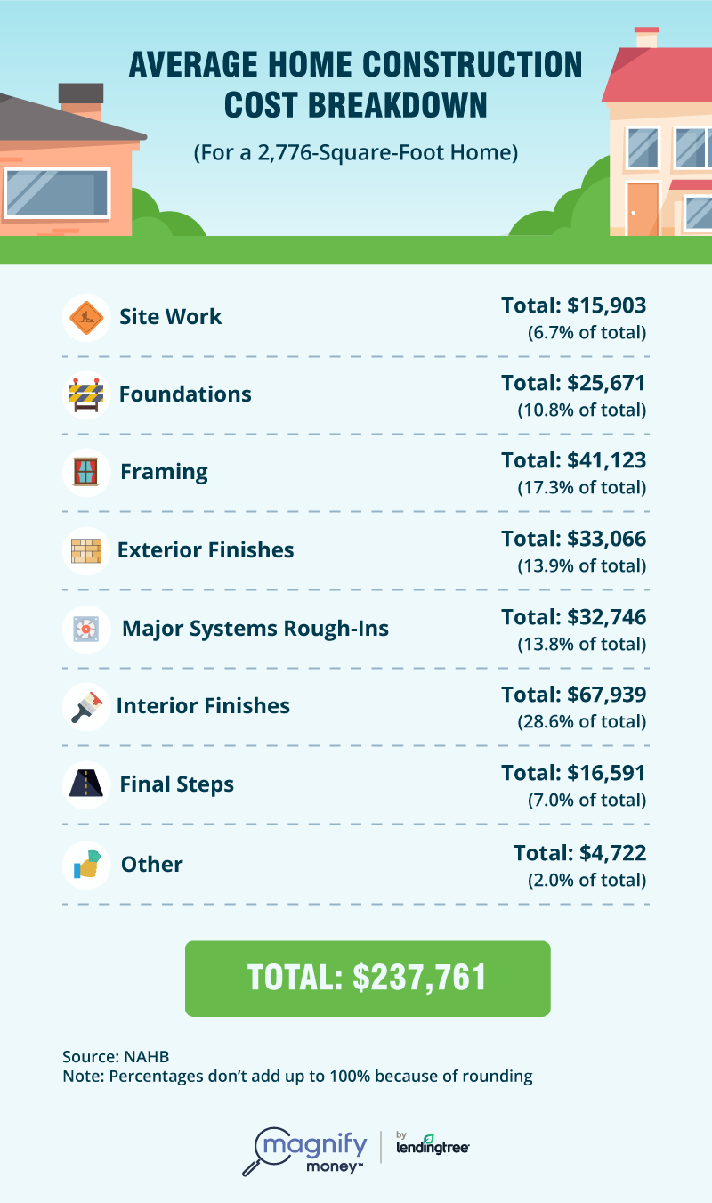

Example: Building a New House

Slide 5
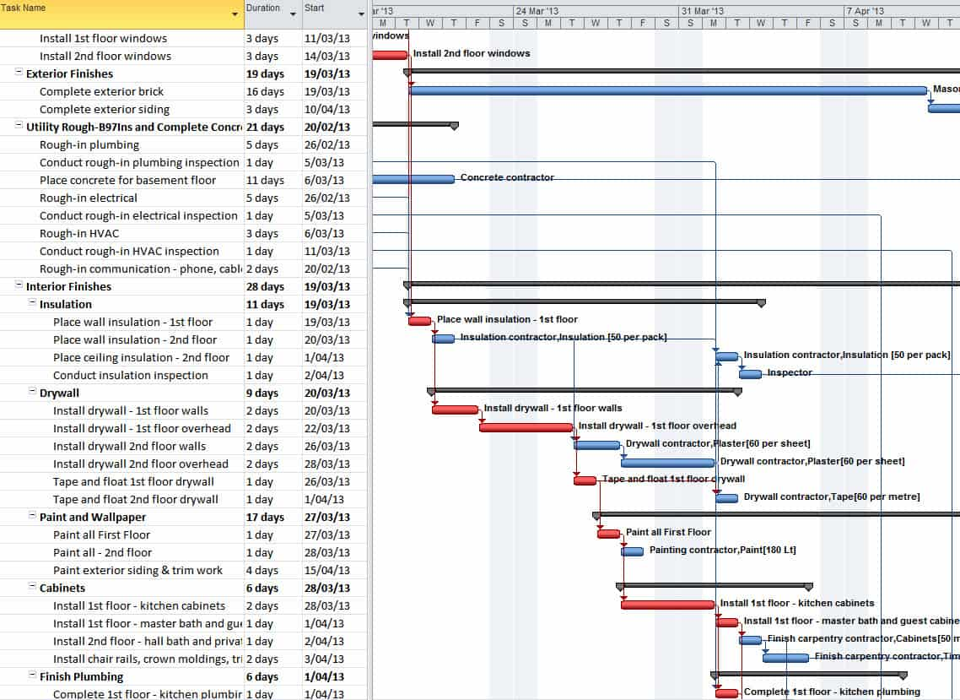
Example of MS Project output…

Slide 6
CPM: Critical Path Method
Developed in the 1950’s.
Answers Two Questions:
  How long will the project take?
  Which steps are critical (towards achieving the deadline)?
The essential technique for using CPM^{[8][9]} is to construct a model of the project that includes the following:
A list of all activities required to complete the project (typically categorized within a work breakdown structure),
The time (duration) that each activity will take to complete,
The dependencies between the activities and,
Logical end points such as milestones or deliverable items.
-- Wikipedia entry.

Slide 7
CPM Example (to be completed in class)
Act = Activities = Steps that must be completed to finish the project. This example has ten steps A through J.
I.P. = Immediate Predecessor = The order in which things must be done. A and B can start right now, C and D must follow A, E and F must follow B, G follows C, H follows both D and E, etc.
Time = How long each step should take if things go according to plan. (Yeah, right!) Could be in days, weeks or months.

