Slide 1
This… Is… Project Management Trivia!
Round 1: Chapters 1,2 & 3

Slide 2
https://www.youtube.com/watch?v=IkdmOVejUlI

Slide 3
Rules
Sit with your teams.
List team names.
Write up four answer cards: A, B, C and D
No notes or electronic assistance.
Two rounds:
Multiple Choice & True/False
Short Answer
Winning team gets prizes!

Slide 4
Round 1:
Multiple Choice
True/False

Slide 5
Question 1
True or False? The three types of PMOs are supportive, controlling and directive.
True
False
Answer: a) True

Slide 6
Question 2
There are a twelve project management knowledge areas.
True
False
Answer: a) False, there are ten, which is enough.

Slide 7
Question 3
Which doesn’t belong: A project is a temporary endeavor undertaken to create a unique:
Baseline
Product
Service
Result
Answer: A) Baseline

Slide 8
Question 4
Darth Vader arrives at the Death Star to track, review and regulate it’s progress and performance and identify any areas in which changes to the plan are required. Which process group is he doing?
P
E
M & C
C
Answer: C) Monitoring and Controlling

Slide 9
Question 5
Rank these from largest to smallest:
Portfolio, Project, Program
Program, Portfolio, Project
Project, Program, Portfolio
Portfolio, Program, Project
Answer: D)

Slide 10
Question 6
The processes required to ensure the project includes all the work required, and only the work required, to complete the project successfully:
Project Resource Management
Project Scope Management
Project Procurement Management
Project Integration Management
Answer: B) Project Scope Management

Slide 11
Question 7
The project manager leads the project team to meet the project’s objectives and stakeholders’ expectations.
True
False
Answer: A) True

Slide 12
Question 8
The six competing project constraints are scope, schedule, budget and all the following except:
quality
resources
risk
stakeholders
Answer: D)

Slide 13
Round 2: Short Answer
Write your team name on a piece of paper.
You can take notes on separate piece(s).
Answer the following questions.
Good luck!

Slide 14
Question 9
The three subsections of Chapter 2 of the PMBoK 6e are EEF, OPA and OS. What do these initials stand for?

Slide 15
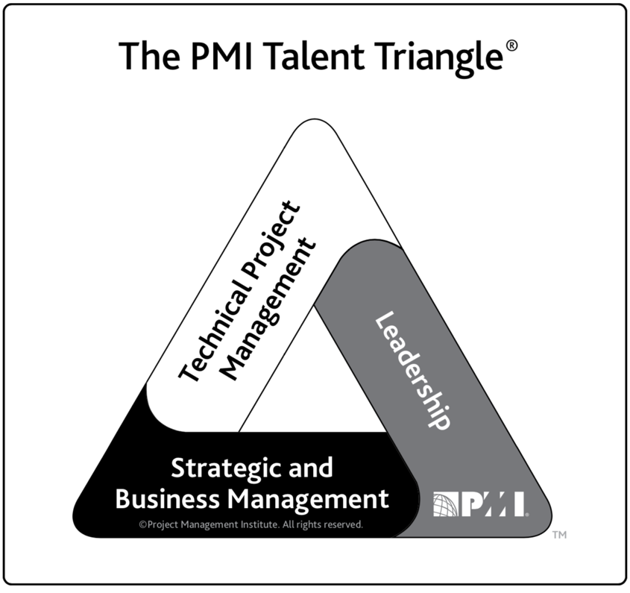
Question 10
Fill in the blanks:

Slide 16
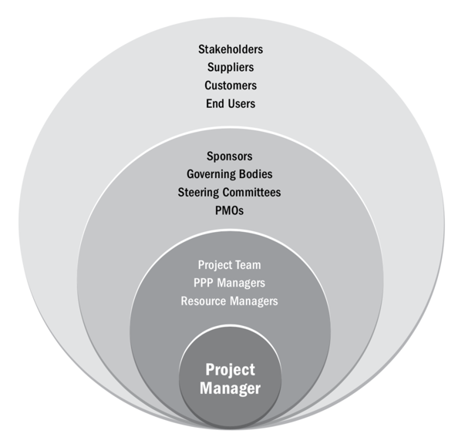
Question 11
Fill in the blank:

Slide 17
Question 12
Our first guest speaker, Darren Stewart, mentioned two animals in his talk. What were they?

Slide 18
Question 13
List the five project management process groups:

Slide 19
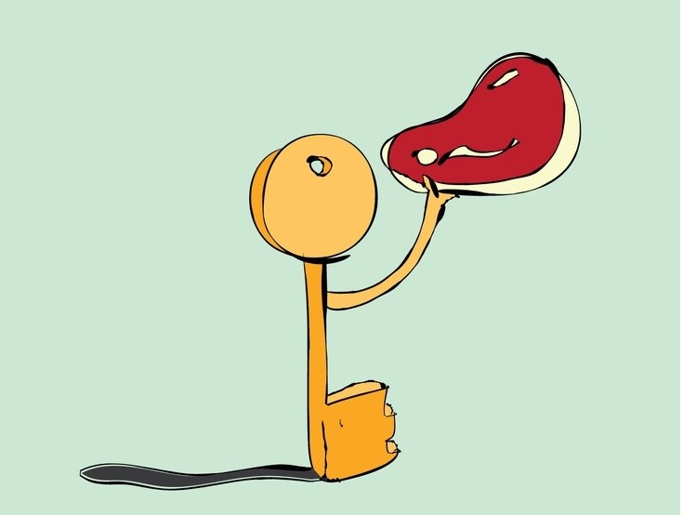
Question 14
To which part of project management does this cartoon refer?

Slide 20
Question 15
Fill in the blank with something funny and relevant to chapters 1, 2 or 3 or the PMBoK 6e:

Slide 21
Break
Grade questions 9 – 15
Check scores
Now to the Final Question

Slide 22
Final Question: 5 points possible
For ½ a point each, list the 10 project management knowledge areas:
After two mistakes, I start subtracting ½ a point for wrong answers.

