Slide 1
This… Is… Project Management Trivia!
Round 3: Chapters 8, 9 & 10

Slide 2
Rules
Sit with your teams.
List team names.
Write up four answer cards: A, B, C and D
No notes or electronic assistance.
Three rounds:
Multiple Choice & True/False
Short Answer
Final Jeopardy

Slide 3
http://www.youtube.com/watch?v=vWuQVpBeqLs

Slide 4
Round 1:
Multiple Choice
True/False

Slide 5
Question 1
True or False: Quality and Grade are the same concept.
True
False
Answer: B) False.

Slide 6
Question 2
Which is the correct sequence of stages in the Tuckman ladder? [Hint: “ing”]
A, P, N, S, F
A, S, N, P, F
F, P, N, S, A
F, S, N, P, A
Answer: D) Forming, Storming, Norming, Performing, Adjourning

Slide 7
Question 3
Which below is not one of the three broadly classified communication methods?
Interactive Communication
Private Communication
Push Communication
Pull Communication
Answer: B) Private Communication.

Slide 8
Question 4
Back to Chapter 7… Your project has PV = $500,000, EV = $550,000 and AC = $600,000. It is:
Ahead of schedule and under budget.
Ahead of schedule and over budget.
Behind schedule and under budget.
Behind schedule and over budget.
Answer: B)

Slide 9
Question 5
How many questions are on the CAPM exam?
100
150
200
225
Answer: B) 150. Although only 135 are “graded.”

Slide 10
Question 6
If six people all meet for the first time and shake hands, how many handshakes will there be (this is also the potential number of communication channels)?
12
15
30
32
Answer: B) ₆C₂ = 6!/(4!*2!) = 6*(6-1)/2 = 30/2 = 15

Slide 11
Question 7
According to our recent speaker LeRoi Smith, the famous photo of Usain Bolt smiling while winning an Olympic sprint was available to editors in:
25 seconds
Just under a minute
About five minutes
Just under an hour
Answer: A). 25 seconds, longer than it took Bolt to win the race, but still pretty fast.

Slide 12
Round 2: Short Answer
Write your team name on a piece of paper.
You can take notes on separate piece(s).
Answer the following questions.
Good luck!

Slide 13
Question 8
What are the six data representation techniques?
AD
C-&-E D
F
H
MD
SD

Slide 14
Question 9
Fill in the blank, regarding tailoring considerations:
Stakeholders
Physical Location
_____________ Technology
Language
Knowledge Management

Slide 15
Question 10
What does PDCA stand for?

Slide 16
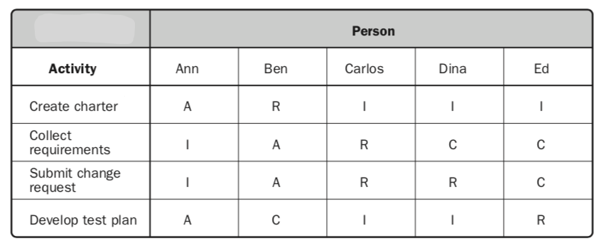
Question 11
What type of chart/matrix is this? Bonus for defining the four the letters in the acronym…

Slide 17
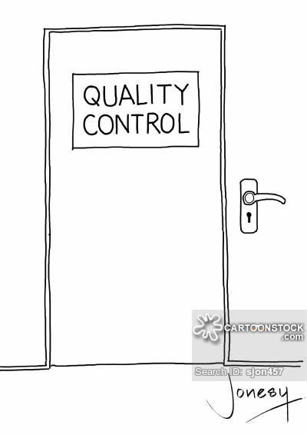
Question 12
Fill in the blanks (two words) for the cartoon on the right. One point for getting it exactly correct, half a point for making me laugh…

Slide 18
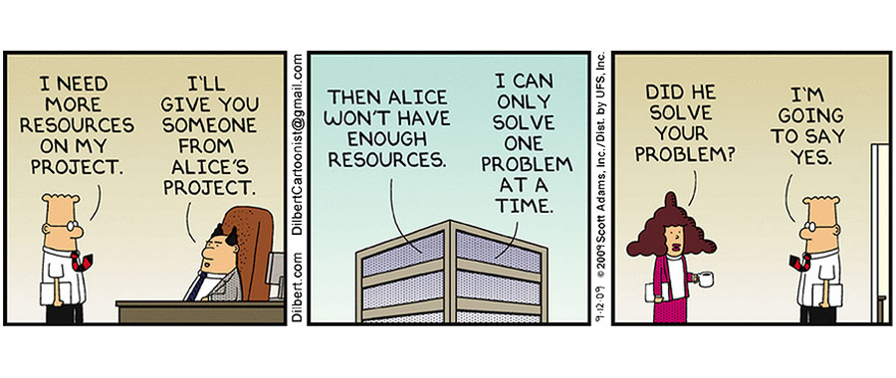
Question 13
Fill in the blanks (same word). Correct answer worth 1, funny answer worth ½.

Slide 19
Question 14
How well did you listen to our recent speaker? Half point each.
What did he major in in college?
Where did he graduate college?
Who did he work for most recently in Seattle? Who does he work for now?
Through what sport did he get his foot in the door in the tech industry?
A lot of stakeholders want to be what with a capital letter even though they are barely that with lowercase letter?

Slide 20
Break
Grade questions 9 – 15
Check scores
Now to the Final Question

Slide 21
Final Question Category: Back to Basics
Bet up to your total current score. All or nothing based on the final question.
Write down your bet now (permanently).
And show it.

Slide 22
Final Question
According to the PMBoK’s definition, “A project is a …” what eleven word phrase?
Must get at least 7/11 of the words correct and in mostly the right order to count.
In case of a tie-breaker, more correct wins.

