Slide 1
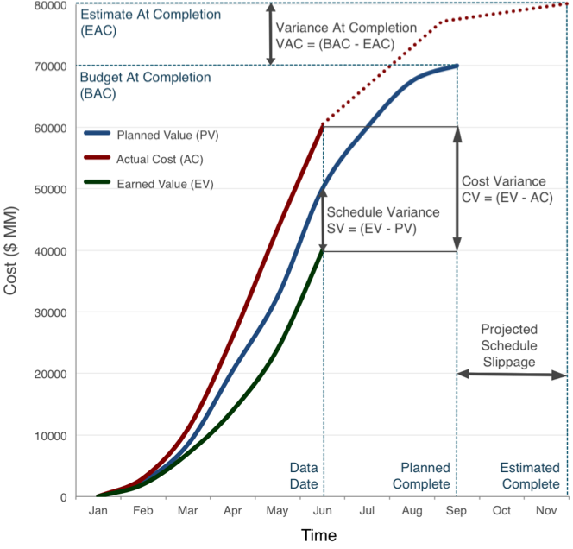
Earned Value
From CHAPTER 7 OF pmbok 6TH eDITION

Slide 3
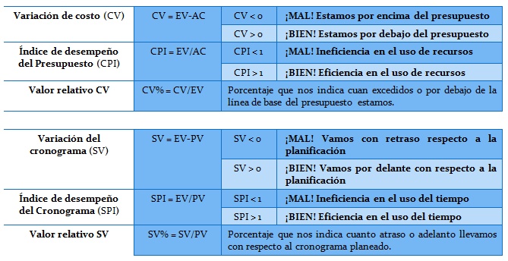

Slide 4
Section 7.4: Earned Value Management (EVM) Methodology that combines scope, schedule, and resource measurements to assess project performance and progress
Example: A million dollar project is planned to be done in 16 months. After 8 months, the data is:
AC = ACWP = $580,000
EV = BCWP = $430,000

Slide 5
Section 7.4: Earned Value Management
Eight months into a sixteen month project, we have:
BAC = $1M
AC = $580,000
EV = $430,000
What do these three things mean?
In general, is this project on track?
Calculate the PV (Planned Value)
PV (BCWS) = 8/16*$1M
= $500,000
Halfway through the project, we should have completed half of the work.

Slide 6
Cost Variance (CV and CPI)
CV = EV – AC =
$430k - $580k =
-$150k
CV < $0 means we are over budget.
We have spent $580k (AC) to complete $430k (EV) worth of work. This is bad.
CPI = EV/AC =
$430k/$580k =
0.74 =
74%
CPI < 1 means we are over budget.
We are at 74% budget efficiency. This is bad.

Slide 7
Schedule Variance (SV and SPI)
SV = EV – PV =
$430k - $500k =
-$70k
SV < $0 means we behind schedule.
We have completed $430k worth of work when we expected to have $500k worth of work done. This is bad.
SPI = EV/PV =
$430k/$500k =
0.86 =
86%
SPI < 1 means we are behind schedule.
We are at 86% schedule efficiency. This is bad.

Slide 8
Estimate at Completion (EAC) and Estimate to Complete (ETC)
EAC = BAC/CPI =
$1M/0.74 =
$1.35M
Our original budget was $1M. Since we are being inefficient cost wise, our new estimate for the total cost is now $1.35M.
ETC = EAC - AC=
$1.35M - $580k =
$770k
At current rates, the remainder of the project will cost us $770k.

Slide 9
