Slide 1
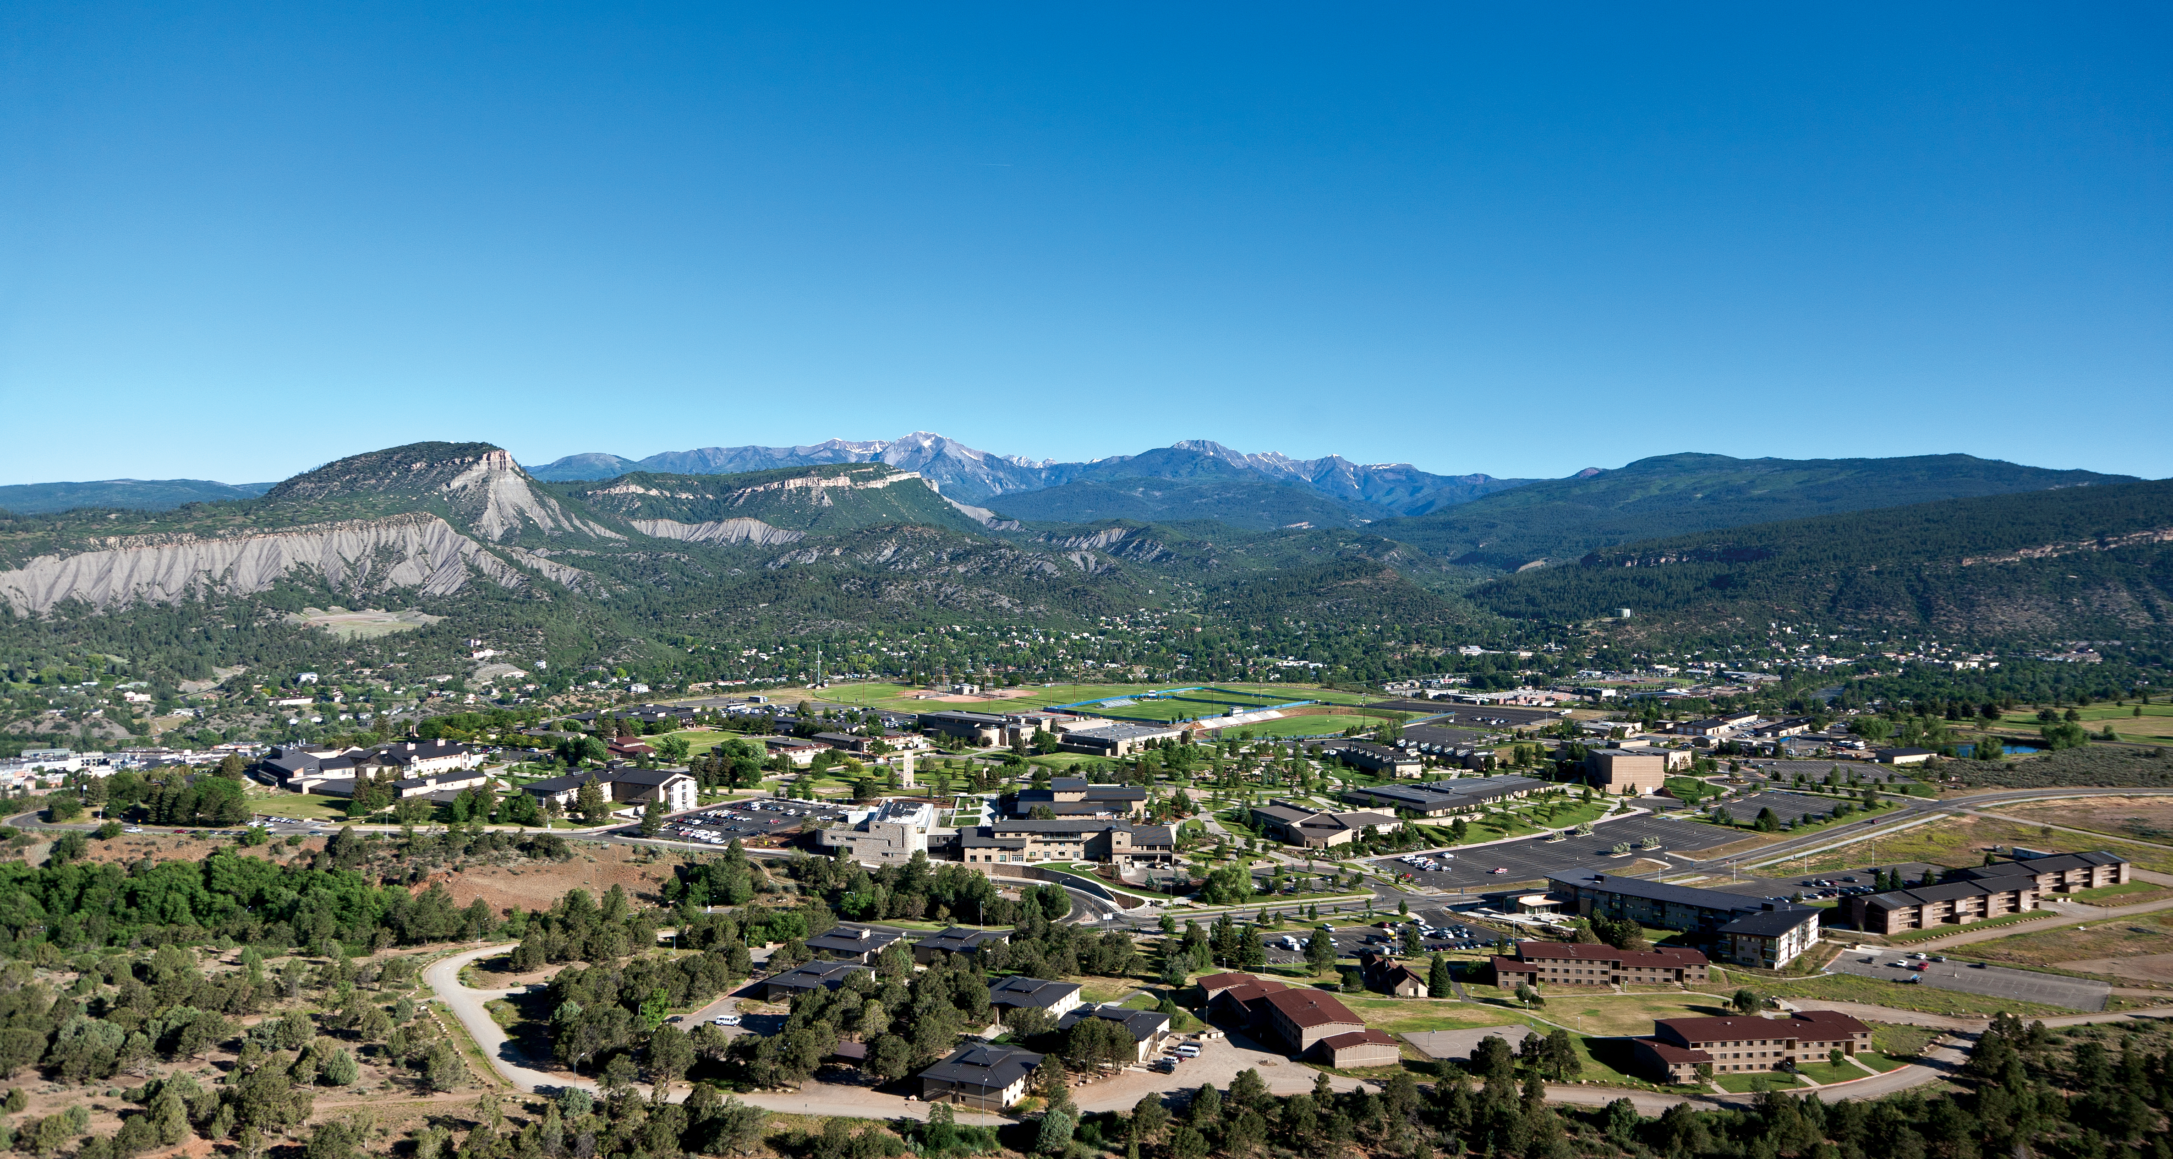
Forecasting: Seasonality

Slide 2
Definition
What Is Seasonality?
Seasonality is a characteristic of a time series in which the data experiences regular and predictable changes that recur every calendar year. Any predictable fluctuation or pattern that recurs or repeats over a one-year period is said to be seasonal. (from Investopedia.com)

Slide 3
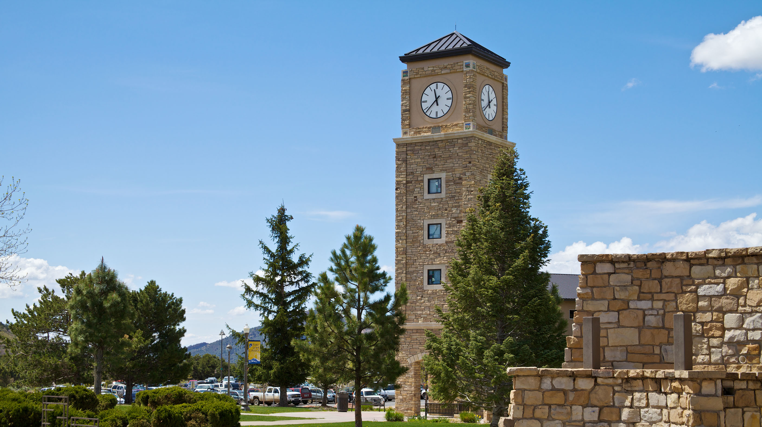
Examples
Almost every business in Durango:
Purgatory
Hotel Occupancy
Restaurants
Also demand for gasoline, holiday items, sports, taxes…

Slide 4
What has no seasonal pattern?
Demand for milk?
Demand for TP?
Not many things are consistent every day and all year long.

Slide 5
What does the pattern look like?
Think about hotel occupancy rates in Durango (during a normal year)…
Very high in summer.
Quiet in Fall.
Busy again for ski season.
Quiet in Spring

Slide 6
Seasonality Example at a Toy Store
The manager of a toy store wants to predict sales (quarterly and total, in $100,000s) for all of Year 5.
Also, the manager wants to estimate the percentage of annual sales the fourth quarter of Year 5 will provide.
a) Graph the data in chronological order to display the seasonal trend.
b) Use linear regression to estimate sales in all quarters.
c) Estimate the percentage of annual sales for Q4 in Year 5.
d) Interpret the slope of the linear regression line for each quarter.
Year | Quarter 1 | Quarter 2 | Quarter 3 | Quarter 4 | Total
1 | 3.2 | 4.1 | 4.7 | 8.8
2 | 3.4 | 4.5 | 4.2 | 9.0
3 | 3.7 | 4.3 | 4.2 | 9.5
4 | 3.8 | 4.6 | 4.1 | 9.7
5
Slope

Slide 7
Now…
Let’s answer parts a) through d) in MS Excel…
Graph the data.
Use LR to estimate sales.
Estimate Q4 as a percentage.
Interpret each slope.

