Slide 1
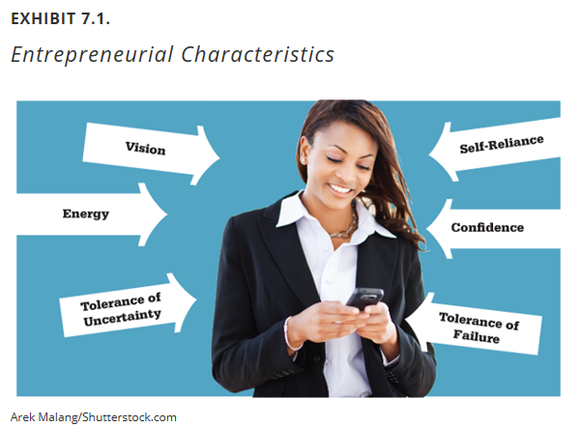
Module 11: Entrepreneurship
Concepts
Application of Lesson
Expectations for This Week

Slide 2
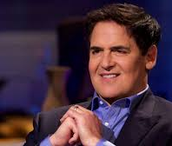
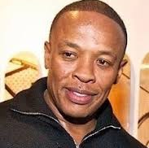

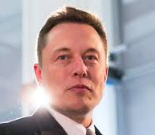
Entrepreneurship
“The process of designing, launching and running a new business, which is often initially a small business, or as the "capacity and willingness to develop, organize and manage a business venture along with any of its risks to make a profit.“
-- Wikipedia.com

Slide 3
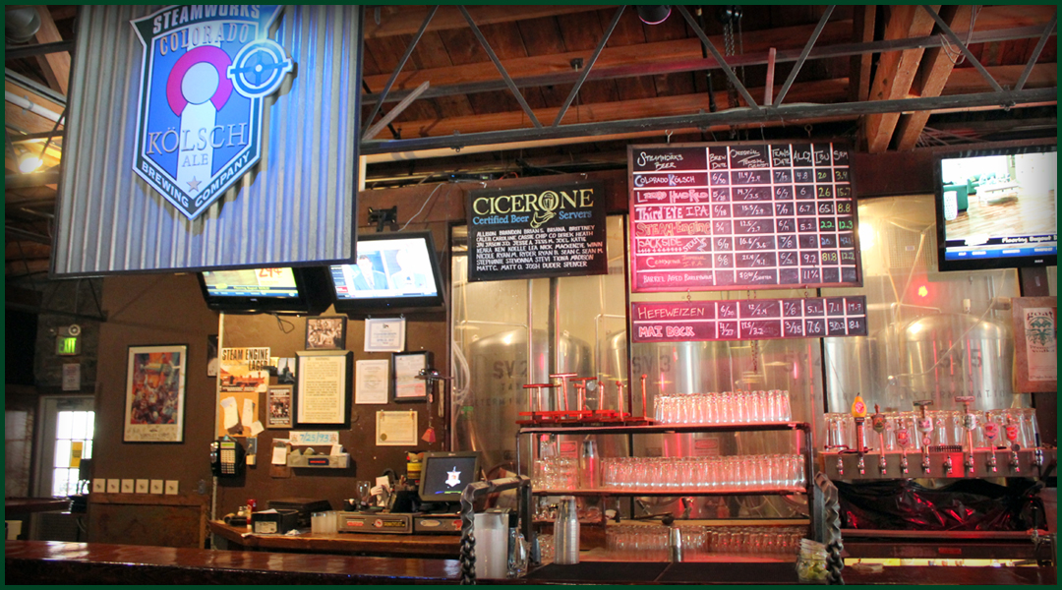
Pros and Cons of Starting a Business
What business is this?
Starting your Business from Scratch
Key Pros
It’s all you: your concept, your decisions, your structure, and so on.
You don’t have to deal with the prior owner’s bad decisions.
Key Cons
It’s all you. That’s a lot of pressure.
It takes time, money, and sheer sweat equity to build a customer base.
It’s harder to get credit from both lenders and suppliers.
The logistics of starting a business can be challenging.

Slide 4


Pros and Cons of Starting a Business
???
Buying an Established Business
Key Pros
The concept, organizational structure, and operating practices are already in place.
Relationships with customers, suppliers, and other stakeholders are established.
Getting financing and credit is less challenging.
Key Cons
Working with someone else’s idea can be a lot less fun for some entrepreneurs.
You may inherit old mistakes that can range from poor employee relations to pending lawsuits.

Slide 5
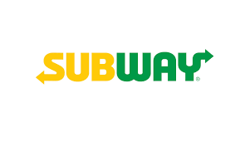

Pros and Cons of Starting a Business
Which one of these has franchises and which one doesn’t? How many are there of each?
Buying into a Franchise
Key Pros
In most cases, you’re buying your own piece of a well-known brand and proven way of doing business.
Management expertise and consulting come with the franchise package.
Franchisers occasionally offer not just advice but also the financing that can make the purchase possible.
Low 5% first-year failure rate.
Key Cons
You have less opportunity for creativity.
If something goes wrong with the national brand your business will suffer, too.
The initial purchase price can be steep, and that doesn’t include the ongoing percent-of-sales royalty fee.

Slide 6

Pros and Cons: Review
Start from Scratch
01
Buy an Existing Business
02
Buy into a Franchise
03
Work for someone else!
04

Slide 7
To be a successful entrepreneur….
BE
Confident
Curious
Excellent
Consistent
Forceful
Fearless
Unpredictable
Unreasonable
Unduplicable
Dominant
Controversial
Universal

Slide 8
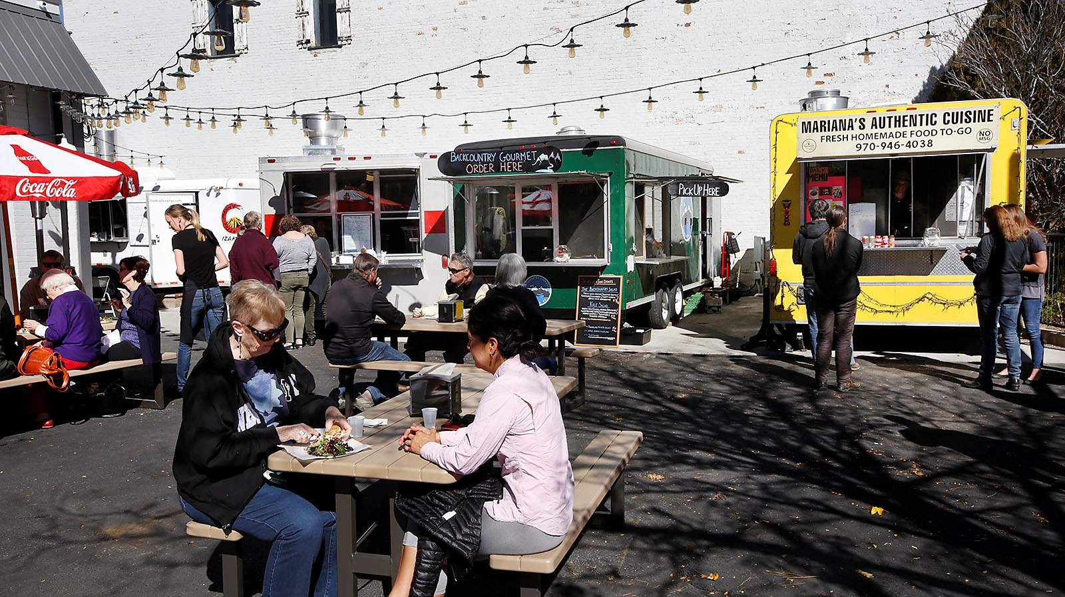
The Evolution of the Food Truck
What entrepreneurial characteristics would you need if you wanted to open a food truck business?
What are the opportunities associated with opening a food truck business?
What are the threats associated with opening a food truck business?
Read “Evolution of the Food Truck: from Roach Coach to Rolling Restaurant”
Watch the following: https://foodtruckempire.com/news/most-food-trucks/

Slide 9
This Week: Assignment #2, No Quiz
Your response to the questions below should be in a 1-page paper, at least 300 words. All answers should be in complete sentences. You can use the readings, your notes, and/or any other resources you may find. Please supply a list of outside resources that you use. Structure your references in APA format using as a guide. Note: You do not have to use outside resources for this assignment.
Directions:
Your task is to think about inventing a new product/business or changing an existing product/business. Then, provide the following in a written document:
Explain the product/business. What value does your product/business provide?
Include a picture or diagram…
Who are the potential customers? Why will they purchase your product (or visit your business)?
How will you fund the development of this product/business?
What will be the biggest challenges associated with developing your product/business?
Does this product or business already exist? Do a reasonably thorough internet search…
*Please be creative with this assignment.*

Slide 10
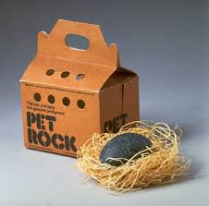
Expectations for This Week
Read Chapter 7
Watch video on Making it Happen
Week 11 In Class Exercise
Complete Assignment #2
Think of a Billion Dollar Idea
https://en.wikipedia.org/wiki/Pet_Rock

