Slide 1
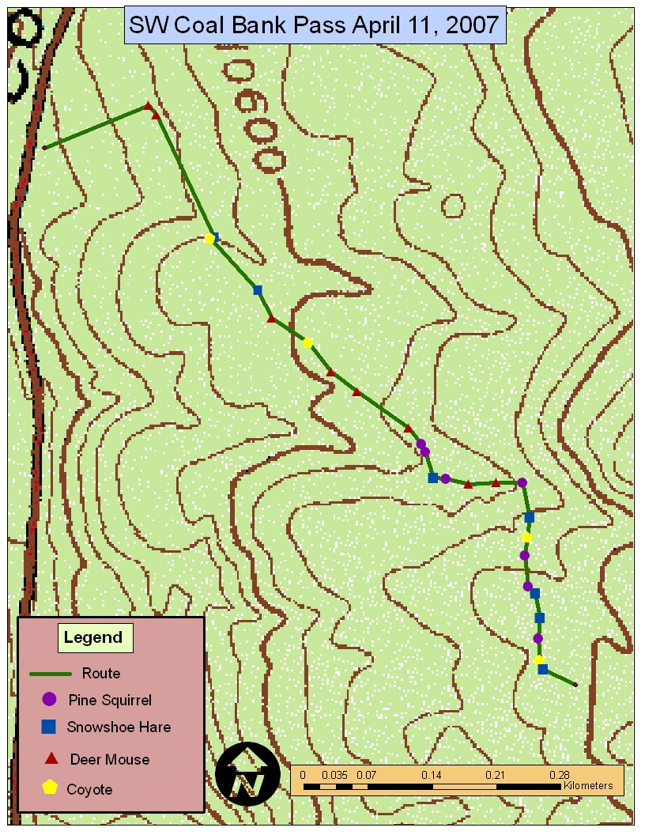
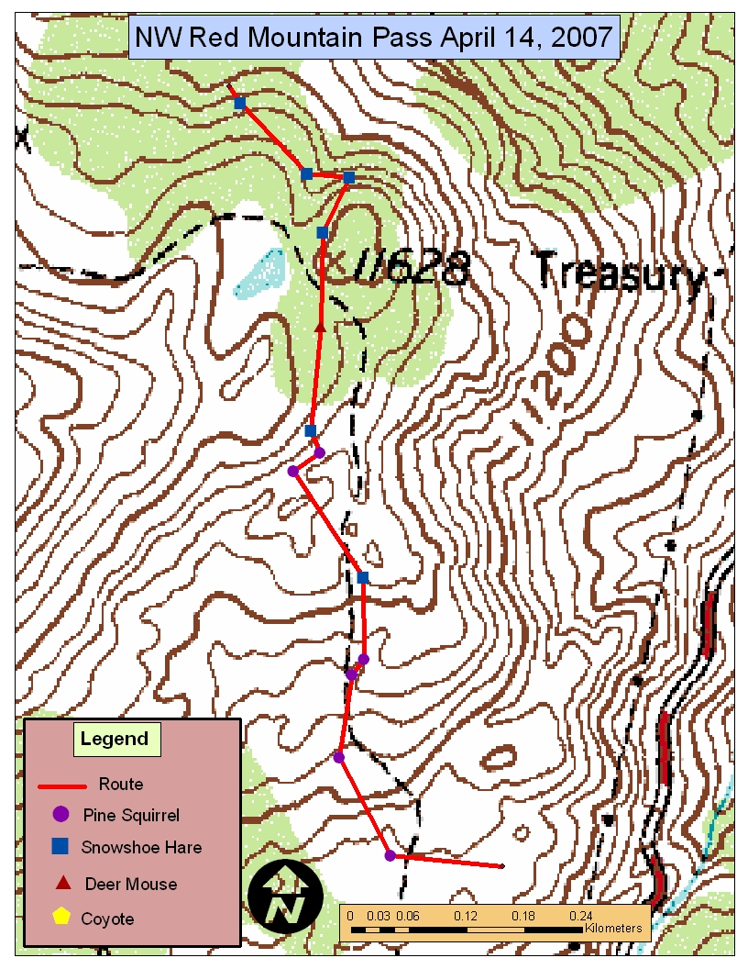
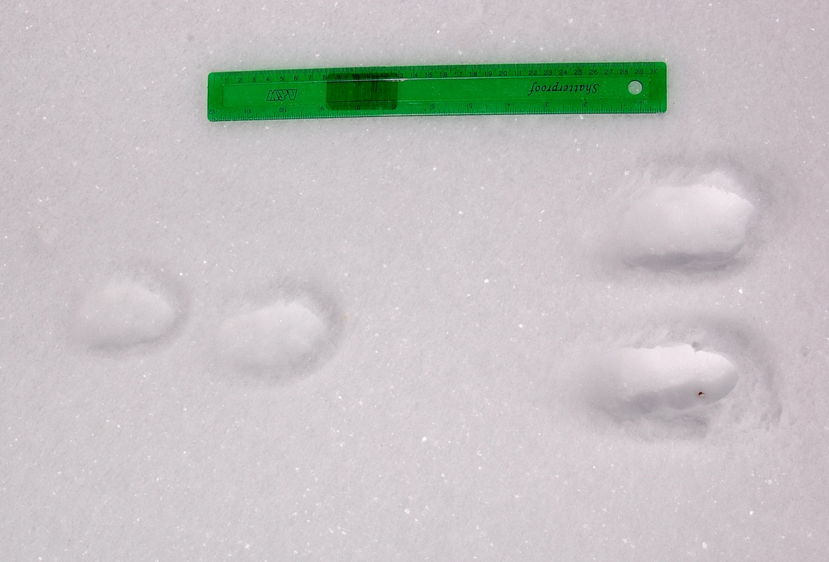
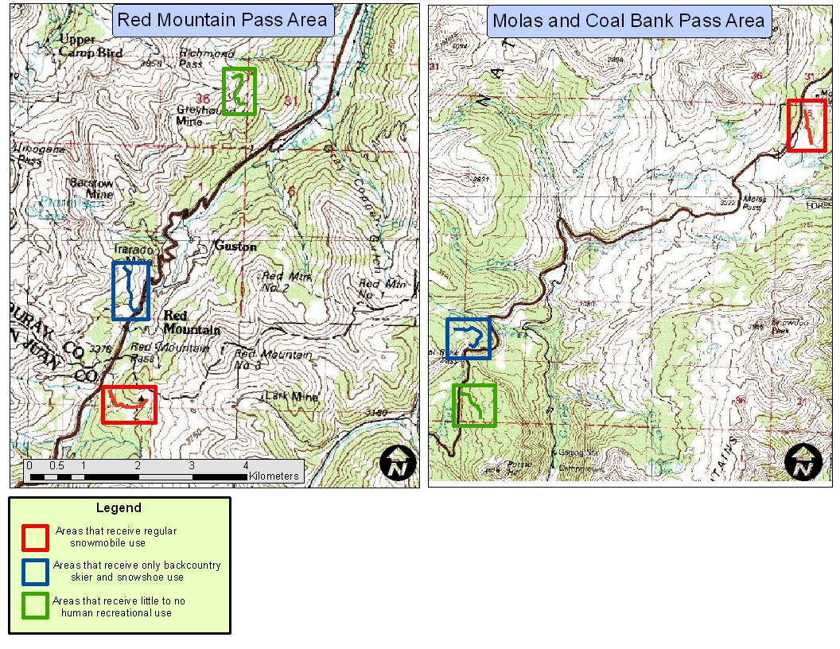
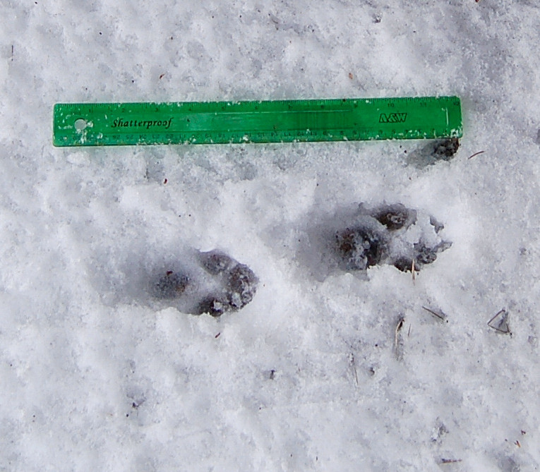
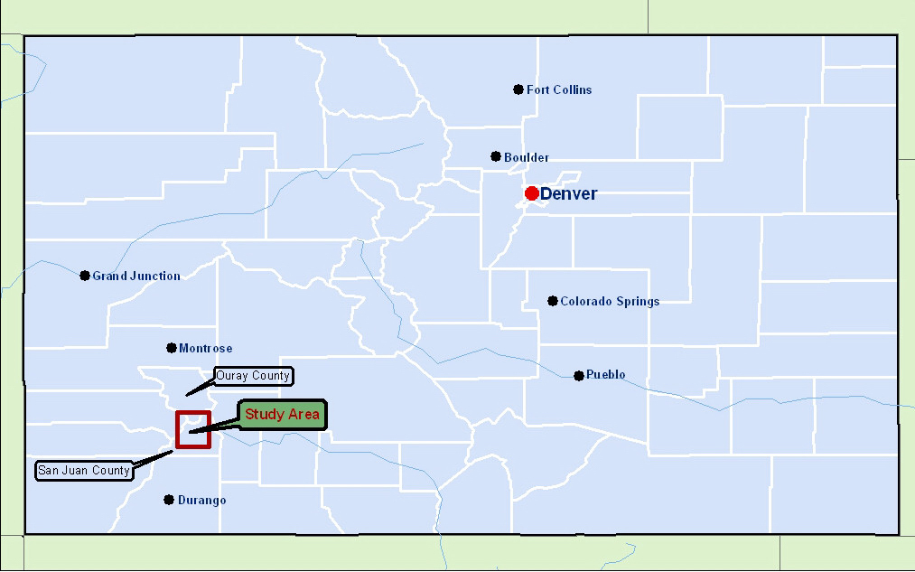
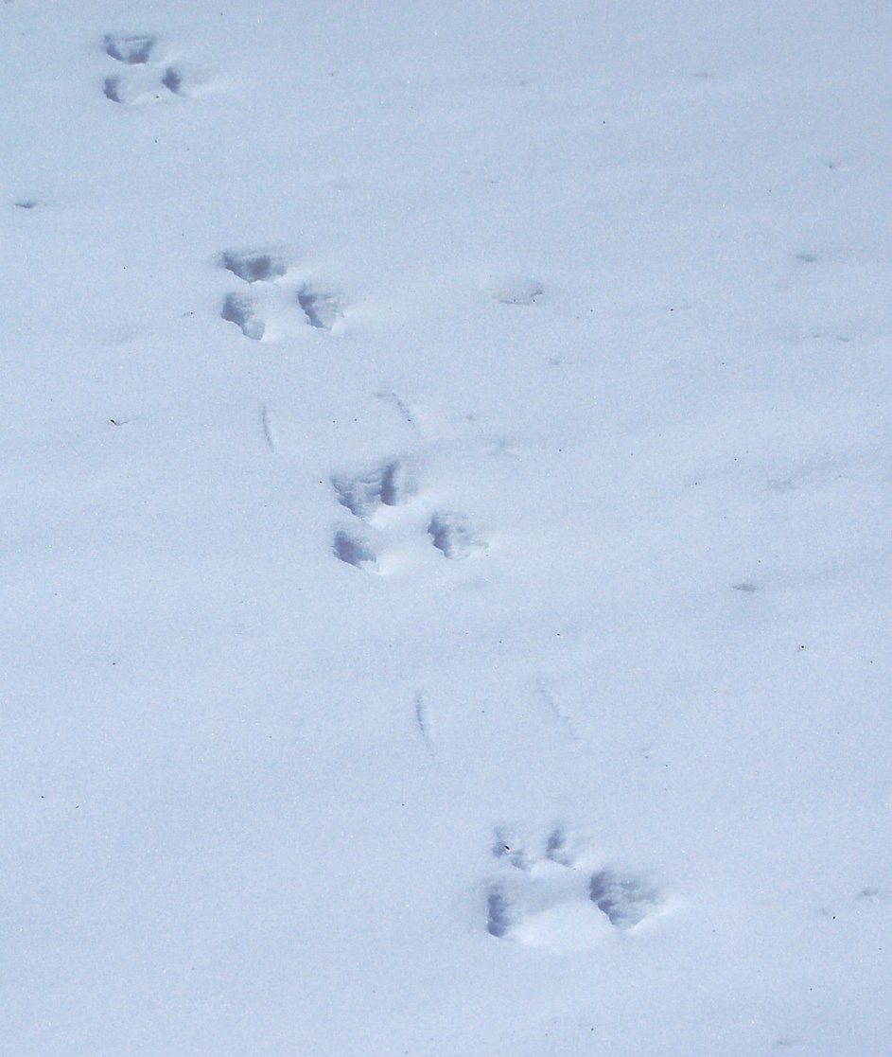
Use of Snow Track Surveys to Examine the Effects of Human Recreation on Mammal Communities in Subalpine Forests, San Juan Mountains, Colorado
Torrey Rodgers
Fort Lewis College Biology Department, Durango, Colorado
INTRODUCTION
Many areas within the subalpine area of the San Juan Mountains are commonly
used for human recreational activities such as backcountry skiing, snowshoeing, and
snowmobiling.
Numerous studies have been conducted to examine the effects of human recreation
on mammals, and most commonly negative effects were reported (Boyle and
Samson, 1985).
Disturbance is the most common negative effect of human recreation on wildlife.
Disturbance can lead to behavioral changes, changes in feeding habits
physiological changes, alteration of energy budgets, alteration of reproductive
success, and even death (Gutzwiller, 1995; Knight and Cole, 1995; MacArthur et
al., 1982).
The effects of motorized forms of recreation such as snowmobiling are often
greater and farther reaching than non motorized forms of recreation (Knight and
Cole, 1995).
Snowmobiles are fast enough to follow an animal for a considerable distance,
which could lead to substantial energy expenditure, increased heart rate, and
exhaustion.
Noise from snowmobiles can be detected from several kilometers, so snowmobiles
can effect animals at a much greater range than forms of non motorized recreation.
Aversive noise levels can impact food intake, metabolic rate, energy budgets, and
parenting. Snowmobile noise can also mask meaningful noises such as approaching
predators (Bowles,1995).
Because mammals are often very elusive, actual visual observation can be difficult.
Thus using snow track surveys to estimate the abundance of mammal species is a
method which is widely used.
Many studies have been conducted to assess the impact of human recreation on
mammals, however few have been undertaken in high, snowy, subalpine areas such
as the San Juan Mountains.
EXPERIMENTAL DESIGN AND METHODS
Study Area: My data was collected in close proximity to the tops of three major mountain
passes along US highway 550: Coal Bank Pass, Molas Pass, and Red Mountain Pass, at
elevations between 10,000 and 12,000 feet. Areas where data collection occurred are vegetated
by moderately dense spruce/fir forests in the Coal Bank, Molas Pass area, and slightly more
open spruce fir forests in the Red Mountain Pass area. These subalpine forests are composed
mostly of engelmann spruce (Picea engelmannii) and corkbark fir (Abies arizonica).
Experimental Design: Track surveys were conducted on skis during the months of April
and May. Surveys were conducted 12-48 hours after a snowfall significant enough to cover
old tracks. To standardize results, the number of tracks observed during each transect were
divided by the number of 12 hour periods since the last snowfall (Thompson et al., 1988).
This is because tracks become more numerous as time goes on after a new snowfall. Thus
a survey conducted 36 hours after a snowfall will produce more tracks than a survey
conducted 12 hours after a snowfall independent of other factors. Data was collected from 3
different area classifications defined by the type of human recreational use they receive. These
classifications are: a) areas that receive considerable backcountry ski and/or snowshoe use, but
no snowmobile use, b) areas that receive considerable snowmobile use, and c) areas that receive
little to no human recreational use. Surveys were conducted at 2 sites per recreational use area
classification; one within the Coal Bank, Molas Pass area, and one within the Red Mountain
Pass area.
Field Methods: At each of the six sites, I conducted one or two, 1 kilometer transects on skis.
During these transects, I recorded and identified any tracks that crossed my transect directly. I
recorded the routes of each of these transects using a handheld GPS unit, and I also marked the
location of each track I observed. From this GPS data, I then made a series of maps using
ArcGIS software to show the routes of each transect, and the location of each mammal track
observed.
Statistical Analysis: Because my data is non-parametric, I assessed statistical differences
between the different recreational use area classifications using a Kruskal-Wallis test.
Figure 3. Examples of two of the maps that I created for each transect. Individual track locations were recorded using a handheld GPS unit.
Figure 6. Number of mammal tracks per kilometer for 4 different mammal species in areas that receive different types of human recreational use. Tracks were collected along 6 different 1 kilometer transects near the tops of Coal Bank, Molas, and Red Mountain Passes in San Juan and Ouray Counties Colorado, at elevations between 10,000 and 12,000 feet. Transects were completed on April 11, April 15, and May 7, 2007. The number to tracks from each transect were divided by the number of 12 hour periods since the last snowfall for uniformity (see methods). There was no significant difference between any of the recreational use classifications for any of the 4 species according to a Kruskal-Wallis test (p<0.05 for all species).
CONCLUSIONS
My results showed no significant difference in the abundance of mammals between areas that receive little
to no human recreational use, areas that receive exclusively non-motorized forms of recreation such as
backcountry skiing and snowshoeing, and areas that receive significant amounts of snowmobile use.
Collecting reliable, quantitative data from track surveys in snow is very difficult in rugged mountainous
regions such as the San Juan Mountains due to the large number of environmental variables present.
Variables such as slope, aspect, and tree density affect snow quality, which in turn affects track detection
rates from one location to another. Selecting transects that are identical in regards to these environmental
variables is nearly impossible in such a variable environment. Track surveys conducted in a flat
homogeneous environment would be much more likely to produce reliable results.
The power of my survey was also too small. As a result of an atypically dry fall snow season, I was forced
to use only my results from April and May. Because I only had three replicates from each recreational use
classification, my data would have had to be overwhelmingly one sided in order to detect any significant
difference between usage areas.
Spring is not the ideal time of year to conduct snow track surveys due to rapidly deteriorating snow
conditions after fresh snowfall. The high angle of the sun during springtime, along with warmer
temperatures, can deteriorate tracks in a matter of hours on a sunny day, making results unreliable.
Conducting track surveys in mid winter would be much preferable to doing so in the spring.
STUDY OBJECTIVES
The primary objective of this study was to determine if there
is a significant difference in the abundance of mammals
in areas with three different levels of human recreational
use: 1) little to no human recreation; 2) non-motorized forms
of recreation such as backcountry skiing and snowshoeing;
and 3) motorized recreation (snowmobiles).
I hypothesized that mammals would be most abundant in
areas that receive little to no human recreational use, least
abundant in areas that experience regular snowmobile use,
and somewhere in between in areas that receive exclusively
non-motorized forms of recreation.
Figure 4. Snowshoe Hare track. Photo taken NE of Molas Pass on May 7, 2007. Ruler is 30 cm.
Photo by Torrey Rodgers
REFERENCES
Bowles, A.E. 1995. “Responses of Wildlife to Noise” Wildlife and Recreationists: Coexistence
Through Management and Research. Ed. R.L. Knight and K.J Gutzwiller. Washington
D.C.: Island Press. 109-156.
Boyle, S.A. and F.B. Samson. 1985. Effects of Nonconsumptive Recreation on Wildlife: A
Review. Wildlife Society Bulletin. 13: 110-116.
Flather, C.H., and H.K. Cordell. 1995. “Outdoor Recreation: Historical and Anticipated Trends”
Wildlife and Recreationists: Coexistence Through Management and Research. Ed. R.L.
Knight and K.J Gutzwiller. Washington D.C.: Island Press. 3-16.
Gutzwiller, K.J. 1995. “Recreational Disturbance and Wildlife Communities” Wildlife and
Recreationists: Coexistence Through Management and Research. Ed. R.L. Knight and K.J
Gutzwiller. Washington D.C.: Island Press. 169-181.
Knight, R.L., and D.N. Cole. 1995a. “Wildlife Responses to Recreationists” Wildlife and
Recreationists: Coexistence Through Management and Research. Ed. R.L. Knight and K.J
Gutzwiller. Washington D.C.: Island Press. 51-70.
MacArthur, R.A., V. Giest, and R.H. Johnston. 1982. Cardiac and Behavioral Responses of
Mountain Sheep to Human Disturbance. Journal of Wildlife Management. 46: 351-358.
Thompson, j.D., I.J. Davidson, S. O’Donnel, and E. Brazean. 1988. Use of track transects to
measure the relative occurrences of some boreal mammals in uncut forest and regeneration
stands. Canadian Journal of Zoology 67: 1816-1823.
Figure 1. Maps created using
GIS software showing the
Locations of the 6 transects
Within the Red Mountain
Pass, and Molas and Coal
Bank Pass area (above), and
map showing the location of
the study area within Colorado
(right).
Figure 5. Number of mammal tracks per kilometer in areas that receive different types of human recreational use. Tracks were collected along 6 different 1 kilometer transects near the tops of Coal Bank, Molas, and Red Mountain Passes in San Juan and Ouray Counties Colorado at elevations between 10,000 and 12,000 feet. Transects were completed on April 11, April 15, and May 7, 2007. The number to tracks from each transect were divided by the number of 12 hour periods since the last snowfall for uniformity (see methods). There was no significant difference between any of the recreational use classifications according to a Kruskal-Wallis test (p=0.460).
Acknowledgements
I would Like to Thank Dr. Julie Korb, Dr. Joe Ortega and Dr. Scott White for their help with different aspects of this project.
Figure 1. Coyote track. Photo taken NE of Molas Pass on April 11, 2007. Ruler is 30 cm. Photo by Torrey Rodgers
Figure 7. Pine Squirrel track. Photo taken NW of Red Mountain pass on February 18, 2007. Photo by Torrey Rodgers

